Slide 1
Creating Financial Statements in P21
Stacy Cline
Cline Financial Services, LLC

Slide 2
Session title
Stacy Cline
Cline Financial Services, LLC
970-744-0206
stacy@clinefinancialservices.com
www.clinefinancialservices.com
CONNECT 2018 – August 19-21

Slide 3
Prophet 21 World Wide User Group Officers
President
Sam Snow
VP
T. J. Snow Company, Inc.
Vice President of Finance
Tim Edmunds
Chief Financial Officer
TSI Solutions
Vice President of Marketing and Education
Mike Chadwick
Director of Information Technology
T. J. Snow Company, Inc.
Vice President of Operations
Ted Hoffman
Senior Business Analyst and IT Infrastructure
Utility Supply and Construction
Vice President of Member Relations
Eric Lunsford
President
Pye-Barker Engineered Solutions

Slide 4
Disclaimer
This conference is an attempt by P21WWUG members to assist each other by demonstrating ways that we utilize the Prophet21 system and other related products.
The P21WWUG and the individuals conducting the classes and round tables take no responsibility for potential issues that arise as a result of taking the advice given during the conference.
The P21WWUG does not recommend using any SQL statements to update your database without having those statements first reviewed by Epicor or other experienced SQL professionals. Test any code in your Play Database!
Using SQL statements to update your database may result in corrupting your database. Test any code in your Play Database!

Slide 5
AGENDA
Introduction/Bio
Statement of Profit and Loss
Balance Sheet
  YTY
  Monthly
Monthly Maintenance
Other Options
Q&A

Slide 6
BIO
  Worked in corporate finance for eight years, running financial budget/plan, monthly close, reporting, etc. of $500M service offering
  Independent consultant for five years
    End user of Prophet 21 for four years
  Specialize in Finance & Accounting practices and procedures, EDI implementation, project management and identifying areas of efficiency and cost savings
  Stacy Cline
  Cline Financial Services, LLC
  stacy@clinefinancialservices.com
  www.clinefinancialservices.com
  970-744-0206

Slide 7
What is the Purpose of Financial Statements?
Goal of Financial Statements:
  Provide financial results in a clear, concise manner that reflects meaningful data specific to your business.
  Statements should be detailed enough to convey relevant data at a glance, but not at such a granular level of detail that the results lose their meaning.
  Statements should clearly communicate the results of operations (Profit & Loss), financial position (Balance Sheet) and cash flow (Statement of Cash Flow).

Slide 8
Financial Statements in P21: Set-up Process
Process:
  Create template in Excel
  Financial Statement Maintenance:
    Identify Statement Type
    Configure Time Periods
    Link Excel template
  Financial Line Express Set-up:
    Associate Time Periods with Columns in Excel Template
    Associate Row Titles with Rows in Excel Template
    Assign accounts to Rows for calculation
  OLE Spreadsheet!

Slide 9
Financial Statements in P21
What P21 can do:
  Set up rows and columns per the template created in Excel. These must match exactly.
  Assign accounts to categories (user defined)
  Retrieve and populate data to your Excel template
What P21 cannot do:
  Read header data
  Dynamically adjust template
  Calculate formulas. These must be embedded in the Excel template.

Slide 10
Statement of Profit & Loss

Slide 11
Step #1: Create Financial Statement Templates in Excel
Profit and Loss (P&L) Elements:
Header Rows
Calculated Columns
Rows for P21 to Populate
Calculated Rows
Rows for P21 to Populate
Rows for P21 to Populate
“Catch-all” for unused accounts. Should be $0

Slide 12
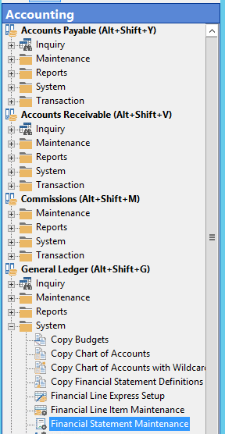
Step #2: Configure Financial Statement in Financial Statement Maintenance
Financial Statement Maintenance:
  Accounting – General Ledger – System – Financial Statement Maintenance

Slide 13
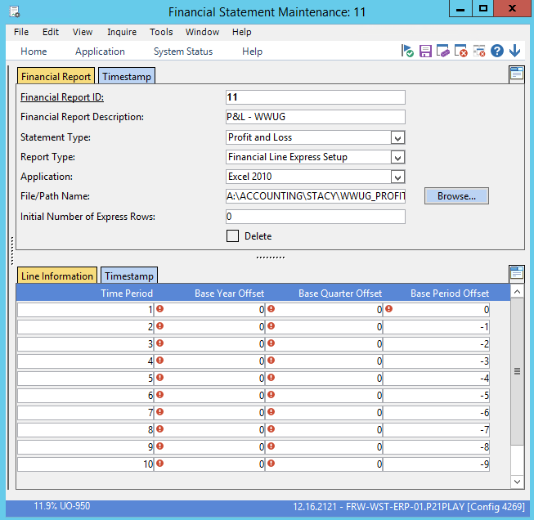
Step #2: Configure Financial Statement in Financial Statement Maintenance
Financial Statement Maintenance:
  Financial Report ID: assigned by P21 when you save the report
  Financial Report Description: entered by P21 user
  Statement Type: select Profit and Loss, Balance Sheet or Other
  Report Type: use Financial Line Express Set-up
  Application: choose version of Excel loaded on P21 server
    If you’re using a newer version of Excel and your statements will no longer work, ensure you have downloaded Web Components!
  File/Path Name: Direct to where template is stored
  Initial Number of Express Rows: The number of blank rows the system provides you with when generating a new financial statement

Slide 14
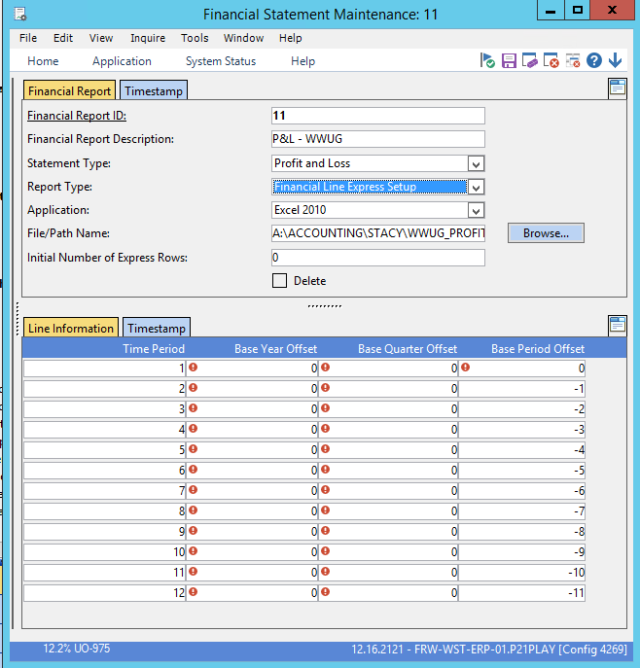
Step #2: Configure Financial Statement in Financial Statement Maintenance
Financial Statement Maintenance:
  In this example we are pulling all data for the year, January-December
    Time Period: relates columns in your template with time periods. Need to create a time period for each column you will retrieve data for in your spreadsheet. In our example we will pull Jan-Dec so we have 12 periods.
    The time period does not have to correspond directly to the column in the spreadsheet (will do that later)
    Base Year Offset: the number of years “away from” the current year.
    i.e.: 2018 = 0, 2017 = -1, 2016 = -2
    Base Period Offset: the number of periods “away from” the current period
      Base Period 0 = December
      Base Period -1 = November
      Etc.
  Save the report and notate the Financial Report ID for the next step
December
June
January

Slide 15
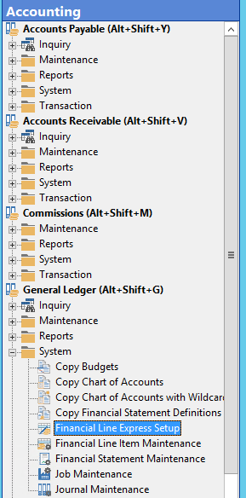
Step #3: Configure Financial Statement in Financial Line Express Set-up
Financial Line Express Set-up:
  Accounting – General Ledger – System – Financial Line Express Set-up

Slide 16
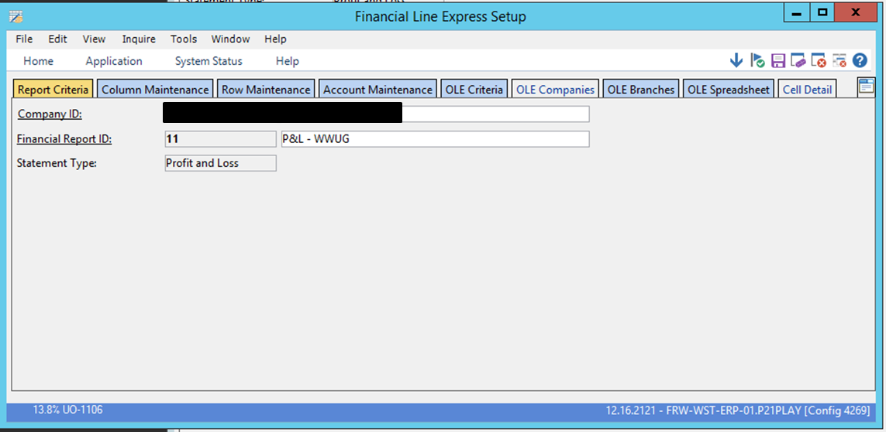
Step #3: Configure Financial Statement in Financial Line Express Set-up
Financial Line Express Set-up:
  Enter Financial Report ID created in prior step

Slide 17
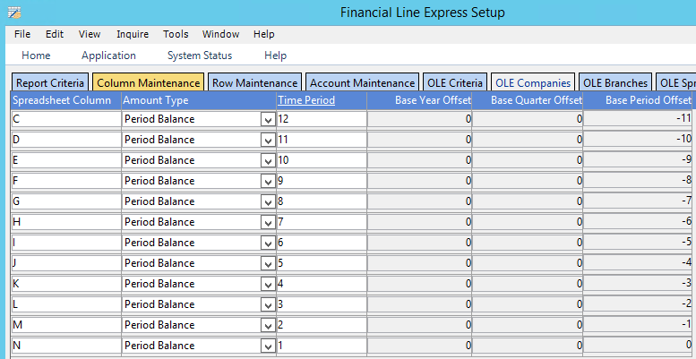
Step #3: Configure Financial Statement in Financial Line Express Set-up
Financial Line Express Set-up: Column Maintenance
  In the last step, we established that:
    January: Time Period=12, Base Year Offset=0, Base Period Offset=-11
    December: Time Period=1, Base Year Offset=0, Base Period Offset=0
  In this step, we link the Time Periods to the Columns we created in the Excel template.
    Spreadsheet Column: January is in Column C, February Column D…December Column N
    Amount Type: Period Balance
      If we were creating the balance sheet we would use Cumulative Balance
    Time Period: enter the corresponding periods created in the last step
January

Slide 18
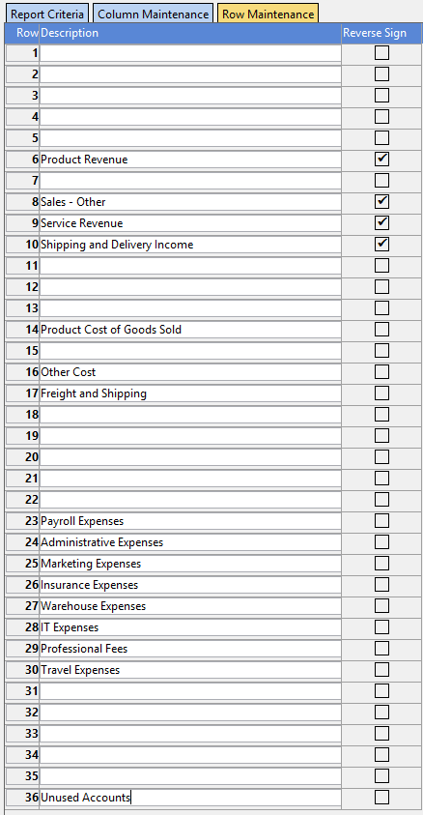
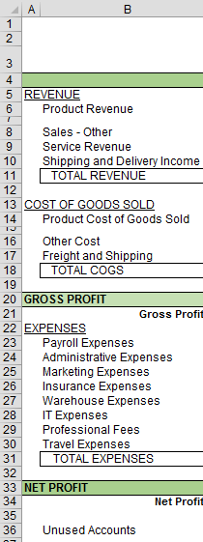
Step #3: Configure Financial Statement in Financial Line Express Set-up
Financial Line Express Set-up: Row Maintenance
  In this step, we tell P21 what rows to populate data in.
  The row number in P21 must match the row number in the Excel template
  Only enter the rows where data will be populated
    i.e. Do not input a row for Total Revenue, Total COGS, Gross Profit, etc.
  Check the “Reverse” Sign box for any data you want to be multiplied by -1
    In this example we are reversing the sign on revenue so it shows as a positive number.

Slide 19
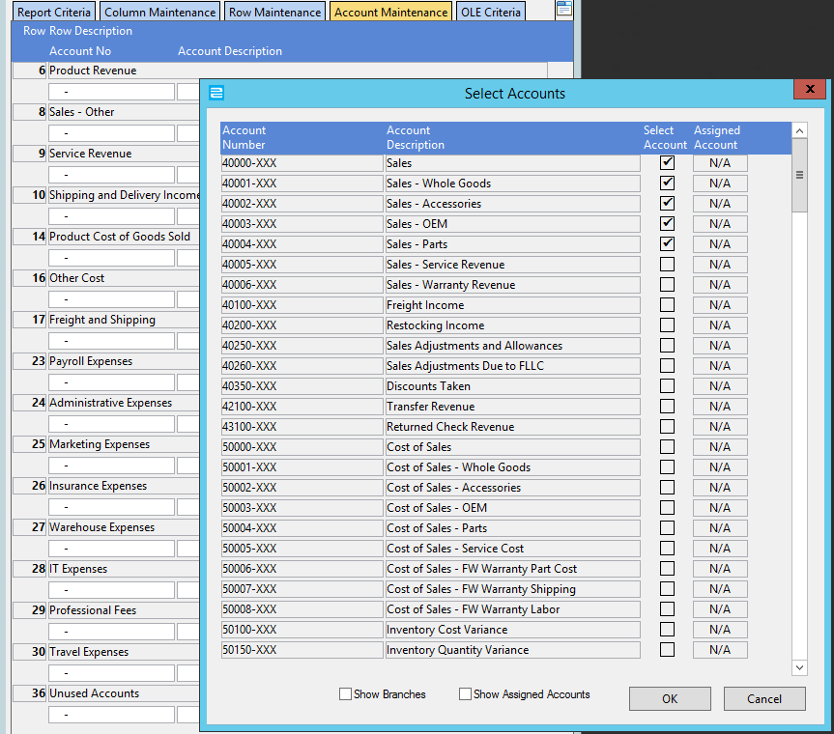
Step #3: Configure Financial Statement in Financial Line Express Set-up
Financial Line Express Set-up: Account Maintenance
  In this step, we assign P21 accounts to the rows we established in the Excel template
  Double click in the box underneath the Row Description
  Check the accounts to assign to the Row Description
  Repeat for each category
  Any accounts not assigned to a Row Description should be assigned to the “Unused Accounts” Row
  Once all accounts are assigned, the “Select Accounts” box will be blank
Double Click
Select Accounts

Slide 20
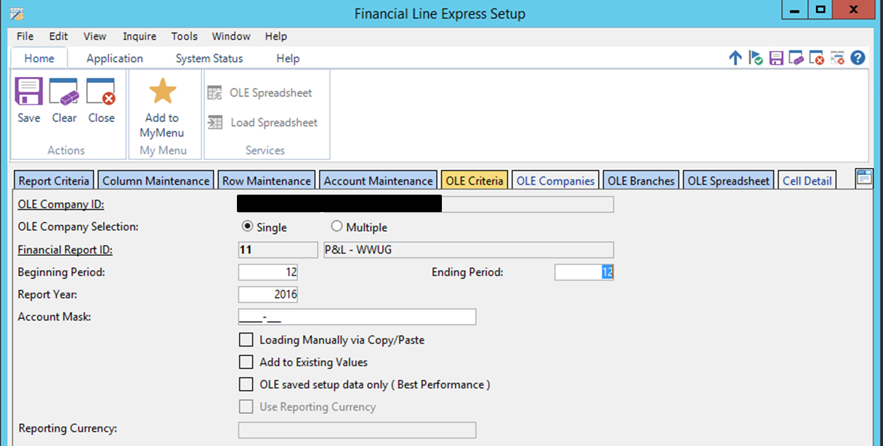
Step #3: Configure Financial Statement in Financial Line Express Set-up
Enter OLE Criteria:
  Enter Company ID
  The Financial Report ID should be populated
  Periods:
    Beginning Period = 12
    Ending Period = 12
    Retrieves YTD data
Click the “OLE Spreadsheet” Icon
Click Here

Slide 21
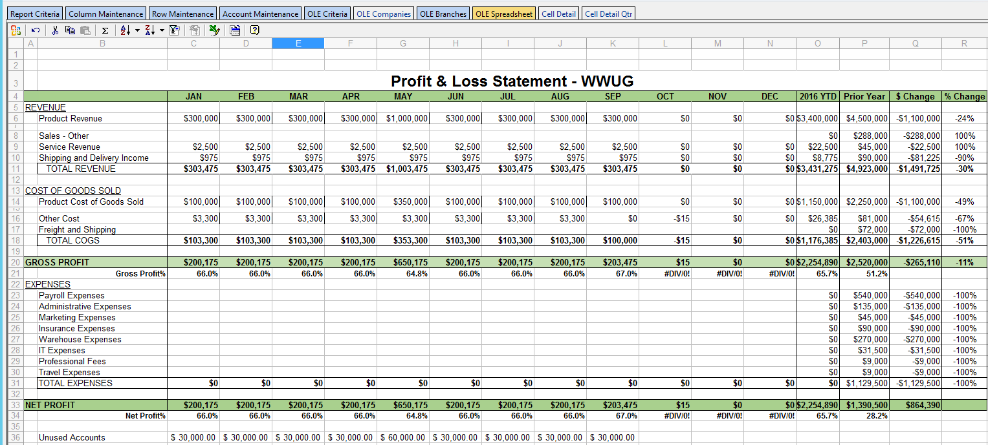
Step #3: Configure Financial Statement in Financial Line Express Set-up
Click Here
OLE Spreadsheet:
  Will populate data as defined in prior steps
  Export Options:
    Click in the corner of the spreadsheet to highlight the data. Copy and paste the data into an external spreadsheet and save
    Click on the Excel icon to export the worksheet to a new workbook and save
In this example, not all accounts were assigned creating a balance in the unused accounts line. This is an indication that accounts need to be re-assigned correctly

Slide 22
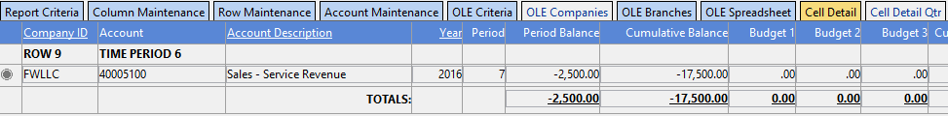
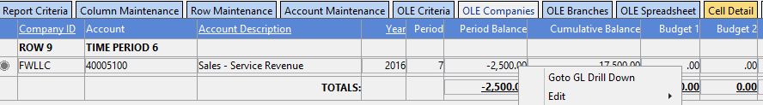
Step #4: Tips and Tricks
OLE Spreadsheet:
  OLE = Object Linking & Embedding
  You cannot have the Excel template open when you OLE the Spreadsheet
  You cannot OLE more than once (without clearing) in the Financial Line Express Set-up window
  You can double click any retrieved cell and P21 will take you to the “Cell Detail” tab. This will show you all accounts that make up the balance in the cell you double clicked:
  From the “Cell Detail” tab you can right click on the balance and select “Goto GL Drill Down” to see the entries that make up the balance

Slide 23
Balance Sheet

Slide 24
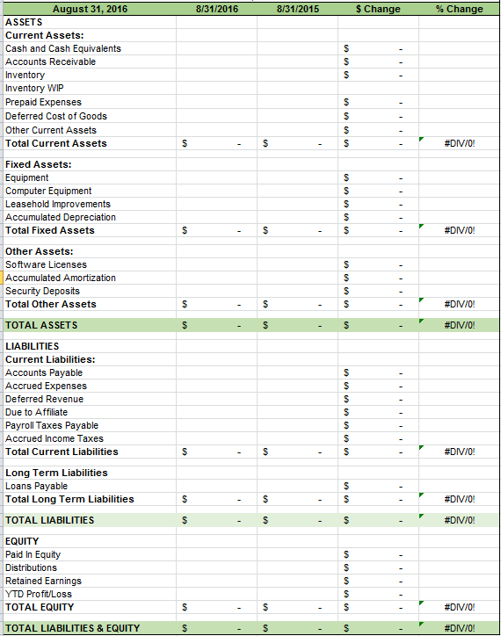
Balance Sheet Overview
Step #1: Create Excel Template – refer to example on left, customize to your company as needed

Slide 25
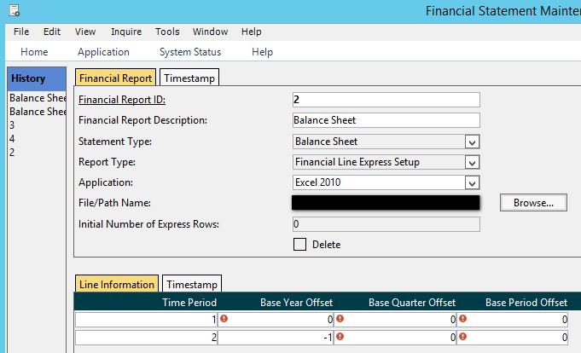
Balance Sheet Overview
Step: #2 – Configure Balance Sheet in Financial Statement Maintenance
  Top Half of Screen:
    Financial Report ID: Assigned by system
    Financial Report Description: User defined
    Statement Type: Balance Sheet
    Report Type: Select “Financial Line Express Set-up”
    File/Path Name: direct P21 to Excel Template
  Bottom Half of Screen:
    Defines the current period balance sheet and compares to the prior period balance sheet.
    Time period 1 = current year, current period
    Time period 2 = prior year (-1), current period

Slide 26
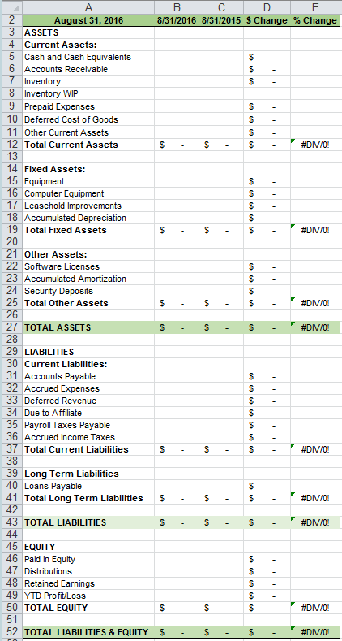

Balance Sheet Overview
Step #3: Link the Time Periods to the Column Maintenance created in the Excel Template
  Amount Type = Cumulative Balance
    Excel Template Column B = Time Period 1, Base Year Offset 0, Base Period Offset 0 (current period)
    Excel Template Column C = Time Period 2, Base Year Offset -1, Base Period Offset 0 (prior year, current period)
    Retrieves current period cumulative balance and compares to prior year current period cumulative balance
Current Period

Slide 27
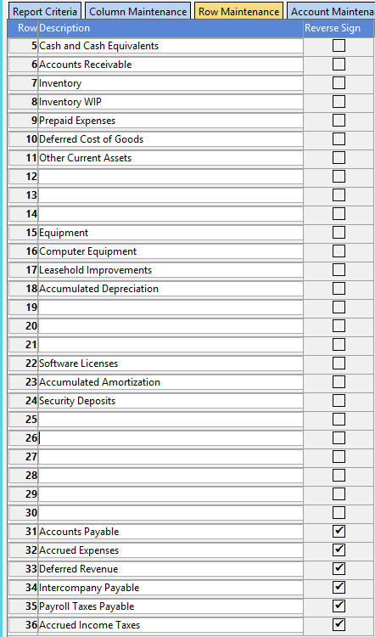
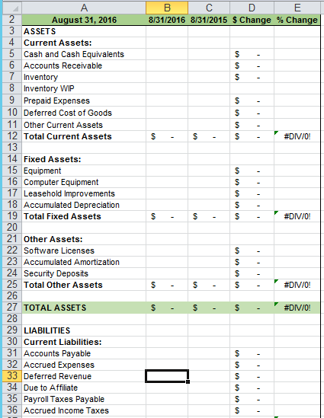
Balance Sheet Overview
Step #3: Row Maintenance
  In this step, we tell P21 what rows to populate data in
  The row number in P21 must match the row number in the Excel template
  Only enter the rows where data will be populated
    i.e. Do not input a row for TOTAL ASSETS, TOTAL LIABILITIES, etc.
  Check the “Reverse” Sign box on any data you want to be multiplied by -1 (Liabilities & Equity)
  P&L accounts need to be assigned to a “YTD Profit/Loss” (or similar name) row to reflect Net Income
    P21 will calculate this monthly until the Fiscal Year is closed and it closes Net Income out to Retained Earnings

Slide 28
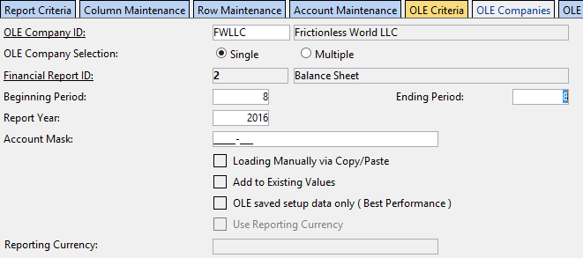
Balance Sheet Overview
Enter OLE Criteria:
  Enter Company ID
  The Financial Report ID should be populated
  Periods:
    Pull one period only
      Ex: Beginning = 8, Ending = 8 will pull August (if fiscal year = calendar year)
    Retrieves Cumulative Balance
  Click the “OLE to Spreadsheet” Icon

Slide 29
Balance Sheet Overview
OLE Spreadsheet:
  Will populate data as defined in prior steps
  Export Options:
    Click in the corner of the spreadsheet to highlight the data. Copy and paste the data into an external spreadsheet and save
    Click on the Excel icon to export the worksheet to a new workbook and save

Slide 30
Monthly Balance Sheet
Using the same set-up as the P&L we can create a Monthly Balance Sheet. This enables you to view your monthly trends for each category on your Balance Sheet.
  For example, if sales are relatively flat we wouldn’t want to see A/R increasing.
  This is another tool for you to quickly identify and address any potential issues.
The criteria in Financial Statement Maintenance will be the same, except the statement type will be Balance Sheet
The criteria in Financial Express Setup will be the same as well, except the Balance Type will be Cumulative instead of Period.

Slide 31
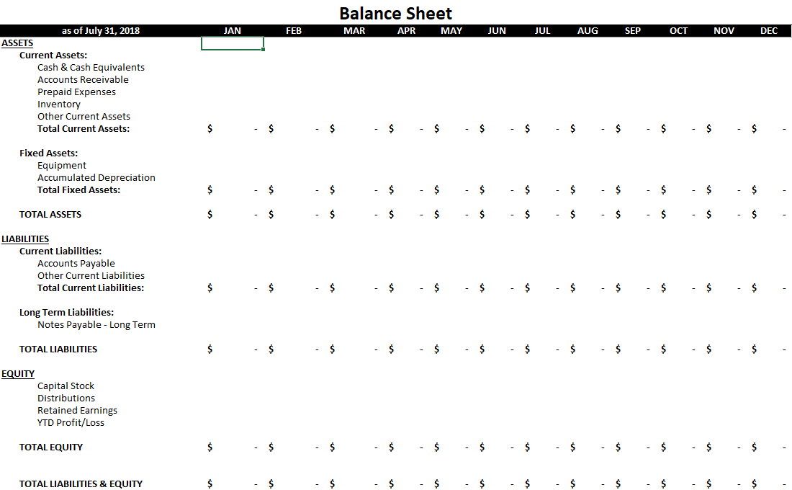
Monthly Balance Sheet

Slide 32
Monthly Maintenance
Update static data
  i.e. update header rows, column titles, etc.
If using a YTD comparison in the template (such as the P&L), update the “YTD Month”
Tie out row data to GL Ledger Report
  Approximately 1x/quarter, spot check total sales, cash & cash equivalents, etc. to GL accounts to ensure validity
Assign unmapped/new accounts to Financial Statement categories
  P&L Accounts must be assigned to the P&L, Balance Sheet & Statement of Cash Flow
  Balance Sheet Accounts must be assigned to the Balance Sheet & Statement of Cash Flow

Slide 33
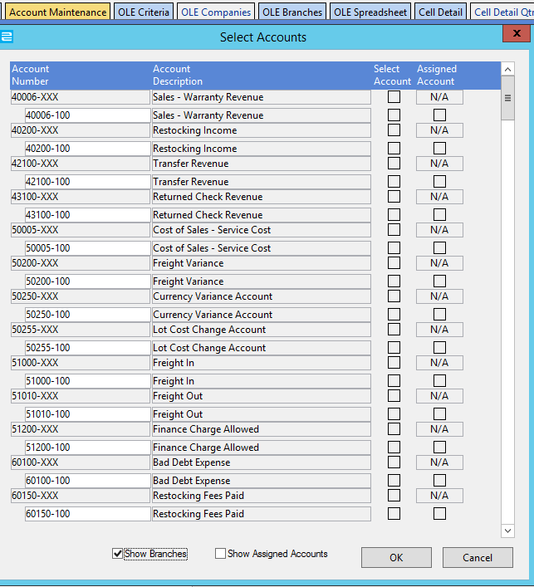
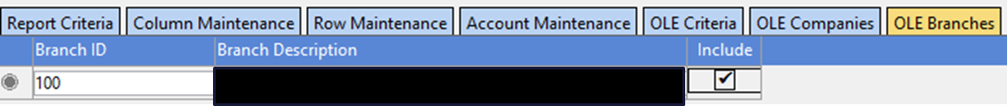
Using Branches
P21 gives you the ability to create financial statements by branch.
When assigning accounts on the Account Maintenance Tab, select “Show Branches” at the bottom of the box
You can then select the accounts by branch or branches you want to display on the report, or the “-XXX” account to pull all branches
Can also define which branches to include on the “OLE Branches” tab: (this particular company only has one branch)

Slide 34
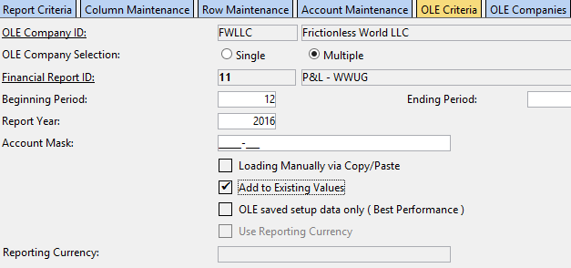
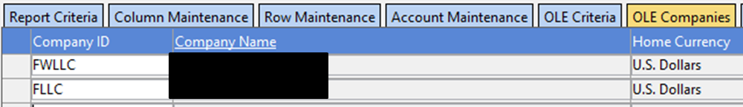
Using Companies
P21 gives you the ability to consolidate financial statements for multiple companies, assuming they are set up on the P21 server.
On the OLE Criteria tab, select the radio button for “Multiple” OLE Companies. This will enable you to access the “OLE Companies” tab.
  If the companies you are going to consolidate do not have the same GL account mask, you must also select the “Add to Existing Values” box (v. 12.0 and newer)
  You also have the ability to select a combination of branches by company to consolidate on the OLE Branches tab
On the OLE Companies tab, add the companies you want to consolidate

Slide 35
Questions?

Slide 36
  Stacy Cline
  Cline Financial Services, LLC
  stacy@clinefinancialservices.com
  www.clinefinancialservices.com
  970-744-0206

