Slide 1
End of day processes
Presented by:
Stacy Cline
Cline Financial Services, LLC

Slide 2
Session title
Stacy Cline Cline Financial Services, LLC stacy@clinefinancialservices.com www.clinefinancialservices.com 970-744-0206

Slide 3
Prophet 21 World Wide User Group Officers
President
Sam Snow T. J. Snow Company, Inc. Vice President of Finance
Tim Edmunds TSI Solutions Vice President of Marketing and Education
Mike Chadwick T. J. Snow Company, Inc.
Vice President of Operations
Ted Hoffman Utility Supply and Construction
Vice President of Member Relations
Eric Lunsford Pye-Barker Engineered Solutions

Slide 4
DISCALIMER
This conference is an attempt by P21WWUG members to assist each other by demonstrating ways that we utilize the Prophet21 system and other related products.
The P21WWUG and the individuals conducting the classes and round tables take no responsibility for potential issues that arise as a result of taking the advice given during the conference.
The P21WWUG does not recommend using any SQL statements to update your database without having those statements first reviewed by Epicor or other experienced SQL professionals. Test any code in your Play Database!
Using SQL statements to update your database may result in corrupting your database. Test any code in your Play Database!

Slide 5
AGENDA
Introduction/Bio
Customer Service
Purchasing
Warehouse
Accounting
Q&A
Agenda

Slide 6
BIO
Background in corporate finance for eight years, running financial budget/plan, monthly close, reporting, etc. of $500M service offering
Independent consultant for six years
End user of Prophet 21 for four years
Specialize in Finance & Accounting practices and procedures, EDI implementation, project management and identifying areas of efficiency and cost savings
Stacy Cline
Cline Financial Services, LLC
stacy@clinefinancialservices.com
www.clinefinancialservices.com
970-744-0206
Bio

Slide 7
END OF DAY PROCESSES
Congratulations! You’ve made it to the end of another work day! BUT, before you head home there are a few items that need to be addressed…
Why?
To ensure all commitments to customers, vendors and internal teams are met.
Maintain the integrity of the data within P21.
Ensures teams have the most accurate data for purchasing, pricing, sales, inventory, etc.
When transactions are aged or not processed through fully, the business doesn’t have the whole picture to make accurate decisions.
What do I have to do?
Review outstanding transactions in P21 via multiple avenues, i.e. “Open” Reports, Transaction Master Inquiry, etc.

Slide 8
END OF DAY PROCESSES
Where to start?
Define the teams within your company. Delineations could be Accounting, Purchasing, Pricing, Warehouse, Customer Service, etc.
These will vary in size and scope based on the size and roles in your business.
Review the Daily/Weekly/Monthly processes.
Assign them out to teams.
Implement internal controls to ensure processes are adhered to.
Recognize that some daily tasks may show up in multiple teams. Assign the responsibility to one team, but make other teams aware that they may have input into a daily task.
For example, you may assign the review of the Unconfirmed Pick Ticket report to the warehouse (since they manage the shipment), but the Customer Service team also needs to review the report to ensure any commitment they made to a customer or expectation of a shipment is fulfilled.

Slide 9
Customer service

Slide 10
Customer service
The Customer Service team will address anything to do with orders.
Goal: ensure the warehouse team understands what orders are in the pipeline, the accounting team can view expected order fulfillment and review Open Orders for upcoming cash flow, etc.
When we think about orders, we will be looking at:
Open Orders
Unapproved Orders
Open Quotes
Open RMA’s
Open Service Orders
Open Production Orders
Orders with upcoming Required Dates
Unconfirmed Pick Tickets
The responsibility of maintaining Price Pages could also sit here. Ensure these are reviewed regularly to know what pages are going to be expiring and address appropriately with the Sales/Pricing team.

Slide 11
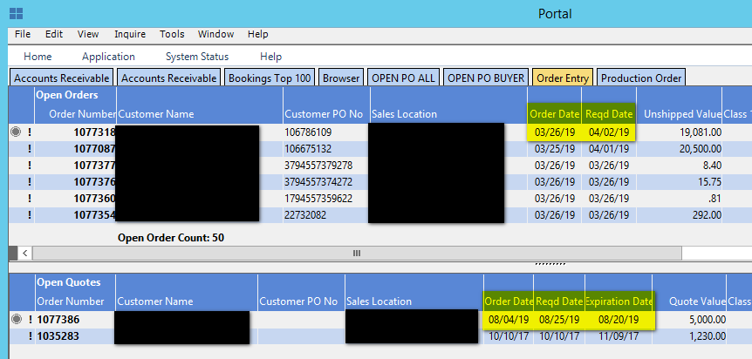
Customer service
Tools:
Use the Portal View to Review:
Open Orders
Open Quotes
We are looking for any orders/quotes that are aged and need to be cancelled, quotes to convert to orders, orders past their Required Date, orders with upcoming Required Dates.
Can be customized to view all orders instead of just the ones you entered.

Slide 12
Customer service
Tools:
Transaction Master Inquiry (F10 key):
Provides an overview of outstanding transactions in P21. Customer Service can will this screen to review:
Open Orders
Open Shipments (Unconfirmed Pick Tickets)
RMA’s
Production Orders
Service Orders

Slide 13
Customer service
Tools:
Transaction Master Inquiry (F10 key):
Open Orders: Review for Approved/Unapproved, Aged Orders, Packing Basis

Slide 14
Customer service
Tools:
Transaction Master Inquiry (F10 key):
RMA’s: Set status to “Both” for Approved and “Yes” for Open. Review for age and validity. Ensure the warehouse has completed RMA receipts for the day.

Slide 15
Customer service
Tools:
Transaction Master Inquiry (F10 key):
Service Orders: Set status to “Both” for Approved and “Yes” for Open. Review for age and validity.

Slide 16
Customer service
Tools:
Transaction Master Inquiry (F10 key):
Production Orders: Set status to “Both” for Approved and “Yes” for Open. Review for age and validity.

Slide 17
Customer service
Tools:
Transaction Master Inquiry (F10 key):
Unconfirmed Pick Tickets: these are not necessarily the responsibility of Customer Service. However, it’s essential to understand what’s waiting for Ship Confirmation to ensure the team can provide excellent Customer Service.

Slide 18
Customer service
Tools:
“Open” Reports:
Open Orders (can also be used for Quotes): Orders – Order Processing – Reports – Open Orders
Open RMA: Orders – Order Processing – Reports – Open RMA
Open Service Order Report: Orders – Service Order – Reports – Open Service Order Report
Unconfirmed Pick Tickets: Orders – Order Processing – Reports – Unconfirmed Pick Tickets
These reports can be used to view open transactions in more detail, limit date ranges, view unapproved, etc.

Slide 19
Purchasing

Slide 20
purchasing
The Purchasing team will address anything to do with inventory forecasting, purchasing of items and maintaining the integrity of items
Goal: ensure the right items are in stock for the right season, lead times are correct in P21, supplier pricing is correct, inform the warehouse of what inventory is coming in, and when.
When we think about daily responsibilities, we will be looking primarily at Open POs.
Additional Items to consider are:
Running purchase requirements – how do you know what to order and when?
Maintaining purchase price pages.

Slide 21
purchasing
Open PO’s:
Open Transaction Master Inquiry – set the Approved to “Both” and Open to “Yes”
Review the Required Date for any PO’s that are past due. Then, check with the warehouse to ensure all item receipts are up to date (ensuring the material isn’t sitting on the dock). You may also need to check status with the supplier.
Review the Approved flag for any Unapproved PO’s
Review the Buyer for each PO to ensure you understand who all is purchasing goods
Open POs Report: Inventory – Purchasing – Reports – Open POs
Use to view more detail of PO’s, limit date ranges for required date, etc.

Slide 22
warehouse

Slide 23
Warehouse
The Warehouse team will address anything to do with items.
Goal: ensure the items have accurate counts, orders are fulfilled in a timely basis, shipments are picked and packed efficiently, returns are received and put away, new inventory receipts are received and put away timely.
When we think about daily responsibilities, we will be looking at:
Unconfirmed pick tickets
Open PO’s
Open RMA’s
Unapproved Physical Counts
Unapproved Cycle Counts
Transfers from Other Locations
Inventory Returns to Vendors
Aged Pick and Holds – designate a space in the warehouse for these and check at least weekly to ensure the items in the pick and hold area are still supposed to be there.

Slide 24
Warehouse
Tools:
Transaction Master Inquiry (F10 key):
Unconfirmed Pick Tickets: manage anything aged, communicate with teams for any fulfillment delays.
Open PO’s: review to know when to expect shipments to arrive to ensure team is prepared to receive, bins are identified and space is made if needed.
Open RMA’s: review to know what orders you’re expecting back. Review with Customer Service for anything aged.

Slide 25
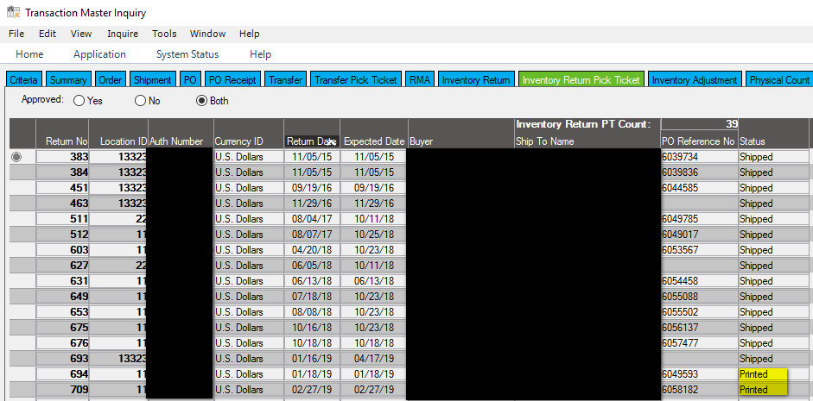
Warehouse
Tools:
Transaction Master Inquiry (F10 key):
Inventory Returns: the returns with a Status of “Printed” are awaiting shipment. Returns with a Status of “Shipped” are waiting to be vouched and are under Accounting’s daily task.

Slide 26
Warehouse
Tools:
Transaction Master Inquiry (F10 key):
Transfers: know what goods your team should be shipping out and receiving. Ensure transfers are received at other locations if they’re shipped from yours

Slide 27
Warehouse
Tools:
Transaction Master Inquiry (F10 key):
Physical & Cycle Count:
Unapproved adjustments are not factored into inventory value.
Aged adjustments should be deleted from the system, as posting these now would throw the inventory value off.
Create a cut-off point for these counts. If they go unapproved for longer than a few days they will be invalid.

Slide 28
accounting

Slide 29
accounting
The Accounting team will address anything to do with vouchers, cash receipts, subledger measurement and overall system hygiene.
Goal: ensure transactions are closed out, cash is forecasted and measured, and transactions keep moving through the system.
When we think about daily responsibilities, we will be looking at:
Cash Drawers
Vouching activity
Cash Collections
Invoice Report
Customer Issues – credit, order validation, etc.
Subledgers (A/R Trial Balance, A/P Trial Balance, Open Deferred Revenue, Unvouchered POs, Unvouchered Landed Cost, Inventory Value, RMA’s, Inventory in Vessel)

Slide 30
accounting
Cash Drawers:
Cash Drawers are used when payment is remitted at time of order entry.
These drawers need to be open to be able to remit payment. Closing the drawer creates a deposit to the bank account in P21.
If your business operates with cash or checks it is recommended that these drawers are closed at the end of each business day and then re-opened immediately to be ready for the following day.
Your company also needs to create an expectation of when deposits occur. For example, any front counter transactions from Monday are put into the bank first thing Tuesday morning. And, the front counter transactions don’t get mixed with other deposits. This ensures you can reconcile efficiently.
If you run only credit cards the drawers could be closed weekly/monthly but does create a more difficult time for reconciliation.
This process can be automated.

Slide 31
accounting
Cash Drawers:
To close/open navigate to Cash Drawer: Orders – Order Processing – Transaction – Cash Drawer
Check the box to “Close the drawer” and save. Print the report to review transactions if needed, other wise it can be accessed anytime via the Cash Drawer Detail Report.
Then enter the drawer again. Ensure users are on the drawer and save. Cash Drawer is open and ready for use!

Slide 32
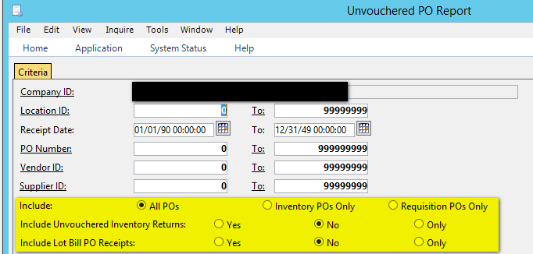
accounting
Vouching Activity:
Enter all vouchers received from the prior day, being aware of which vendor invoices are for SG&A versus inventory/landed cost
Review the Unvouchered Reports: An item will show on an Unvouchered Report if there has been a receipt of goods but no vendor invoice matched against it.
Unvouchered PO: Accounting – Accounts Payable – Reports – Unvouchered PO Report
Shows all receipts that are awaiting a voucher. Review for anything aged or any PO that has already been vouchered, but not through the “Convert PO to Voucher” screen. These will need to be cleared.
Run Report wide open, also decide if you will include Inventory Returns

Slide 33
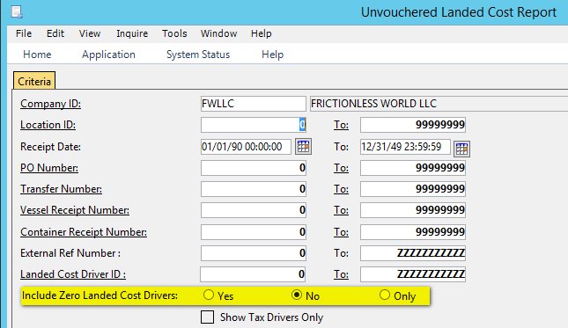
accounting
Vouching Activity:
Review the Unvouchered Reports: An item will show on an Unvouchered Report if there has been a receipt of goods but no vendor invoice matched against it.
Unvouchered Landed Cost: Accounting – Accounts Payable – Reports – Unvouchered Landed Cost Report
Shows all receipts that are awaiting a voucher. Review for anything aged.
Run Report wide open, decide if you will include Zero Landed Cost Drivers
Review Disputed Vouchers, edit the disputes if needed.
Review the A/P Aged Trial Balance. Identify any aged balances that need to be addressed.

Slide 34
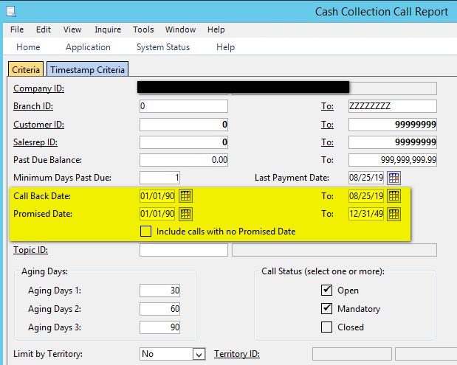
accounting
Cash Collections:
Run the Cash Collection Call Report: Accounting – Accounts Receivable – Reports – Cash Collection Call Report
Use the Criteria to generate a list of customers that need a call back, or customers with broken promises for cash receipts.

Slide 35
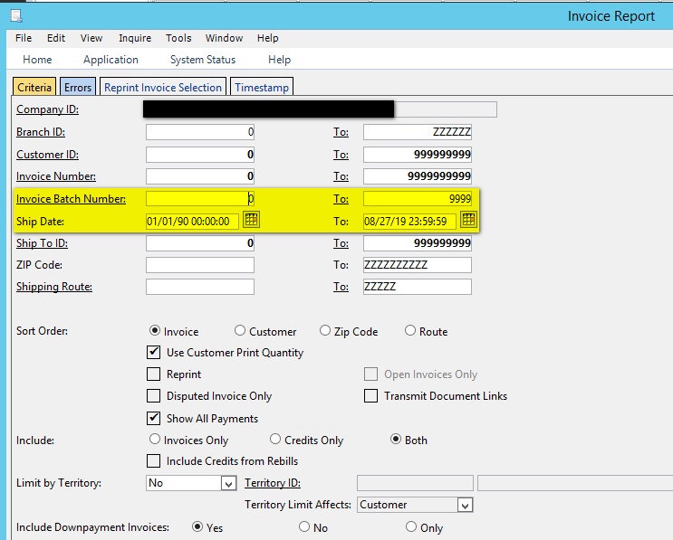
accounting
Invoice Report:
Run the Invoice Report by Batch to Email, Print, Fax, EDI, Mail, etc. invoices to customers
Accounting – Accounts Receivable – Reports – Invoice Report

Slide 36
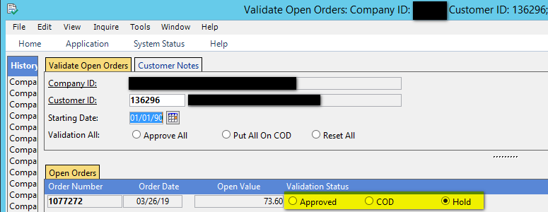
accounting
Credit Issues:
Check for Orders that have a Credit Status Violation and have been placed on hold.
This is available in the Portal View. Use the Validate Open Orders window to Release, continue to hold or change the terms to COD.

Slide 37
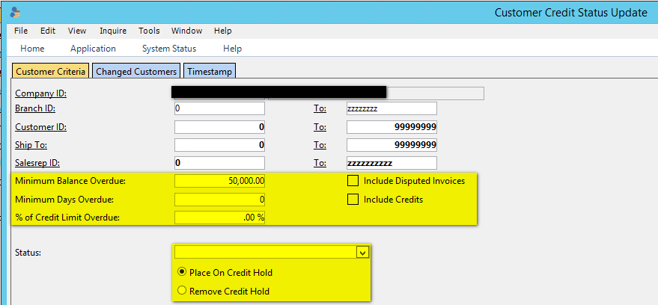
accounting
Credit Issues:
Check for Customers that are on Credit Hold that should not be, or Customers that aren’t on Hold that need to be using the Customer Credit Status Update.
Set search parameters - for example customers with overdue balance > $50K

Slide 38
accounting
Credit Issues:
After Setting the parameters, hit Retrieve.
Use the Changed Customers tab to review results. Then, use the drop down arrow on the “New Credit Status” box to change the credit for each customer if necessary.
This can also be used to remove customers from credit holds.

Slide 39
accounting
Subledgers: ensure every subledger stays in balance with the General Ledger. Below are the reports to run. This can be done monthly, weekly or daily depending on whether transactions are in balance or not
If transactions are not in balance run these daily and save so you can trace through the daily activity to identify the root cause.
GL Account | Subledger Report
Inventory | Inventory Value
Accounts Receivable | Aged Trial Balance
Cash | Reconcile Cash Detail & Reconcile Disbursement feed the Bank Reconciliation Worksheet (ties out cash)
Deferred Revenue | Open Deferred Revenue (may need to add in Store Credits)
Accounts Payable | AP Trial Balance
Inventory Receipts Clearing | Unvouchered PO (Include Inventory Returns)
Landed Cost Clearing | Unvouchered Landed Cost
RMA Receipts Clearing | Open RMAs (run as ONLY)
Inventory in Vessel | Vessel Report
Run as Summary and Detail | General Ledger Report

Slide 40
accounting
Accounting Wrap Up:
The accounting group has a set of tasks specific to itself.
However, it is recommended that the accounting team is aware of all the other teams’ responsibilities.
While they are not directly responsible for the reports, it does affect the work that they do. For example, knowing what’s on the Open Order and Open PO report helps project future cash flow, monitoring open cycle counts and physical counts helps ensure inventory adjustments are reasonable, etc.
Waiting until months after transactions have occurred to resolve issues is cumbersome and difficult to deal with. The more on top of the system transactions, and overall hygiene of P21 the easier any research will be, and the less chance there will be of transactions going awry.

Slide 41
Questions??

Slide 42
Stacy Cline Cline Financial Services, LLC stacy@clinefinancialservices.com www.clinefinancialservices.com 970-744-0206

