Slide 1
RMA’s
Presented by:
Stacy Cline
Cline Financial Services, LLC

Slide 2
Session title
Stacy Cline Cline Financial Services, LLC stacy@clinefinancialservices.com www.clinefinancialservices.com 970-744-0206

Slide 3
Prophet 21 World Wide User Group Officers
President
Sam Snow T. J. Snow Company, Inc. Vice President of Finance
Tim Edmunds TSI Solutions Vice President of Marketing and Education
Mike Chadwick T. J. Snow Company, Inc.
Vice President of Operations
Ted Hoffman Utility Supply and Construction
Vice President of Member Relations
Eric Lunsford Pye-Barker Engineered Solutions

Slide 4
DISCALIMER
This conference is an attempt by P21WWUG members to assist each other by demonstrating ways that we utilize the Prophet21 system and other related products.
The P21WWUG and the individuals conducting the classes and round tables take no responsibility for potential issues that arise as a result of taking the advice given during the conference.
The P21WWUG does not recommend using any SQL statements to update your database without having those statements first reviewed by Epicor or other experienced SQL professionals. Test any code in your Play Database!
Using SQL statements to update your database may result in corrupting your database. Test any code in your Play Database!

Slide 5
AGENDA
Introduction/Bio
RMA Base Case:
RMA Entry
RMA Receipt
Completing a Receipt
Freight, Tax & Remittances
Q&A
Agenda

Slide 6
BIO
Background in corporate finance for eight years, running financial budget/plan, monthly close, reporting, etc. of $500M service offering
Independent consultant for six years
End user of Prophet 21 for four years
Specialize in Finance & Accounting practices and procedures, EDI implementation, project management and identifying areas of efficiency and cost savings
Stacy Cline
Cline Financial Services, LLC
stacy@clinefinancialservices.com
www.clinefinancialservices.com
970-744-0206
Bio

Slide 7
RMA
What is an RMA?
Wikipedia defines it below:
Why does it matter?
Returns are costly, in both money and time.
There’s expense for return shipping (and outbound if you send a replacement), time to assess why the item was returned, time to unpack and restock the item, etc.
It’s important to understand the underlying reasons for returns and address them.
Consider tracking return reasons and identifying areas where your company can improve on to reduce return rates

Slide 8
Rma – Base case – rma entry

Slide 9
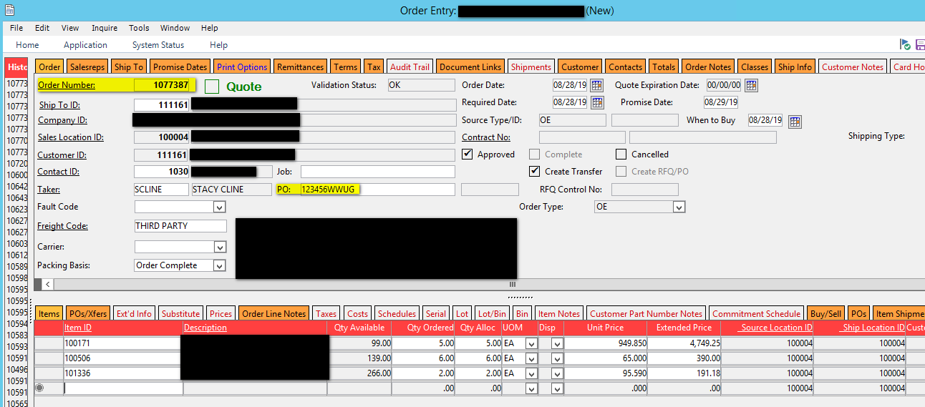
RMA
Below is the order we will be working with. Note the order number and the PO number. Since this is the Base Case we are not looking at Sales Tax or Freight, instead focusing on the system process for RMA’s.

Slide 10
RMA
Let’s dive into how RMA’s work in P21 – Navigate to the RMA screen:
Orders – Order Processing – Transaction – RMAs
The RMA screen looks very similar to the Order Entry screen, and it functions much the same, just in reverse!
We will step through the main tabs and both the header and line level to understand the functionality of the fields and how P21 processes this information.

Slide 11
RMA – header tabs
Order Tab:
Most of the information about the RMA is entered here. And much like the Order entry screen you will enter a Customer ID, Credit Location ID, Ship to ID, Contact ID, PO, etc.
The Decision Point on this screen is the Expiration Date. After this date the RMA is “void”. P21 doesn’t actually void the RMA and you can still receive it; instead this field is used to manage customer expectations.
PO: recommend entering the original PO number used for the order here with a “-R” or something similar. This will help you trace these through the system.

Slide 12
RMA – header tabs
Reason Codes Tab:
This tab is enabled if the “Lost Sales” functionality is enabled in Company Maintenance.
When this function is enabled you can choose the areas where you want to track a reason for a lost sale. For a RMA you have to have the “Order-RMA” selected. When it is set to “Prompt” you will have to select a reason for the lost sale, or in this case the reason why the customer is returning the product.

Slide 13
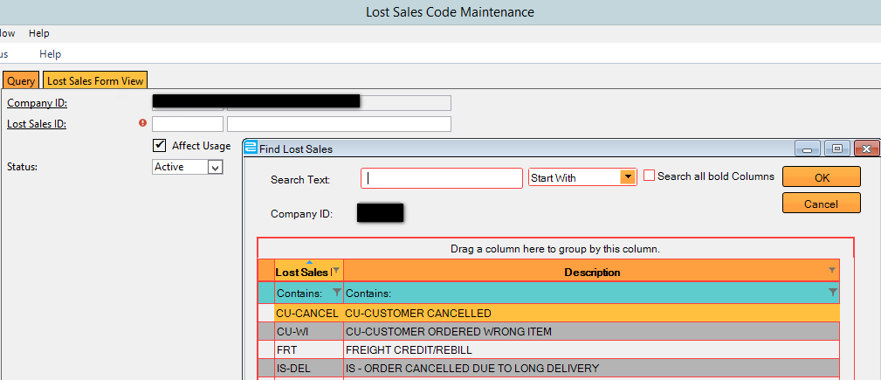
RMA – header tabs
Reason Codes Tab:
Once the “Lost Sales” is enabled, Reason Codes can be created.
Navigate to “Lost Sales Code Maintenance”: Inventory – Inventory Management – Maintenance – Lost Sales Code Maintenance
Here you create the reason codes that you will be able to select from the RMA screen. These are free form and anything you want can be entered. Try to think of the most common reasons product is returned and enter them as individual codes.

Slide 14
RMA – header tabs
Reason Codes Tab:
Back to the RMA Entry Screen! – select a Reason Code ID for the return.
In this case I selected “Shipping Damage” – by entering codes for each return you can start tracking why customers are returning items and improving on the item.
For example, if you have a large amount of “Shipping Damage” it’s an easy fix – the warehouse needs to address the quality of their packaging.
If it’s a lead time issue then you can address with either the supplier if you’re awaiting shipments regularly or address with the warehouse if they’re not fulfilling orders in a timely manner.
This screen is all about giving visibility into your business!

Slide 15
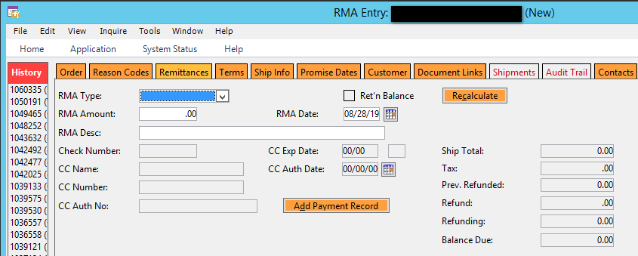
RMA – header tabs
Remittance Tab:
Use this tab the same way you do on the Order Entry screen. Only populate this tab if you are giving the customer a physical refund. If it is going on account then do not populate anything here.
The refund will go through the cash drawer and be a part of that days’ activity.
For this example we are going to put the credit on the customer account.

Slide 16
RMA – header tabs
Ship Info Tab:
Use this tab the same way you do on the Order Entry screen. It will default to the settings on the customer account. Since this is base case we are changing the freight code so your company pays the return freight. Everything else we are leaving as is for the time being.

Slide 17
RMA – header tabs
Tax Tab:
Use this tab the same way you do on the Order Entry screen. It will default to the settings on the customer account. Since this is base case we are leaving this particular order as tax exempt.

Slide 18
RMA – line tabs
Now we change our focus to the bottom half of the screen, the line level.
Enter the item(s) that will be returned:

Slide 19
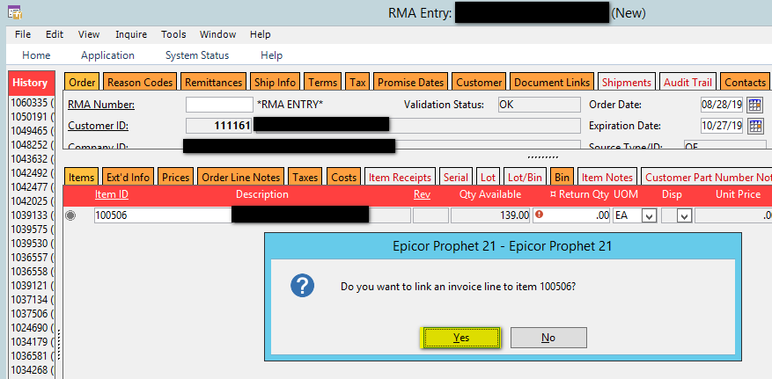
RMA – line tabs
As soon as you hit enter on the item P21 will prompt you to link an invoice (if desired). Click “Yes”. This will take you to the Sales History Tab.

Slide 20
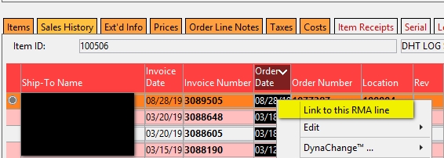
RMA – line tabs
From the Sales History Tab you want to find the order to link the return to. Right click and select the option to “Link to this RMA line”:
Once the line is linked you’ll automatically be back on the “Items” tab. P21 will populate the original ordered quantity of the item:

Slide 21
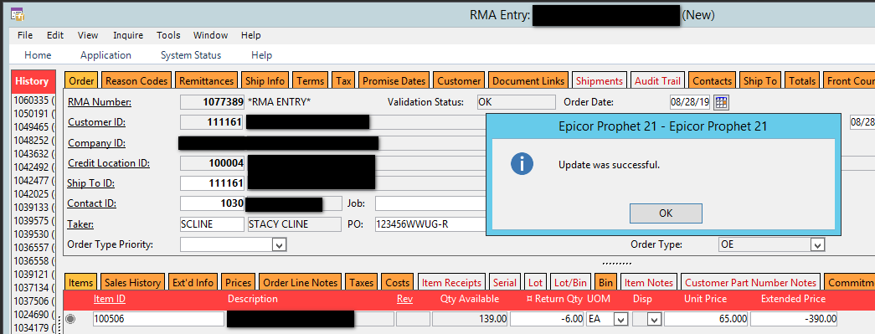
RMA – line tabs
We aren’t adjusting any line item taxes since we just have one item and it was tagged with an Exempt Jurisdiction above.
We are ready to Save! Notate the RMA number.

Slide 22
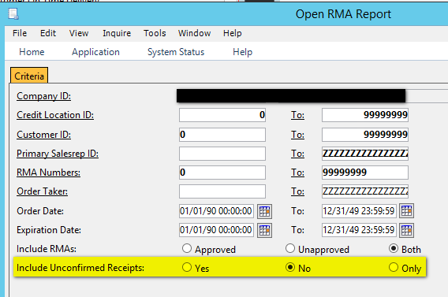
RMA – open rma report
Now that the RMA is in the system, without any receipts, it will show on the Open RMA Report.
Navigate to the Open RMA Report, Orders – Order Processing – Reports – Open RMA Report.
Change the “Include Unconfirmed Receipts” to No. This will show you only RMAs in P21 that are awaiting a receipt. Then Print Preview.

Slide 23
RMA – open rma report
Report is as follows:
Note the lines of the RMA
($390.00) revenue
($128.36) cost – we will reference this again shortly.
This RMA can also be seen in Transaction Master Inquiry (F10):
At this point, there are no GL transactions made in P21.

Slide 24
Rma – Base case - receipt

Slide 25
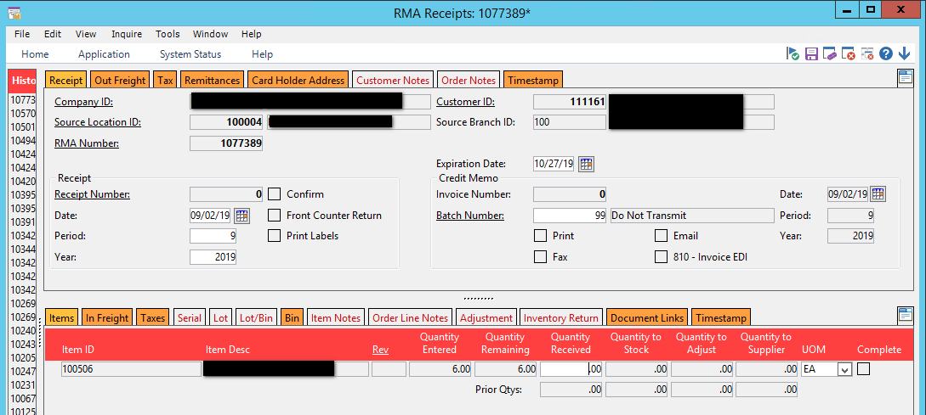
RMA – receipt
Now, the goods have returned to the warehouse. Navigate to RMA Receipts: Orders – Order Processing – Reports – Open RMA.
Enter the Source Location of the RMA and the RMA number:

Slide 26
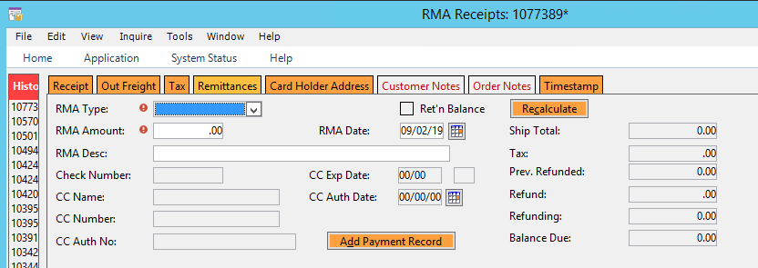
RMA – receipt
Ensure the Out Freight, Tax and Remittances tabs are correct. We are setting these aside for the time being and will address later:

Slide 27
RMA – receipt
Now, we move to the line level and focus on the “Items” tab. When the RMA number is populated the item will automatically populate based on the RMA.
Enter the Quantity Received.
Now, we have a decision to make as to what to do with the inventory:
Quantity to Stock: returns these items to inventory
Quantity to Adjust: writes the item off, it will not show in inventory.
This is typically if the item is now unsellable, or if it was more expensive to ship it back than it was to write if off, thus the item was scrapped in field.
Quantity to Supplier: this will launch the Inventory Return wizard and walk you through the screens of creating the Inventory Return.

Slide 28
RMA – receipt
We are going to return these items to Inventory:
Select the Bin Tab (if applicable) and enter what bin to place these items in:

Slide 29
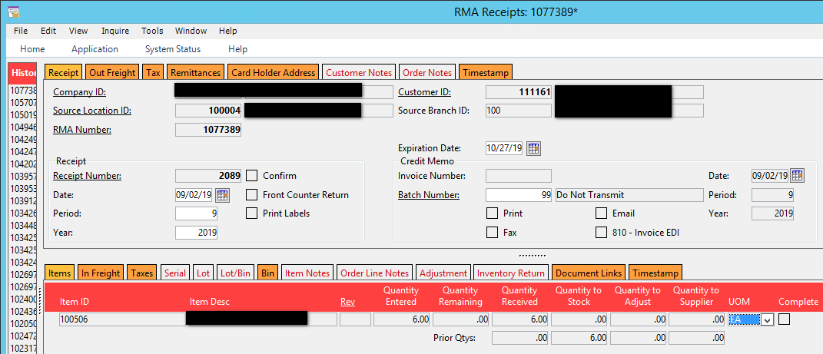
RMA – receipt
Save the Receipt.
Are we done?!?

Slide 30
Rma – Base case – Completing a receipt

Slide 31
RMA – receipt
Let’s check. If the transaction is complete we would expect to see:
RMA dropped off of the Open RMA Report
Credit to Customer Account in A/R w/ Debit to Sales
Debit to Inventory w/ Credit to COGS
Open RMA Report:
Criteria (same as before): Change “Unconfirmed Receipts” to “No” and Print Preview.
RMA is no longer on the report. This is as we expected.
Credit to Customer Account:
Credit isn’t posted to Customer Account:

Slide 32
RMA – receipt
Debit to Inventory:
The Debit to Inventory is there, but the Credit is to the RMA Receipts Clearing account, not to the Cost of Goods Sold Account:
Why??

Slide 33
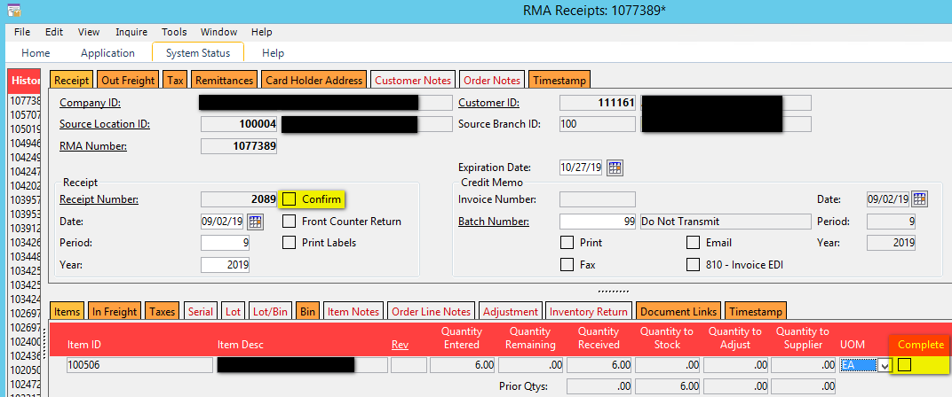
RMA – receipt
Re-Open the RMA Receipt:
Since neither the “Confirm” or “Complete” boxes are checked P21 holds this RMA as incomplete and thus a liability.

Slide 34
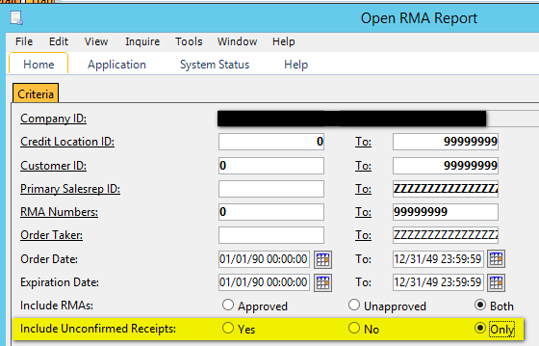
RMA – receipt
It can now be seen on the Open RMA reports by focusing on “Unconfirmed Receipts ONLY”:

Slide 35
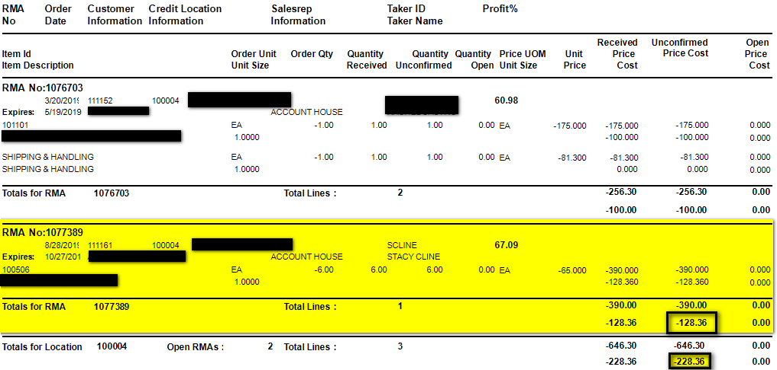
RMA – receipt
The Open RMA Report is as follows:
We can see the RMA we just created for ($128.36) of cost, along with one other. The total of the Unconfirmed RMA’s is ($228.36).
This ties to the Total Balance in the RMA Receipts Clearing Account:
Ensures your RMA Subledger is in balance with the General Ledger.

Slide 36
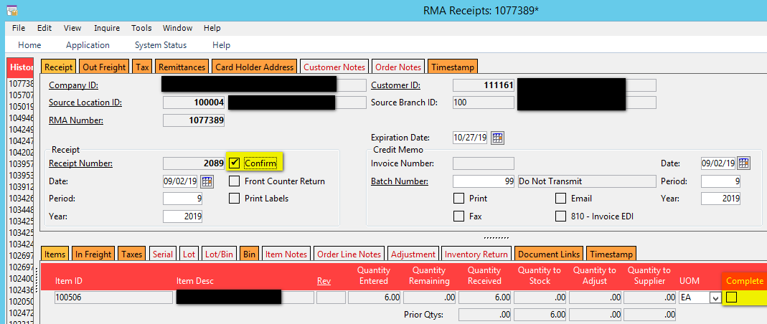
RMA – receipt
But, that doesn’t help us get the credit to the Customer Account. Open the RMA Receipt Again.
If you mark the line item as “Complete” and save P21 will still show the Receipt as Unconfirmed and the liability will remain in the RMA Receipts Clearing Account as the RMA has not been Confirmed.
If you check the “Confirm” checkbox and ALL QUANTITY on the RMA is received, P21 will automatically check the “Complete” checkbox for you when the receipt is saved. You are now done.
If you receive the return in pieces and parts then create a receipt for only the Quantity you received into the warehouse. Mark the Receipt as “Confirmed” but DO NOT mark the complete checkbox. This will leave the lines(s) open for further receiving.

Slide 37
RMA – receipt
Confirm that the Receipt is now fully confirmed by re-running the Open RMA report as Unconfirmed Receipts only.
Also check to ensure the transaction has cleared from the RMA receipts clearing account, and the credit is sitting on customer account:
Note that we now see the transaction detail to Debit Sales and Credit Cost of Goods Sold.

Slide 38
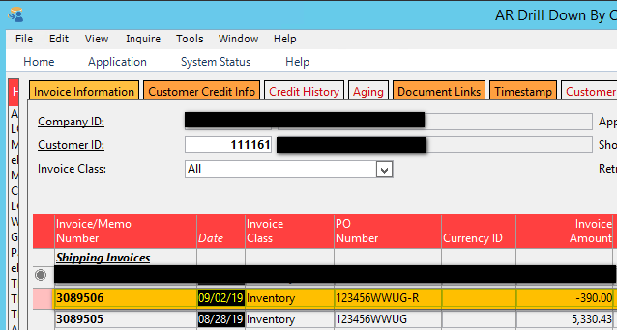
RMA – receipt
Confirm that the Receipt is now fully confirmed by re-running the Open RMA report as Unconfirmed Receipts only.
Also check to ensure the transaction has cleared from the inventory receipts clearing account, and the credit is sitting on customer account:
Note that we now see the transaction detail to Debit Sales and Credit Cost of Goods Sold.

Slide 39
Rma – FREIGHT, TAX & REMITTANCES

Slide 40
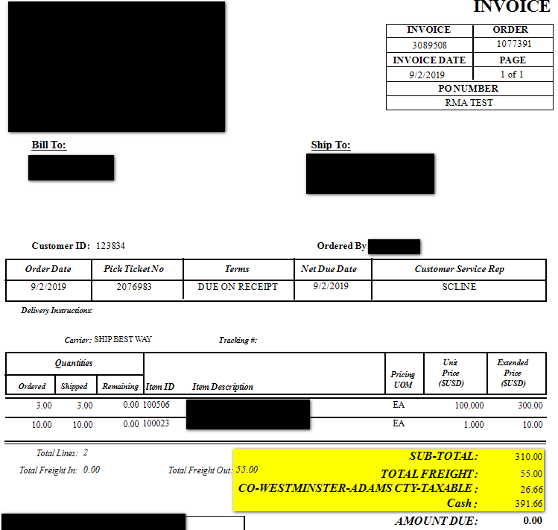
RMA – freight, tax & remittances
RMA’s are fairly straightforward as base case. But, what happens when Freight, Taxes and Remittances are involved? How do you know what to apply and where to apply it?
We will work with Order 1077391, Invoice 3089508:
Note that there is goods, freight, tax and a remittance on the invoice.
In this case the customer wants to return two units of item 100506.

Slide 41
RMA – freight, tax & remittances
Open the RMAs window. Enter the Customer ID, Ship to, Reason Code, etc. on the RMA header.
Enter the item on the RMA line level. Link the invoice.
Now, we have some decisions to make:
How much tax is due back (let P21 calculate this)
How much of the freight will we refund the customer since they’re only returning part of the order?
How much do we owe them total?
Start with what you know:
You know what item(s) they’re returning.
You know to ensure the RMA is taxable so P21 can calculate the tax credit.
And that may be all for right now – you may choose to wait to credit freight and provide a refund to the customer until the item(s) are received in the warehouse.
Or, you may be more accurate determining the freight because the warehouse wouldn’t know to add the amount.
This step is an internal business control. Create a workflow for the most common RMA situations so your Order Entry/Front Counter teams know what’s expected at each stage of the process.
If you enter a remittance on the RMA and save, P21 will automatically receive the entire RMA and invoice it.
This is appropriate in a front counter or other similar situation where you have the goods back immediately.
In this case we will assume we will estimate a freight credit based on the total value of the order enter the remittance at time of RMA receipt.

Slide 42
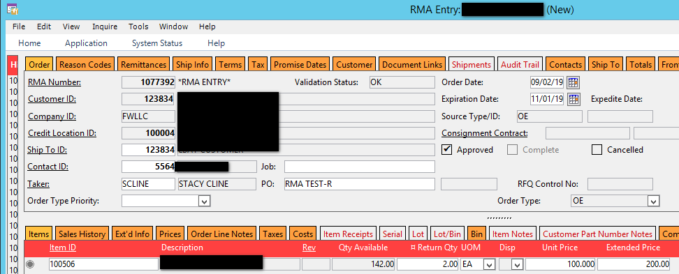
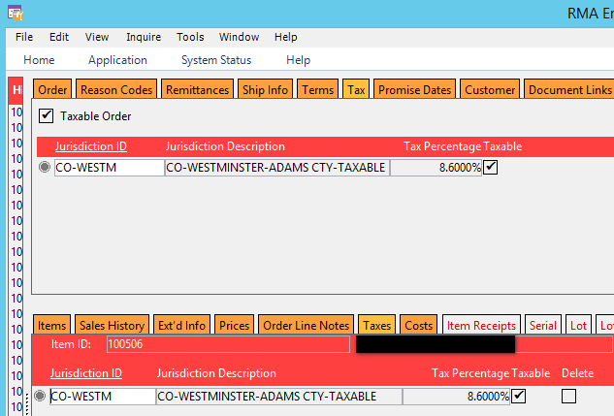
RMA – freight, tax & remittances
The RMA is as follows:
Tax:
Ensure all taxable boxes are checked, if applicable
Ensure the tax jurisdictions are set. They cannot be edited on the RMA Receipt. (Tested on version 18.2.3453)

Slide 43
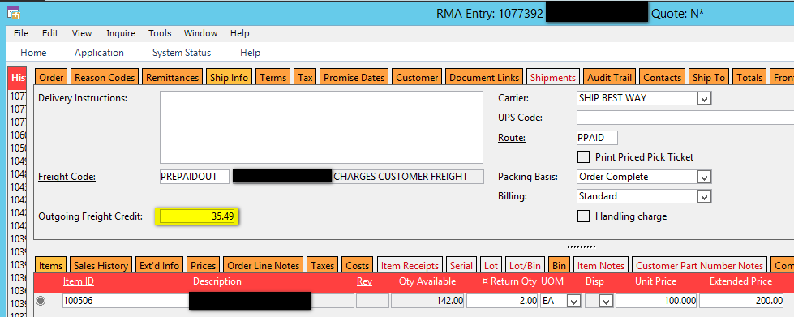
RMA – freight, tax & remittances
We pro-rated the freight the best we could and came up with a calculated freight amount of $35.49 (original was $55.00).
We also ensured the Freight Code chosen has the customer paying freight. Without that option (managed in Freight Code Maintenance) you can put the outgoing freight but it will not show up on the RMA.

Slide 44
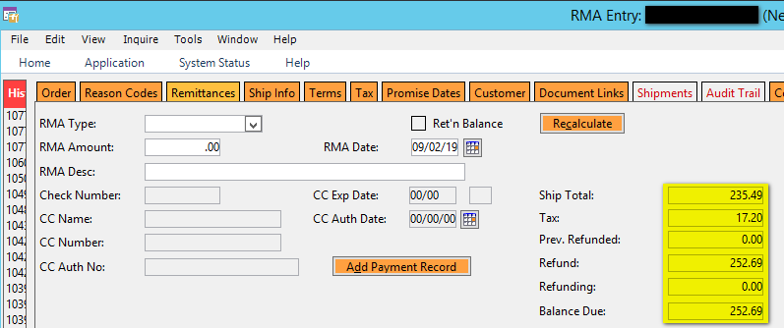
RMA – freight, tax & remittances
Check the Remittance tab to ensure the Item Credit, Freight Credit and Tax Credits are reflected:
Items ($200) + Shipping ($35.49) = Ship Total ($235.49)
Tax = ($17.20)
Balance Due = ($252.69)
Leave the RMA Type and RMA amount blank unless you are receiving the goods and ready to create the invoice.

Slide 45
RMA – freight, tax & remittances
Navigate to the RMA Receipt Window. Enter the Source Location, RMA Number and line(s) being returned. All the header tabs should match what you entered into the RMA.
You now have the opportunity to adjust the Freight here. For example, the freight was calculated to pro-rate how much the returned items would have cost to ship out. But, the Customer Service team has agreed to refund the customer the entire amount of shipping.
Navigate to the “Out Freight” tab. Change the Out Freight to $55.00 from $35.49. Then, click back on the remittance tab. Here you see the Ship Total has changed to $255.00, reflecting the entire amount of freight.

Slide 46
RMA – freight, tax & remittances
Now, enter your payment details as needed. In this example we are remitting the entire amount back to the customer:
This payment will now flow through the cash drawer and show up in the drawer for this day.
You’re done!!

Slide 47
Questions??

Slide 48
Stacy Cline Cline Financial Services, LLC stacy@clinefinancialservices.com www.clinefinancialservices.com 970-744-0206

