Slide 1
Prophet 21 World Wide
User Group Webinars
An Introduction to Management of Cash Drawers in P21
Presented by:
Stacy Cline
Cline Financial Services, LLC

Slide 2
P21 Worldwide User Group Officers
President
Sam Snow
Information Technology Manager, T. J. Snow Company, Inc.
Vice President of Finance
Brian Williams
Director of Information Technology, Industrial Supply Company
Vice President of Marketing and Education
Mike Chadwick
Director of Information Technology, T. J. Snow Company, Inc
Vice President of Operations
Ted Hoffman
Supply Chain Analyst, Utility Supply and Construction
Vice President of Member Relations
Eric Lunsford
Vice President Sales & Marketing, Pye-Barker Supply Co., Inc.

Slide 3

SAVE THE DATE
CONNECT 2017
September 17-19
Renaissance Orlando SeaWorld

Slide 4
Disclaimer
This webinar is an attempt by P21WWUG members to assist each other by demonstrating ways that we utilize the Prophet21 system and other related products.
The P21WWUG and the individuals conducting these webinars take no responsibility for potential issues that arise as a result of taking the advice given during the session.
The P21WWUG does not recommend using any SQL statements to update your database without having those statements first reviewed by Epicor or other experienced SQL professionals.
Using SQL statements to update your database may result in corrupting your database

Slide 5
For more information
Cheryl Richardson
P21WWUG Administrator
cheryl@p21ww.org
Telephone: 215-688-5580

Slide 6
Agenda
Introduction/Bio
Definitions
Creating a Cash Drawer
Payment Type Maintenance
Assigning Users to a Cash Drawer
Opening & Closing a Cash Drawer
Cash Drawer Detail Reports
Q&A

Slide 7
Bio
  Worked in corporate finance for eight years, running financial budget/plan, monthly close, reporting, etc. of $500M service offering
  Independent consultant for three years
    End user of Prophet 21 for two years
  Specialize in Finance & Accounting practices and procedures, identifying areas of efficiency and cost savings
  Stacy Cline
  Cline Financial Services, LLC
  stacy@clinefinancialservices.com
  970-744-0206

Slide 8
Definitions
Cash Drawer:
  Used to track money collected by a front counter cashier, customer service representative, etc. A company may have one or multiple drawers depending on the business structure
  A cash drawer does not reflect any payments received by ACH, wire transfer, mailed in checks, etc.
  A cash drawer must exist and be open to receive front counter remittances (cash, check or credit card)
  A cash drawer must be closed to create a deposit in P21
Payment Type:
  Payment types tell P21 how to group transactions together. An effective configuration enables a much simpler reconciliation process
Users:
  Users are assigned to a cash drawer. A user cannot use a cash drawer if they are not assigned to it, or if they have a different drawer open

Slide 9
CREATING A CASH DRAWER

Slide 10
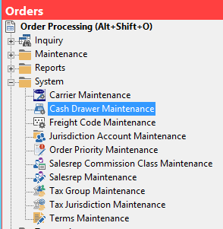
Creating a Cash Drawer –
Cash Drawer Maintenance
Order Processing – System – Cash Drawer Maintenance

Slide 11
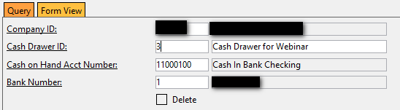
Creating a Cash Drawer –
Cash Drawer Maintenance
Enter Company ID
Enter a Cash Drawer ID and description
  The Drawer ID is user defined, can be numeric or alphanumeric
Enter the account transactions will be deposited to
Enter the bank number the cash drawer will deposit to
Save
Repeat as needed

Slide 12
PAYMENT TYPE MAINTENANCE

Slide 13
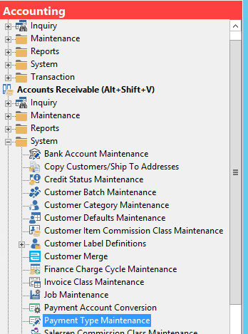
Payment Type Maintenance
Accounting – Accounts Receivable – System – Payment Type Maintenance

Slide 14
Payment Type Maintenance
Payment Types are assigned at a COMPANY LEVEL, not a cash drawer level
Payment Types configured in Payment Type Maintenance apply to all receipts – Cash Drawers and Cash Receipts
The Payment Types created will derive how P21 reflects payments on your Cash Drawer Detail Report & the Reconcile Cash Detail function
The goal is to have each P21 created deposit match a deposit on your bank statement! This significantly simplifies the cash reconciliation process.

Slide 15
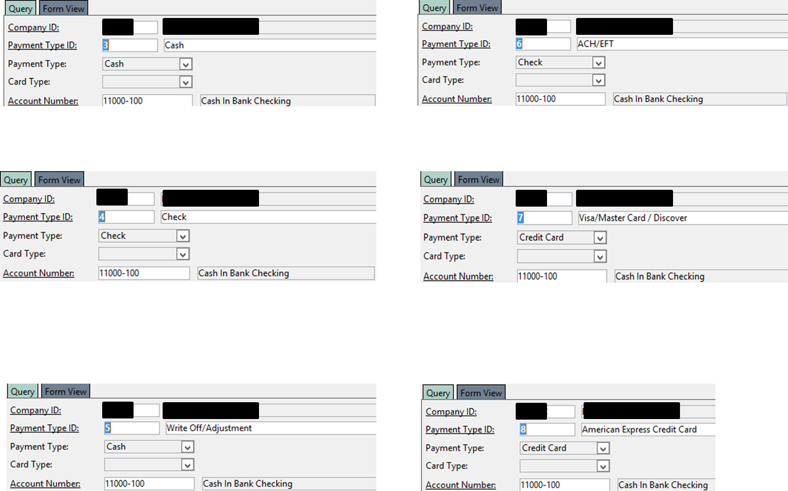
Payment Type Maintenance
Credit Cards should be grouped together to reflect how they batch through your credit card processor.
  Example: If Visa, MasterCard & Discover hit the bank in one deposit, create a Payment Type ID of Visa/MasterCard/Discover to batch these transactions
Any other payment types (store credit, gift card, etc.) need to be assigned to the payment type that makes sense for your business.

Slide 16
Payment Type Maintenance
The prior example assumes your company has credit card processing within P21 configured.
If credit card processing within P21 is not configured do not select payment type of “Credit Card”.
  P21 will let you configure this in Payment Type Maintenance, however the front counter will not be able to process that payment type (ex: American Express).
If you don’t process credit cards within P21, create the payment types based on how transactions batch into your bank account. However, instead of selecting “Credit Card” you will select “Cash” or “Check” – determined by what makes the most sense for your business.
  i.e. if you rarely/never receive checks through the front counter it may make sense to select “Check” and vice versa.

Slide 17
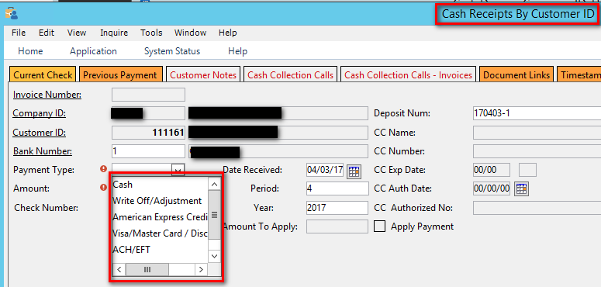
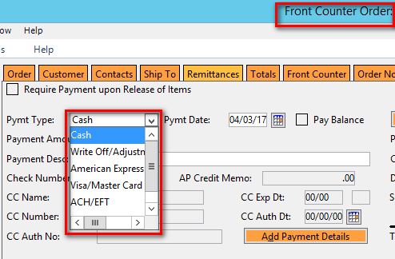
Payment Type Maintenance

Slide 18
ASSIGNING USERS TO A CASH DRAWER

Slide 19
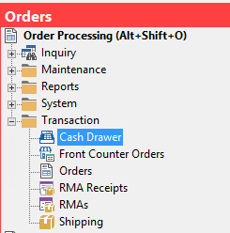
Assigning Users to a Cash Drawer
Orders – Transaction – Cash Drawer

Slide 20
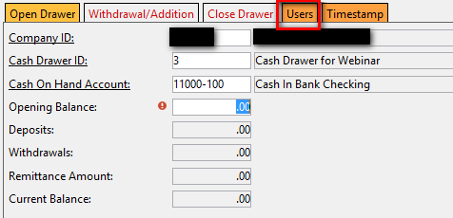
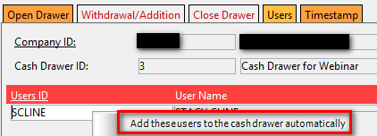
Assigning Users to a Cash Drawer
Enter the Company ID and the Cash Drawer ID
Enter the Opening Balance if applicable
Click on the “Users” Tab
A user can be assigned to multiple drawers, but a user cannot have more than one drawer open at a time
Assign user(s) to each drawer they may use or be responsible for. A drawer can have multiple users
Right Click and select “Add these users to the cash drawer automatically” if you want the user to be able to open/close repeatedly
Save

Slide 21
OPENING AND CLOSING A CASH DRAWER

Slide 22
Opening/Closing a Cash Drawer
After a user is assigned to a Cash Drawer the drawer can be opened and closed
Opening a Cash Drawer enables the drawer to receive transactions
Closing the Cash Drawer creates a deposit for the drawer in P21
Cash drawers should be opened and closed daily.
  If you do not have a large volume of cash drawer transactions the drawer still needs to be opened and closed weekly or monthly
  This is NOT recommended if you have an actual front counter for sales
The open/close process can be automated – there’s Epicor documentation on the WWUG of how to do this

Slide 23
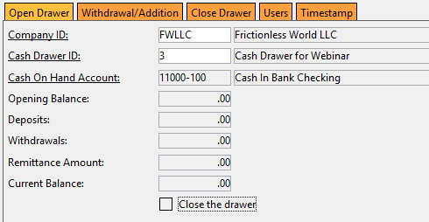
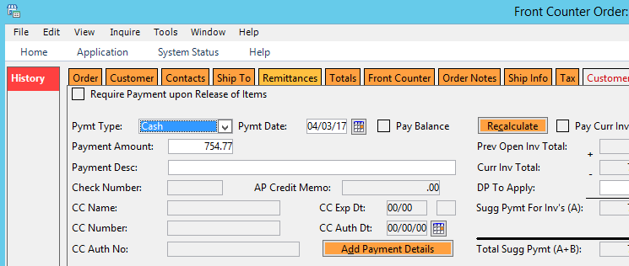
Opening/Closing a Cash Drawer
Open Drawer:
Process Front Counter Transactions:

Slide 24
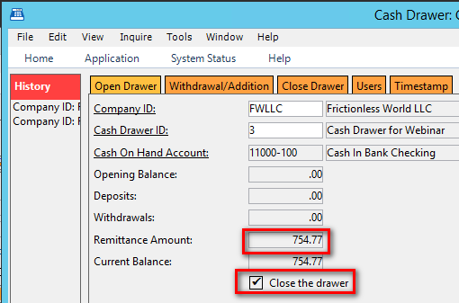
Opening/Closing a Cash Drawer
Close Drawer:
  Remittances processed through the front counter will sum, giving you the current balance for the drawer.
  Select “Close the Drawer” and Save
  Print Report if needed

Slide 25
CASH DRAWER REPORTING

Slide 26
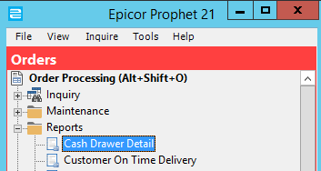
Cash Drawer Detail Report
Order Processing – Reports – Cash Drawer Detail

Slide 27
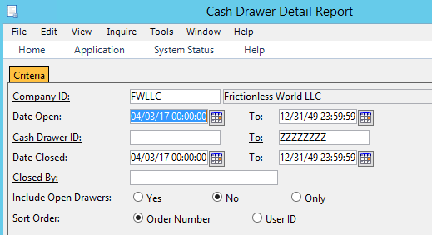
Cash Drawer Detail Report
Enter the Report Parameters:
  Range of Days Open
  Range of Cash Drawer ID’s
  Range of Days Closed
Print Preview

Slide 28
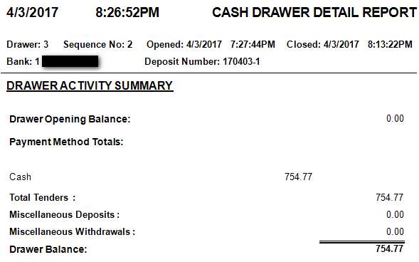
Cash Drawer Detail Report
Report will show the detail and a summary of all transactions processed through the drawer from the time it was opened to the time it was closed

Slide 29
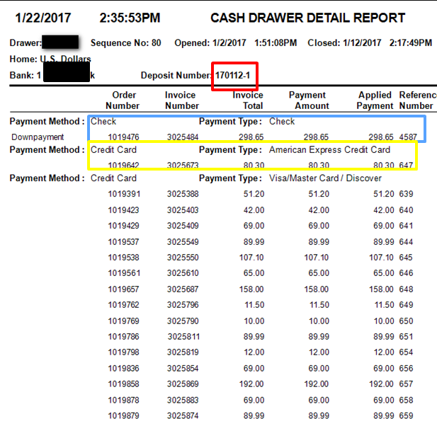
Cash Drawer Detail Report
The Cash Drawer Detail Report contains a Deposit Number and Detail of all transactions processed through the cash drawer.
  Transactions are sorted in the following hierarchy:
    Cash Drawer ID
    Payment Method
    Payment Type
If you have multiple cash drawers ensure they are ALL closed on the same schedule.
  This alleviates having to search in multiple P21 cash drawer deposits for a bank statement merchant deposit

Slide 30
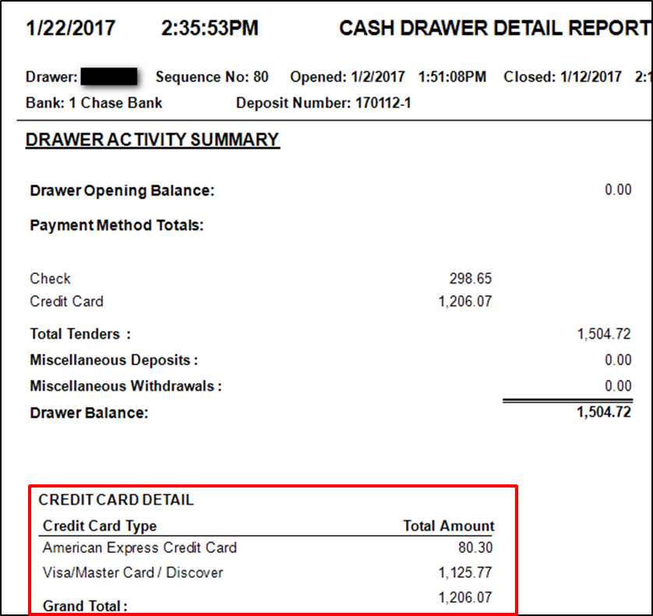
Cash Drawer Detail Report
Drawer Activity Summary is summed by Payment Method – cash/check/credit card
The credit card detail is broken out by the credit card types configured in Payment Type Maintenance
In this example (with only one drawer) I would know to expect the following deposits in the bank account:
  $80.30 for American Express
  $1,125.77 for Visa/Master Card/ Discover
If you have multiple drawers the payment methods will be summed to derive the totals for the bank deposits

Slide 31
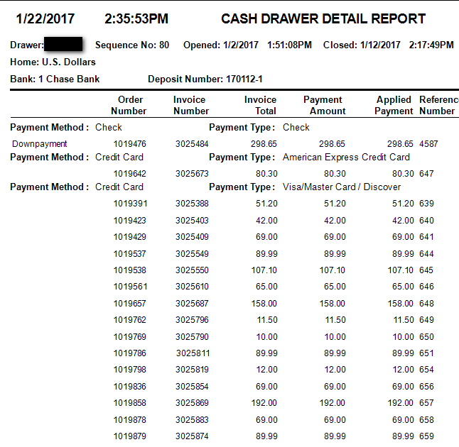
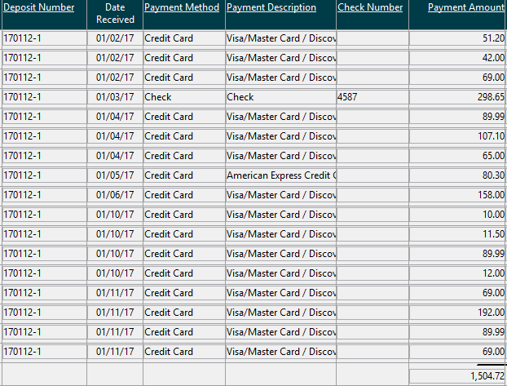
Reconcile Cash Detail – Cash Drawers
The Cash Drawer Detail report contains the same transactional detail as the Reconcile Cash Detail Function (Accounting – Accounts Receivable – Transaction – Reconcile Cash Detail
  The Reconcile Cash Detail function will not show detail by drawer
  It will ONLY contain the transactions pushed when the drawers were closed
If you have multiple cash drawers ensure they are ALL closed on the same schedule.
  This alleviates having to search in multiple P21 cash drawer deposits for a bank statement merchant deposit

Slide 32
Accounting for Front Counter Transactions
Will call – when order is paid for at time of service (customer shops and pays – order is picked/packed/confirmed and invoiced) the accounting transactions are as follows:
If customer places an order and does not pay at time of service or pickup, an invoice will be created and will remain in A/R until paid/due

Slide 33
QUESTIONS?

Slide 34
  Stacy Cline
  Cline Financial Services, LLC
  stacy@clinefinancialservices.com
  970-744-0206

