Slide 1
REPORTING SALES NUMBERS
Presented by:
Stacy Cline
Cline Financial Services, LLC

Slide 2
Session title
Stacy Cline
Cline Financial Services, LLC
stacy@clinefinancialservices.com
www.clinefinancialservices.com
970-744-0206

Slide 3
Prophet 21 World Wide User Group Officers
President
Sam Snow
T. J. Snow Company, Inc.
Vice President of Finance
Tim Edmunds
TSI Solutions
Vice President of Marketing and Education
Mike Chadwick
T. J. Snow Company, Inc.
Vice President of Operations
Ted Hoffman
Utility Supply and Construction
Vice President of Member Relations
Eric Lunsford
Pye-Barker Engineered Solutions

Slide 4
DISCALIMER
This conference is an attempt by P21WWUG members to assist each other by demonstrating ways that we utilize the Prophet21 system and other related products.
The P21WWUG and the individuals conducting the classes and round tables take no responsibility for potential issues that arise as a result of taking the advice given during the conference.
The P21WWUG does not recommend using any SQL statements to update your database without having those statements first reviewed by Epicor or other experienced SQL professionals. Test any code in your Play Database!
Using SQL statements to update your database may result in corrupting your database. Test any code in your Play Database!

Slide 5
AGENDA
Introduction/Bio
Reporting Sales Numbers
Sales History Report
Sales History – Bridge to Accounting View & Executive Metrics
Sales History – Bridge to GL
GL – Bridge to Statement of Profit & Loss
Pulling it all Together
Q&A
Agenda

Slide 6
BIO
  Background in corporate finance for eight years, running financial budget/plan, monthly close, reporting, etc. of $500M service offering
  Independent consultant for six years
    End user of Prophet 21 for four years
  Specialize in Finance & Accounting practices and procedures, EDI implementation, project management and identifying areas of efficiency and cost savings
  Stacy Cline
  Cline Financial Services, LLC
  stacy@clinefinancialservices.com
  www.clinefinancialservices.com
  970-744-0206
Bio

Slide 7
Reporting sales

Slide 8
Reporting sales
Anytime an order is ship confirmed/invoiced, and RMA is completed or a Credit Memo/Debit Memo (CM/DM) is created, P21 creates an invoice.
The set of invoices is designated in P21 with a Journal ID = “SJ”, meaning “Sales Journal”
All of the reports that we will reference pull a representation of this activity.

Slide 9
Reporting sales
Where are some places you can find a Sales number in P21?
  Sales History Report
    Orders – Order Processing – Reports – Sales History
  Executive Metrics
    Accounting – Management Summary – Inquiry – Executive Metrics
  Accounting View
    Accounting – Management Summary – Inquiry – Accounting View
  Financial Line Express Set-up
    Accounting – General Ledger – System – Financial Line Express Set-up
  General Ledger
    Accounting – General Ledger – Reports – General Ledger
  Sales Tax Report
    Accounting – Accounts Receivable – Reports – Sales Tax
    This is used for different reasons – will exclude it for this analysis. For a Sale to show up here, the order must be marked as “Taxable” which usually drives the difference between the Sales History Report and the Sales Tax Sales number
  There are more, but these ones are the ones I use the most

Slide 10
Reporting sales
What does the output of each of these show?
  Definitely not the same Sales Number!
So which one is right?
  They all are! Each one just represents something different.

Slide 11
Reporting sales
Sales History Report:
  Reflects ALL INVOICING ACTIVITY, including invoices for sales, RMA’s, credit memos and debit memos.
  It DOES NOT include Sales Tax or Freight Revenue associated with an invoice.
  Can be pulled multiple ways, a few examples are:
    By Invoice Date(s), including CM/DM
    By Invoice Date(s), excluding CM/DM
    By GL Period, including CM/DM
    By GL Period, excluding CM/DM

Slide 12
Reporting sales
Executive Metrics:
  Provides a Summary of Sales by period.
  Based on the Sales History Report (does not include freight revenue or sales tax).
  Cannot view individual invoices.
Accounting View:
  Provides a Summary of Sales for a single day, single period or range of periods.
  Based on the Sales History Report (does not include freight revenue or sales tax).
  Cannot view individual invoices.

Slide 13
Reporting sales
General Ledger:
  Details all sides of invoicing activity.
  All invoicing activity is referenced with Journal ID = “SJ”
P&L – Financial Line Express Set-Up:
  Summarizes any GL accounts that we have defined as Revenue together. Includes ALL Journal ID’s pointed to that set of accounts.

Slide 14
SALES History REPORT

Slide 15
Sales history REPORT– what is it?
The Sales History Report is a report that enables you to view all invoicing activity in P21. You can define criteria and pull the report multiple different ways.
The criteria you enter will determine what data is pulled.
When trying to pull a Sales Number for the month, the most common way to pull the report is either by Invoice Date or by GL Period.
However, there is *typically* a difference between the two.

Slide 16
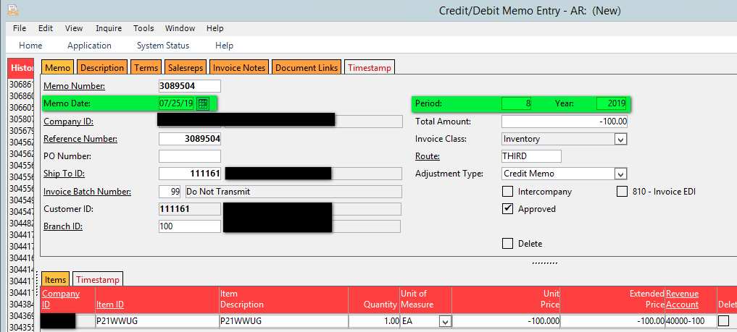
Sales history REPORT– why the difference?
Why is there a difference in the Sales History Report when you pull by Invoice Dates versus Periods?
Let’s use the Credit Memo below as a reference.
  Note that the Memo Date is 7/25/19 but it is posted in Period 8 (company is on Fiscal Year = Calendar Year)

Slide 17
Sales history REPORT– why the difference?
Why is there a difference in the Sales History Report when you pull by Invoice Dates versus Periods?
Drives Sales History Report by Invoice Date
Drives Sales History Report by Period

Slide 18
Sales history REPORT– why the difference?
Because we have a date mismatch between the Memo Date and the Period the Sales History report will be different when pulled by Invoice Date vs. Period.
  To see the Credit Memo you’d pull the Invoice Date range of 7/1/19-7/31/19 OR Period 8

Slide 19
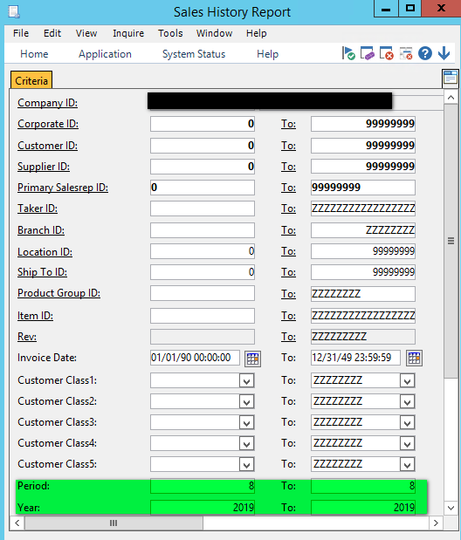
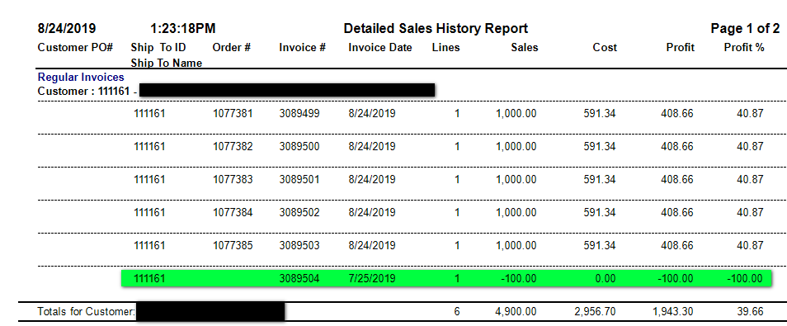
Sales history REPORT– why the difference?
Run the Sales History Report by Period.
The credit memo will show in period 8 because the period on the memo was set to 8:

Slide 20
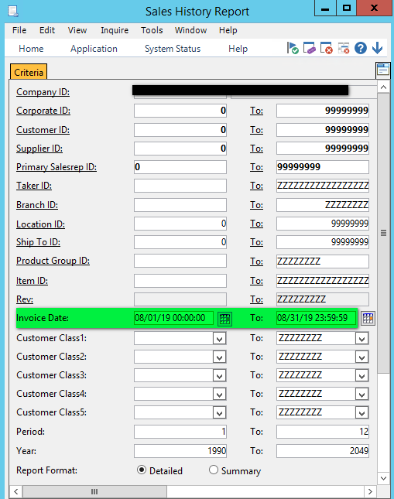
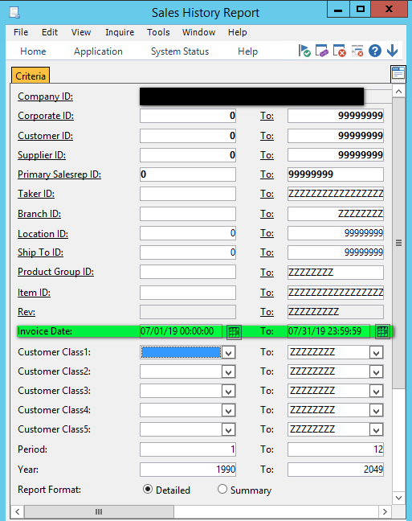
Sales history REPORT– why the difference?
Now, let’s run the Sales History Report by Invoice Date.
The credit memo will not show in the 8/1/19-8/31/19 date range because it was dated 7/25/19.
It will only show if the date range is set to 7/1/19-7/31/19.

Slide 21
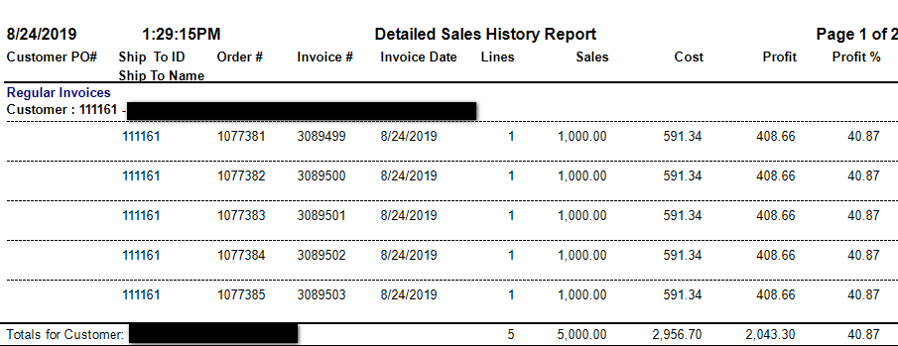
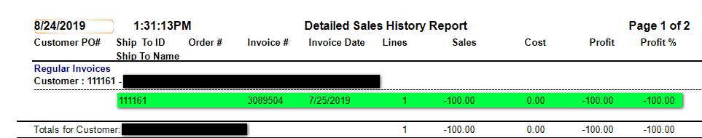
Sales history REPORT– why the difference?
The credit memo will not show in the 8/1/19-8/31/19 date range because it was dated 7/25/19:
It will show if the date range is set to 7/1/19-7/31/19:

Slide 22
Sales history REPORT– why the difference?
So, if we are looking at August Sales for this customer we have to define what we deem as “August” – Is it invoices with an August date? Or invoices posted to period 8 (August)?
  August Sales by Date = $5,000.00
  August Sales by Period = $4,900.00
  **I tend to define it as invoices posted to the period. This is because our GL and Financial Line Express Set-Up is defined by period.**
For the remainder of this class we will use the Sales History Report as our basis of analysis. We will create bridges from the Sales History Report to other reports so you can see how they all tie together.

Slide 23
SALES History – bridge to executive metrics and accounting view

Slide 24
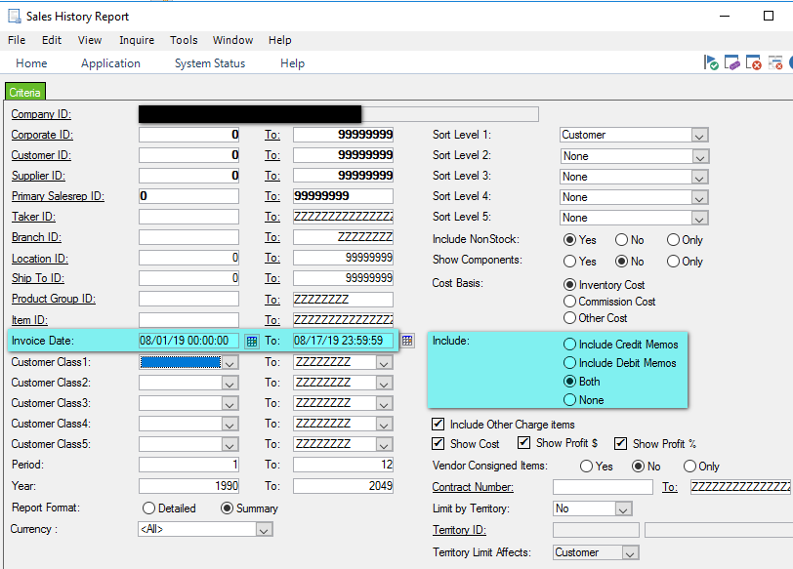
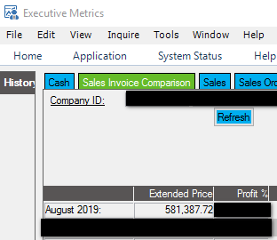
Sales history – bridge TO EXECUTIVE METRICS
Executive Metrics reflects the Sales History Report when pulled by a set of invoice dates:

Slide 25
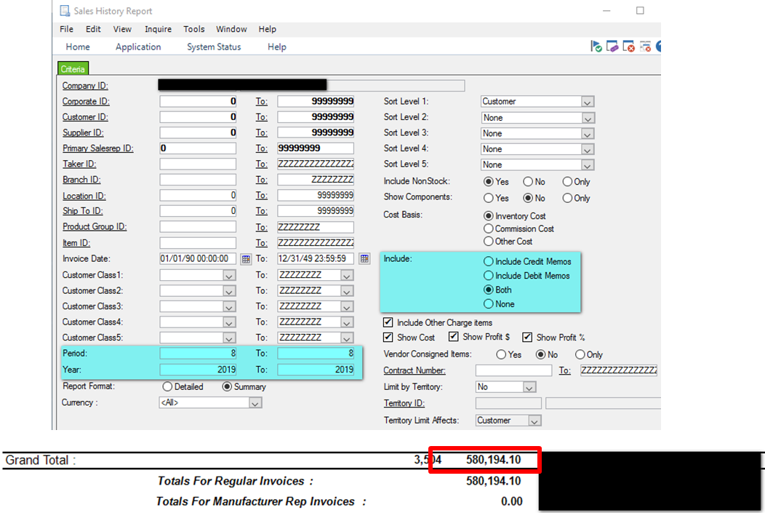
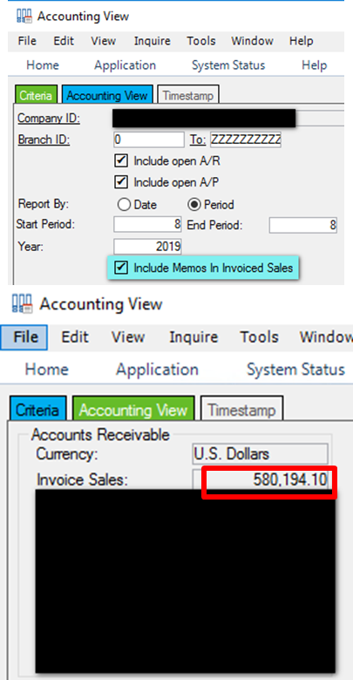
Sales numbers – bridge TO accounting view
Accounting View reflects the Sales History Report when pulled by period:

Slide 26
SALES History – bridge to general ledger

Slide 27
Sales numbers – TIE TO general ledger
Step #1: Pull the Sales History Report by Period. In this case we are pulling Period 8, 2019
  We need to pull by period because the GL is period based.
  Total Sales for tie out to the GL = $580,194.10

Slide 28
Sales numbers – TIE TO general ledger
Step #2: Pull the General Ledger Report at a Detail Level. This enables you to see the Journal ID for each transaction. Save in Excel and create a Pivot Table. Focus on Journal ID = “SJ”. Add the GL Accounts to the pivot, output will be similar to below:
These are sorted by the items that make up the Total A/R and Total Inventory.
Note that the “SJ” total = $0. This is because the GL shows all sides of a transaction. Since CR = DR the total is $0.

Slide 29
Sales numbers – TIE TO general ledger
Step #3: Isolate the accounts having to do with Item Sales, RMA’s, Credit Memos and Debit Memos. Remember that the Sales History Report does not include Sales Tax or Freight Revenue:
Also notice that we have two Credit Memos – one for Amazon Fees and one for a Marketing Allowance. While these are a part of the Sales History Report, they typically aren’t included as a part of “Total Sales” reported for the month.
Why does this matter?
  We can definitively show that we can bridge the Sales History report (all invoicing activity) to the General Ledger. Now we go one step further and pull in the other components of Sales.

Slide 30
bridge general ledger TO STATEMENT OF PROFIT & LOSS

Slide 31
Sales numbers – TIE TO general ledger
Step #1: Open Financial Line Express Setup. Enter the Report ID for your Statement of Profit & Loss. Enter the Period(s) on the OLE Criteria tab and OLE the spreadsheet.
  Note which lines comprise Total Revenue.

Slide 32
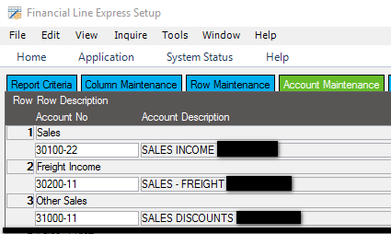
Sales numbers – TIE TO general ledger
Step #2: Now we find what accounts make up each line of Sales, Freight Income and Other Sales.
  Click on the Account Maintenance Tab.
  Notate these accounts and go back to your GL Report (at Detail Level)

Slide 33
Sales numbers – TIE TO general ledger
Step #3: Open the GL Report you previously pulled. Focus on the accounts that comprise Total Revenue. The sum of the account(s) will match each line of Total Revenue. Add on the Journal ID to see what Journal ID’s comprise the total balance of each account:
There can be other types of transactions that hit in the “Revenue” accounts. In this case there is a “GJ” – General Journal (manual entry) and “CR” – Cash Receipt (generated from the Cash Receipt window). These all affect the Total Revenue/Sales for the month.

Slide 34
Pulling it all together

Slide 35
Pulling it all together
1. Difference is invoices posted in periods other than August
3. Total Sales is comprised of invoicing activity + all other transactions posted to defined revenue accounts
2. Invoices post across multiple P&L categories, beyond Sales

Slide 36
Pulling it all together

Slide 37
Questions???

Slide 38
  Stacy Cline
  Cline Financial Services, LLC stacy@clinefinancialservices.com www.clinefinancialservices.com
  970-744-0206

