Slide 1
Accounting:
Connecting the Dots
Stacy Cline
Cline Financial Services, LLC

Slide 2
Session title
Stacy Cline
Cline Financial Services, LLC
970-744-0206
stacy@clinefinancialservices.com
www.clinefinancialservices.com
CONNECT 2018 – August 19-21

Slide 3
Prophet 21 World Wide User Group Officers
President
Sam Snow
VP
T. J. Snow Company, Inc.
Vice President of Finance
Tim Edmunds
Chief Financial Officer
TSI Solutions
Vice President of Marketing and Education
Mike Chadwick
Director of Information Technology
T. J. Snow Company, Inc.
Vice President of Operations
Ted Hoffman
Senior Business Analyst and IT Infrastructure
Utility Supply and Construction
Vice President of Member Relations
Eric Lunsford
President
Pye-Barker Engineered Solutions

Slide 4
Disclaimer
This conference is an attempt by P21WWUG members to assist each other by demonstrating ways that we utilize the Prophet21 system and other related products.
The P21WWUG and the individuals conducting the classes and round tables take no responsibility for potential issues that arise as a result of taking the advice given during the conference.
The P21WWUG does not recommend using any SQL statements to update your database without having those statements first reviewed by Epicor or other experienced SQL professionals. Test any code in your Play Database!
Using SQL statements to update your database may result in corrupting your database. Test any code in your Play Database!

Slide 5
AGENDA
Introduction/Bio
Sales Order to Cash Cycle
    Sales Order to Cash (no cash drawer)
    Sales Order to Cash (with cash drawer)
    RMA to Cash
Purchase Order to Cash Cycle
    Purchase Order to Cash (no landed cost)
    Purchase Order to Cash (with landed cost)
So What Matches What?!?
Q&A

Slide 6
BIO
  Worked in corporate finance for eight years, running financial budget/plan, monthly close, reporting, etc. of $500M service offering
  Independent consultant for five years
    End user of Prophet 21 for four years
  Specialize in Finance & Accounting practices and procedures, EDI implementation, project management and identifying areas of efficiency and cost savings
  Stacy Cline
  Cline Financial Services, LLC
  stacy@clinefinancialservices.com
  www.clinefinancialservices.com
  970-744-0206

Slide 7
Sales Order to Cash Cycle*:
#1: Sales Order Entry
#2: Pick Ticket
#3: Ship Confirmation (creates invoice)
#4: Invoice sent to Customer
#5: Cash Receipt
#6: Reconcile Cash Detail/Bank Reconciliation
*Not using a cash drawer

Slide 8
Sales Order to Cash Cycle:
#1: Sales Order Entry
#2: Pick Ticket
#3: Ship Confirmation (creates invoice)
#4: Invoice sent to Customer
#5: Cash Receipt
#6: Reconcile Cash Detail/Bank Reconciliation
Open Order Report
Pick Tickets Report
A/R:
Aged Trial Balance Report
Inventory:
Inventory Value Report
Invoice Report or Generate Customer Statements Report
Cash Receipts History &
Deposit Slips Report
Reconcile Cash Detail
No Subledger Activity
Inventory subledger allocates items, no value change
Accounts Receivable Subledger debited for invoice
Inventory Subledger credited for items
No Subledger Activity
Accounts Receivable subledger credited for invoice
No Subledger Activity
No GL Activity
No GL Activity
A/R GL Account Debited
Inventory GL Account Credited
No GL Activity
A/R GL Account Credited, Cash Account Debited
No GL Activity

Slide 9
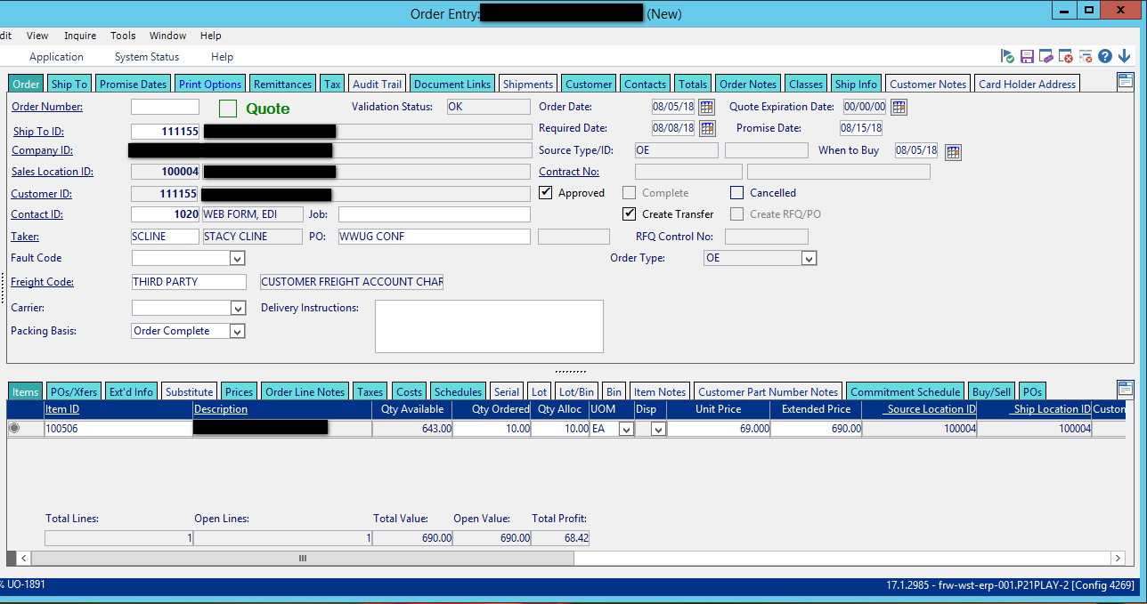
Sales Order to Cash Cycle - Transactions
Example: Customer places an order for 10 units of 100506.
  Step #1: Order is entered into P21, saved and assigned order #1050838
    Orders – Order Processing – Reports – Open Orders Report
    No GL Transactions made
  Step #2: Pick Ticket is Printed and assigned Pick Ticket #2050496
    Pick Tickets Report (generates pick tickets on a schedule) or Pick Ticket is generated from the Print Options/Front Counter Tab
    Inventory Value Report now shows the Item Qty as “Allocated” instead of “Available”, but the value remains the same

Slide 10
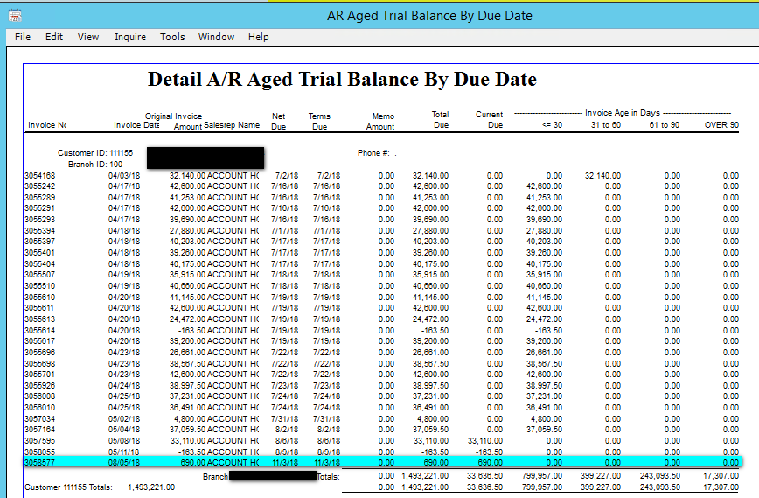
Sales Order to Cash Cycle - Transactions
Example: Customer places an order for 10 units of 100506.
  Step #3: Utilizing the pick ticket, order is 100% fulfilled and ship confirmed, generating invoice #3058577.
    Order Processing – Orders – Transaction - Shipping
    Aged Trial Balance Report (Accounting – Accounts Receivable – Reports – Aged Trial Balance) now reflects invoice. It will remain there until the Cash Receipt is completed
    GL Account: Accounts Receivable Debited

Slide 11
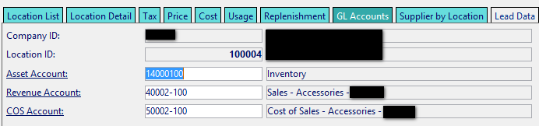
Sales Order to Cash Cycle - Transactions
Example: Customer places an order for 10 units of 100506.
  Step #3 (continued): Utilizing the pick ticket, order is 100% fulfilled and ship confirmed, generating invoice #3058577.
    GL Transactions are as follows:
      The combination of the Sales Location and the Item derives the GL accounts hit for Sales, COS and Inventory. This is found in Item Maintenance (Inventory - Inventory Management – Maintenance – Item Maintenance) on the GL Accounts tab (line level):
Account | Debit | Credit
Sales – 40002-100 |  | $690.00
Accounts Receivable – 13000-100 | $690.00
Cost of Sales – 50002-100 | $217.90
Inventory – 14000-100 |  | $217.90

Slide 12
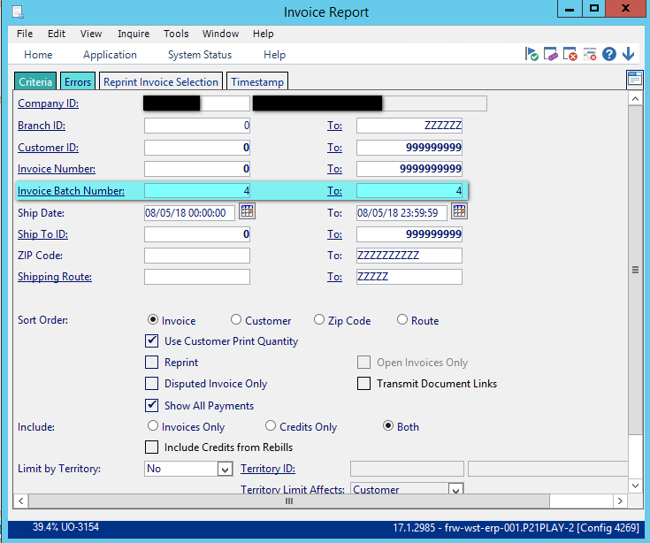
Sales Order to Cash Cycle - Transactions
Example: Customer places an order for 10 units of 100506.
  Step #4: Invoice Report (Accounting – Accounts Receivable – Reports – Invoice Report) is run and Invoice sent to Customer. Be aware of whether invoices should be emailed, mailed, faxed or sent via EDI. Run in individual batches.
  No GL Transactions

Slide 13
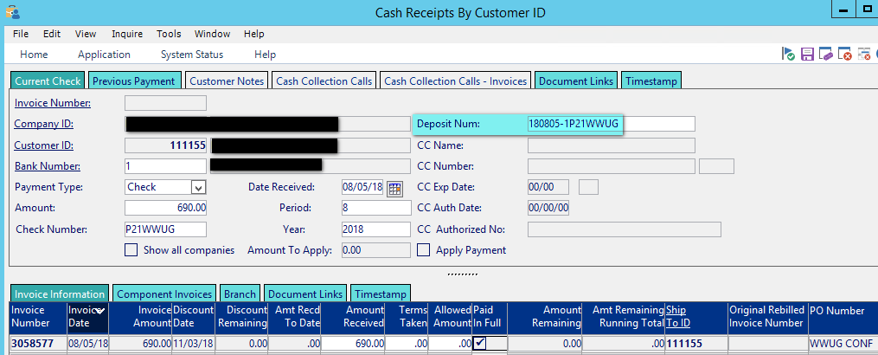
Sales Order to Cash Cycle - Transactions
Example: Customer places an order for 10 units of 100506.
  Step #5: Cash Receipt is completed.
    This step removes the invoice from A/R and deposits it into cash. The “Deposit Num” field determines what shows up in Reconcile Cash Detail. The Cash Receipt should match the bank deposit 1:1
    GL Transactions are as follows:
Account | Debit | Credit
Cash – 11000-100 | $690.00
Accounts Receivable – 13000-100 |  | $690.00

Slide 14
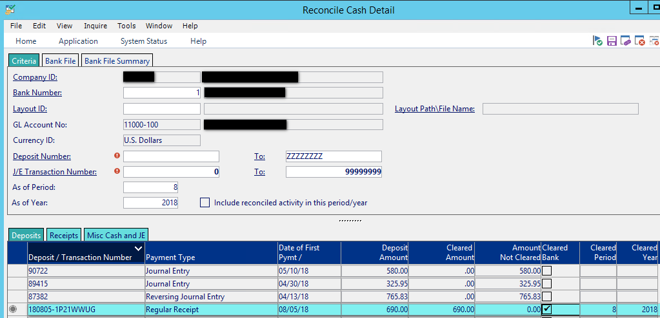
Sales Order to Cash Cycle - Transactions
Example: Customer places an order for 10 units of 100506.
  Step #6: Reconcile Cash Detail/Bank Reconciliation
    Reconcile Cash Detail (Accounting – Accounts Receivable – Transaction – Reconcile Cash Detail) pulls up all outstanding deposits in P21. Clearing the deposit in Reconcile Cash Detail let’s P21 know that the deposit is not outstanding. This enables you to use the Bank Reconciliation at worksheet at month end.

Slide 15
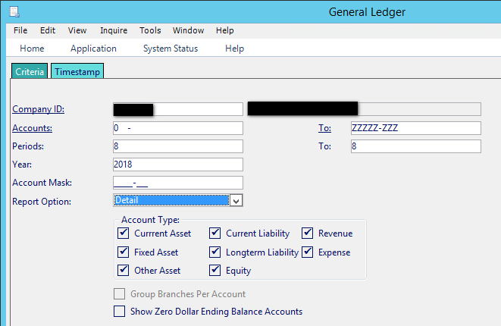
Sales Order to Cash Cycle - Transactions
Example: Customer places an order for 10 units of 100506.
  How do we verify what actually happened in the GL?
    Run the General Ledger Report (Accounting – General Ledger – Reports – General Ledger) for the period of the transaction, at a Detail level.

Slide 16
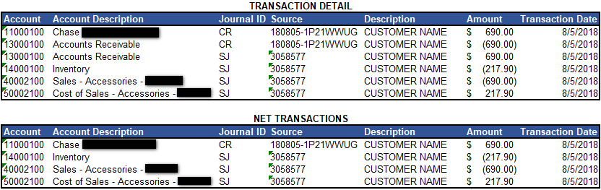
Sales Order to Cash Cycle - Transactions
Example: Customer places an order for 10 units of 100506.
  How do we verify what actually happened in the GL?
    Right click on the report, select Services, then Save As. Save as an Excel File with Headers
    Journal ID: designates the source of the transaction.
      SJ: Sales Journal – originating from a sales order
      CR: Cash Receipt – originating from the cash receipts function
    Source: identifies the invoice number and the cash receipt Deposit Number
    Research originating from the GL enables you to identify transactions to research, and utilizing the combination of the Journal ID, Source and Description you can then utilize the A/R drilldown or the Order Entry screen to drill into transactions

Slide 17
Sales Order to Cash Cycle: Cash Drawer
#1: Sales Order Entry
#3: Pick Ticket
#4: Ship Confirmation (creates invoice)
#5: Cash Receipt – System Generated
#6: Reconcile Cash Detail/Bank Reconciliation
#2: Remit Payment at Time of Order Entry
Open Deferred Revenue
Example: Customer places an order for 5 units of 100171.
  Accepting Remittance at time of order alters the Order to Cash Cycle slightly. It accounts for the cash receipt at the time of order entry, placing the received funds into Deferred Revenue (credit) and Cash (debit). The deposit number to cash is system generated, YYMMDD-Bank Number. It is available to clear when the cash drawer is closed.
  The received funds will show on the Deferred Revenue Report until the order is ship confirmed/invoiced.
Deferred Revenue Subledger Credited
GL Deferred Revenue Credited, Cash Debited

Slide 18
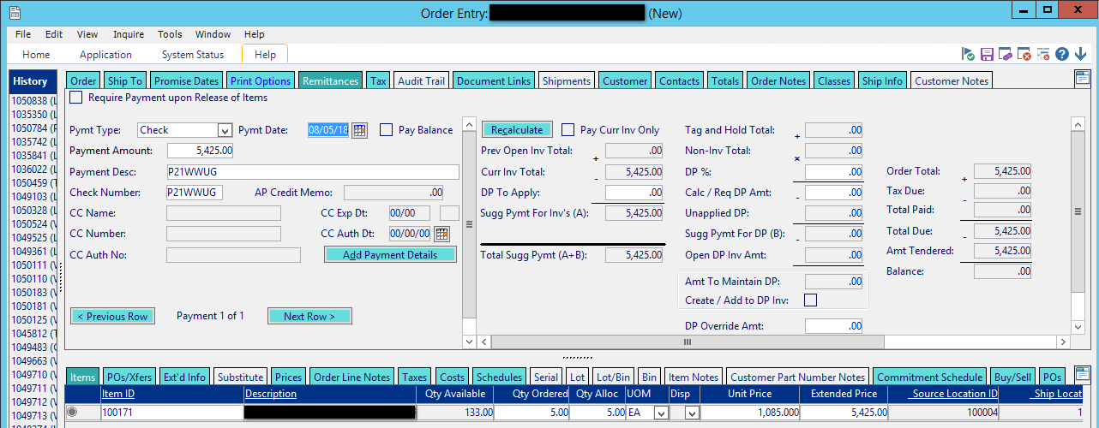
Sales Order to Cash Cycle – Cash Drawer
Example: Customer places an order for 5 units of 100171.
  Order is entered, payment is accepted on the “Remittance” tab:
  Order is saved, #1050839

Slide 19
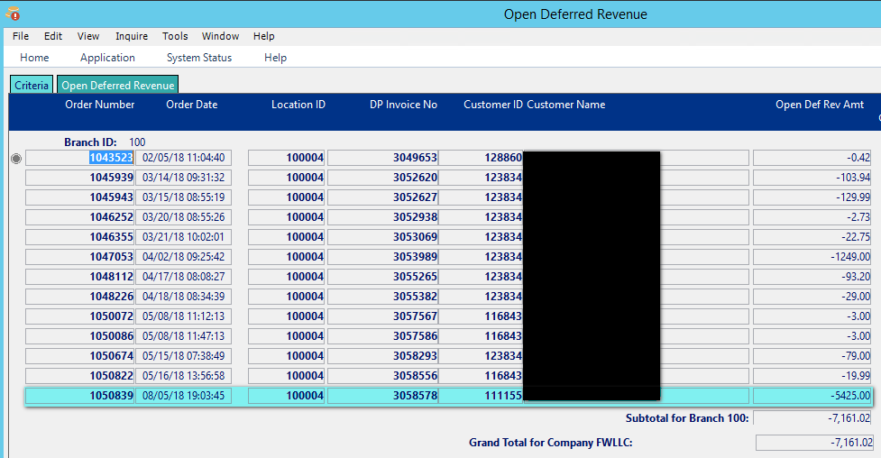
Sales Order to Cash Cycle – Cash Drawer
Example: Customer places an order for 5 units of 100171.
  Payment Remittance shows on the Open Deferred Revenue screen (Accounting – Accounts Receivable – Inquiry – Open Deferred Revenue)
    Enter Location(s) and Retrieve:

Slide 20
Sales Order to Cash Cycle – Cash Drawer
Example: Customer places an order for 5 units of 100171. Order is Ship Confirmed/Invoiced in P21.
  GL Transactions:

Slide 21
Sales Order to Cash Cycle: RMA
#1: RMA Entry
#2: RMA Receipt
#4: Reconcile Cash Detail/Bank Reconciliation
#3: Cash Receipt
Open RMA Report
A/R:
Aged Trial Balance Report
Inventory:
Inventory Value Report
Cash Receipts History &
Deposit Slips Report
Reconcile Cash Detail
No Subledger Activity
Accounts Receivable Subledger credited for invoice
Inventory Subledger debited for items
Accounts Receivable subledger debited for invoice
No Subledger Activity
No GL Activity
A/R GL Account Credited
Inventory GL Account Debited
A/R GL Account Debited, Cash Account Credited
No GL Activity

Slide 22
Sales Order to Cash Cycle – RMA
Example: Customer returns two units of 100506. RMA number is 1050840. The goods are received back in the warehouse, RMA receipt is completed and Cash Receipt completed for the RMA.
  GL Transactions:

Slide 23
Purchase Order to Cash Cycle*:
#1: Purchase Order Entry
#2: Purchase Order Receipt
#3: Convert PO to Voucher
#4: Check Issued
#5: Reconcile Disbursements /Bank Reconciliation
*Not using landed cost

Slide 24
Purchase Order to Cash Cycle:
#1: Purchase Order Entry
#2: Purchase Order Receipt
#3: Convert PO to Voucher
#4: Check Issued
#5: Reconcile Disbursements /Bank Reconciliation
Open POs Report
Unvouchered POs Report
Inventory Value Report
AP Trial Balance
Check Register
Reconcile Disbursements
No Subledger Activity
Inventory subledger debited for items
Accounts Payable Subledger credit for invoice
Accounts Payable subledger debited for invoice
No Subledger Activity
No GL Activity
Inventory GL Account Debited, Inventory Receipts Clearing Account Credited
Accounts Payable credited, Inventory Receipts Clearing Account Debited
A/P GL Account Debited, Cash Account Credited
No GL Activity

Slide 25
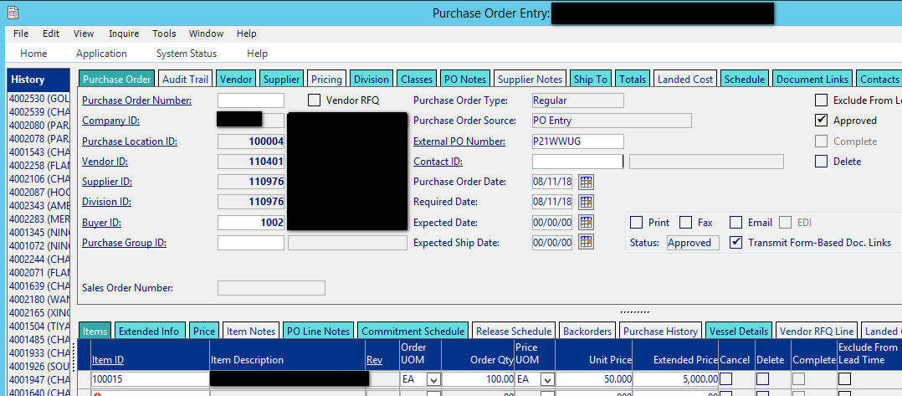
Purchase Order to Cash Cycle - Transactions
Example: Company places a purchase order for 100 units of 100015.
  Step #1: Purchase Order is entered into P21, saved and assigned purchase order #4002922
    Inventory – Purchasing – Reports – Open POs

Slide 26
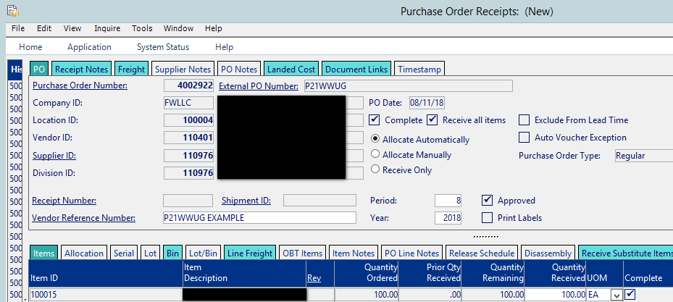
Purchase Order to Cash Cycle - Transactions
Example: Company places a purchase order for 100 units of 100015.
  Step #2: Inventory is received from Supplier into the warehouse
    Inventory – Inventory Management – Transaction – Purchase Order Receipts

Slide 27
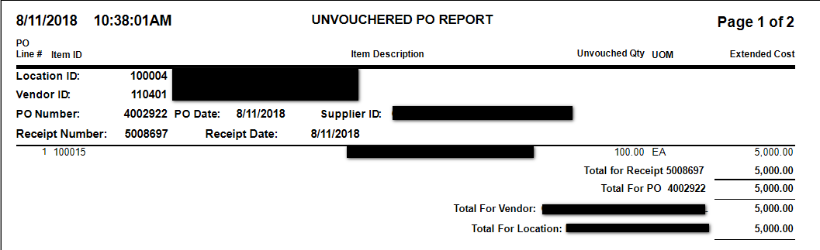
Purchase Order to Cash Cycle - Transactions
Example: Company places a purchase order for 100 units of 100015.
  Step #2 (continued): Inventory is received from Supplier into the warehouse
    Value has increased on the Inventory Value Report
    Unvouchered PO report shows value until the voucher from the supplier is matched to the PO
      Accounting – Accounts Payable – Reports – Unvouchered POs

Slide 28
Purchase Order to Cash Cycle - Transactions
Example: Company places a purchase order for 100 units of 100015.
  Step #2 (continued): Inventory is received from Supplier into the warehouse
    GL Transactions:
Account | Debit | Credit
Inventory | $5,000.00
Inventory Receipts Clearing |  | $5,000.00

Slide 29
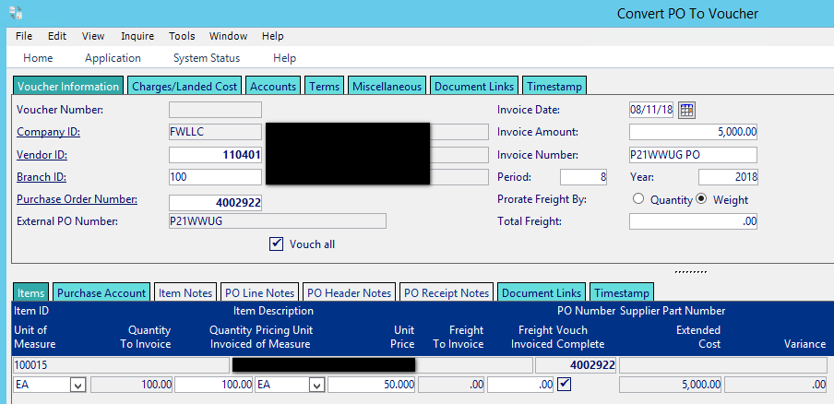
Purchase Order to Cash Cycle - Transactions
Example: Company places a purchase order for 100 units of 100015.
  Step #3: Convert PO to Voucher
    Accounting – Accounts Payable – Transaction – Convert PO to Voucher

Slide 30
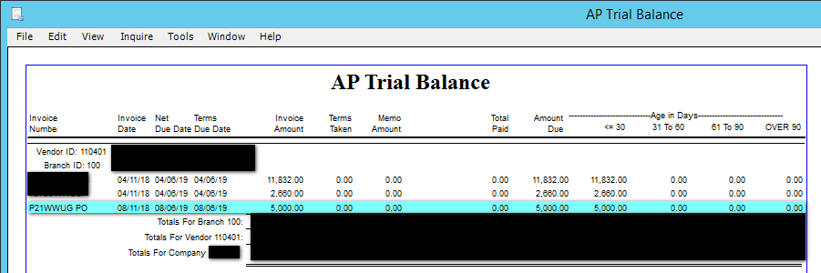
Purchase Order to Cash Cycle - Transactions
Example: Company places a purchase order for 100 units of 100015.
  Step #3 (continued): Convert PO to Voucher
    Accounting – Accounts Payable – Reports – AP Trial Balance
      Clears transaction from Unvouchered PO Report, moves it to AP Trial Balance Report
    GL Account: Accounts Payable Credited, Inventory Receipts Clearing Debited
Account | Debit | Credit
Inventory Receipts Clearing | $5,000.00
Accounts Payable |  | $5,000.00

Slide 31
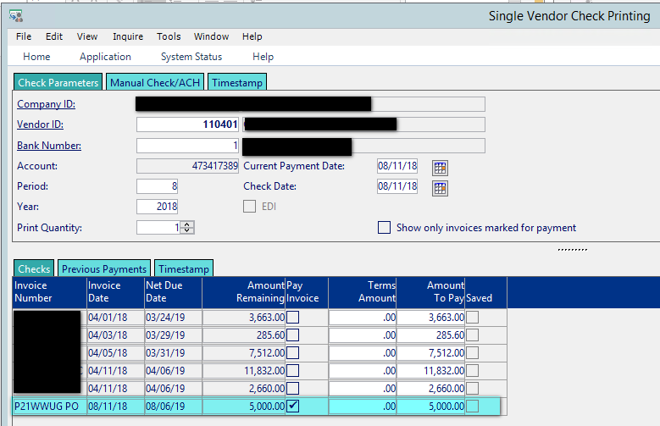
Purchase Order to Cash Cycle - Transactions
Example: Company places a purchase order for 100 units of 100015.
  Step #4: Check Issued
    Accounting – Accounts Payable – Reports – Checks (either Scheduled Checks or Single Vendor Checks)
    GL Transactions: A/P is debited, Cash is credited
Account | Debit | Credit
Accounts Payable | $5,000.00
Cash |  | $5,000.00

Slide 32
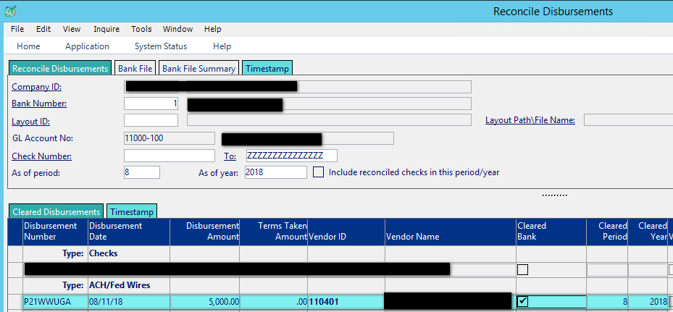
Purchase Order to Cash Cycle - Transactions
Example: Company places a purchase order for 100 units of 100015.
  Step #5: Reconcile Disbursements/Bank Reconciliation Worksheet
    Accounting – Accounts Payable – Reports – Checks (either Scheduled Checks or Single Vendor Checks)
    No GL Transactions

Slide 33
Sales Order to Cash Cycle - Transactions
Example: Customer places an order for 100 units of 100015.
  How do we verify what actually happened in the GL?
    Run the General Ledger Report (Accounting – General Ledger – Reports – General Ledger) for the period of the transaction, at a Detail level.

Slide 34
Sales Order to Cash Cycle - Transactions
Example: Customer places an order for 100 units of 100015.
  How do we verify what actually happened in the GL?
    Right click on the report, select Services, then Save As. Save as an Excel File with Headers
    Journal ID: designates the source of the transaction.
      IR: Inventory Receipts – originating from the Purchase Order Receipts function
      PJ: Purchase Journal – originating from the Convert PO to Voucher function
      CD: Cash Disbursement – originating from the Checks (Scheduled Payment or Single Vendor)
    Source: identifies the Inventory Receipt (5008697), Voucher (6019389) and the Check (P21WWUGA)
    Research originating from the GL enables you to identify transactions to research, and utilizing the combination of the Journal ID, Source and Description you can then utilize the A/R drilldown or the Order Entry screen to drill into transactions

Slide 35
Purchase Order to Cash Cycle: Landed Cost
#1: Purchase Order Entry
#3: Purchase Order Receipt
#4: Convert PO to Voucher
#6: Check Issued
#7: Reconcile Disbursements /Bank Reconciliation
#2: Enter Landed Cost on PO
#5: Convert Landed Cost to Voucher
Unvouchered Landed Cost Report
Inventory Value Report
AP Trial Balance
Inventory subledger debited for items
Accounts Payable Subledger credit for invoice
Inventory GL Account Debited, Landed Cost Clearing Account Credited
Accounts Payable credited, Inventory Receipts Clearing Account Debited

Slide 36
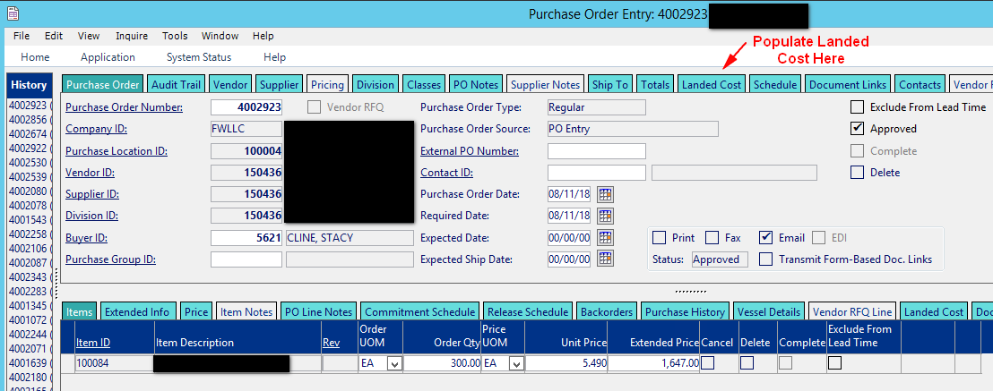
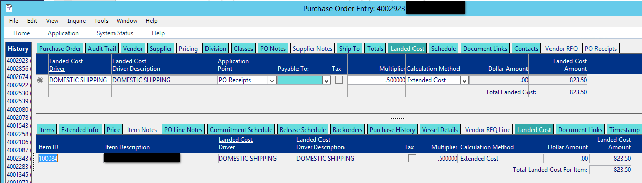
Sales Order to Cash Cycle - Transactions
Example: Customer places an order for 300 units of 100084. They add Landed Cost Drivers on the PO to capture inbound expense.
  Step #1: Purchase Order Entry
  Step #2: Enter Landed Cost for the PO

Slide 37
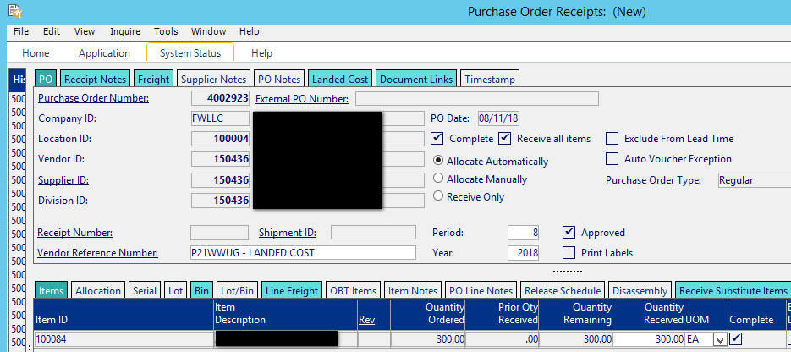
Purchase Order to Cash Cycle - Transactions
Example: Company places a purchase order for 300 units of 100084.
  Step #3: Inventory is received from Supplier into the warehouse
    Inventory – Inventory Management – Transaction – Purchase Order Receipts

Slide 38
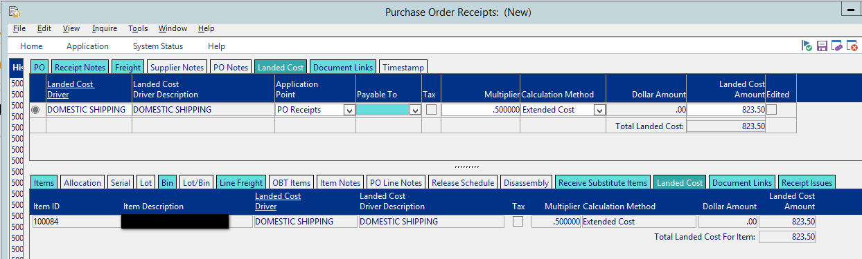
Purchase Order to Cash Cycle - Transactions
Example: Company places a purchase order for 300 units of 100084.
  Step #3 (continued): Inventory is received from Supplier into the warehouse
    Completing the Purchase Order Receipt automatically receives the Landed Cost. After the Purchase Order Receipt is saved Landed Cost and the Purchase Order become two separate transactions
    Landed Cost can be edited in the Purchase Order Receipts Window

Slide 39
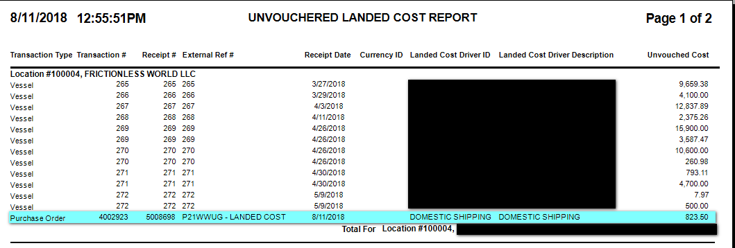
Purchase Order to Cash Cycle - Transactions
Example: Company places a purchase order for 300 units of 100084.
  Step #3 (continued): Inventory is received from Supplier into the warehouse
    Value has increased on the Inventory Value Report
    Unvouchered PO report shows value until the voucher from the supplier is matched to the PO
    Unvouchered Landed Cost report shows value of the inbound expenses until the voucher from the inbound supplier is matched to the PO

Slide 40
Purchase Order to Cash Cycle - Transactions
Example: Company places a purchase order for 300 units of 100084.
  Step #3 (continued): Inventory is received from Supplier into the warehouse
    GL Transactions:
  Step #4: Convert PO to Voucher (same process as previous example)
Account | Debit | Credit
Inventory | $2,470.50
Inventory Receipts Clearing |  | $1,647.00
Landed Cost Clearing |  | $ 823.50

Slide 41
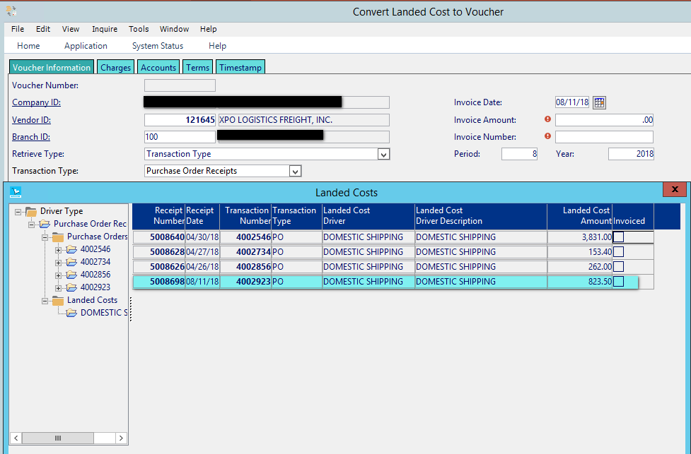
Purchase Order to Cash Cycle - Transactions
Example: Company places a purchase order for 300 units of 100084.
  Step #5: Convert Landed Cost to Voucher:
    Accounting – Accounts Payable – Transaction – Convert Landed Cost to Voucher
    The Vendor ID here is the Vendor that you’re paying for the inbound expense.

Slide 42
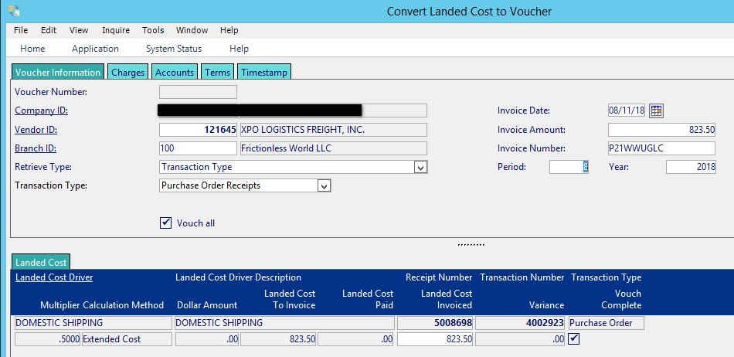
Purchase Order to Cash Cycle - Transactions
Example: Company places a purchase order for 300 units of 100084.
  Step #5 (continued): Convert Landed Cost to Voucher:
  Steps #6-7: Same as prior example

Slide 43
Purchase Order to Cash Cycle - Transactions
Example: Company places a purchase order for 300 units of 100084.
  GL Transactions

Slide 44
So What Matches What?!?

Slide 45
So What Matches What?!?
You should always be aware of what reports (subledgers) and GL accounts tie together, keeping the balances in sync will ensure accurate transactions and reporting:
Account | Account Description | Report
14020-100 | Inventory | Inventory Value
14004-100 | Inventory in Vessel | Vessel Report
13000-100 | Accounts Receivable | Aged Trial Balance
11000-100 | Cash | Reconcile Cash Detail & Reconcile Disbursement feed the Bank Reconciliation Worksheet (ties out cash)
22200-100 | Deferred Revenue | Open Deferred Revenue (may need to add in Store Credits)
20010-100 | Accounts Payable | AP Trial Balance
20100-100 | Inventory Receipts Clearing | Unvouchered PO
20190-100 | Landed Cost Clearing | Unvouchered Landed Cost
20130-100 | RMA Receipts Clearing | Open RMAs (run as ONLY)

Slide 46
So What Matches What?!?
Non GL Reports
Action | Report
Order Entry | Open Orders
RMA Entry | Open RMAs
Purchase Order Entry | Open POs

Slide 47
Questions?

Slide 48
  Stacy Cline
  Cline Financial Services, LLC
  stacy@clinefinancialservices.com
  www.clinefinancialservices.com
  970-744-0206

