Slide 1
Prophet 21 World Wide User Group Webinars
Cash Drawers: Part 2
Presented by: Stacy Cline
Cline Financial Services, LLC

Slide 2
P21 Worldwide User Group Officers
President
Sam Snow Information Technology Manager, T. J. Snow Company, Inc.
Vice President of Finance
Brian Williams Director of Information Technology, Industrial Supply Company
Tim Edmunds
CFO, TSI Solutions
Vice President of Marketing and Education
Mike Chadwick Director of Information Technology, T. J. Snow Company, Inc
Vice President of Operations
Ted Hoffman
Supply Chain Analyst, Utility Supply and Construction
Vice President of Member Relations
Eric Lunsford
Vice President Sales & Marketing, Pye-Barker Supply Co., Inc.

Slide 3
P21WWUG Annual Dues Invoices 2018
2018 P21WWUG Annual Dues Invoices have now been sent out via email.
Annual dues for 2018 are $500 per company, however, if you choose to pay this invoice prior to January 31, 2018 please apply a discount of $150 to your payment. If you are either the billing or primary contact at your company and you did not receive your invoice, let me know via email -cheryl@p21ww.org.

Slide 4
SAVE THE DATE CONNECT 2018
August 19-21, 2018
Crystal Gateway Marriott
Planning is already underway!
If you have session suggestions or want to teach, please contact: Cheryl@p21ww.org

Slide 5
Disclaimer
This webinar is an attempt by P21WWUG members to assist each other by demonstrating ways that we utilize the Prophet21 system and other related products.
The P21WWUG and the individuals conducting these webinars take no responsibility for potential issues that arise as a result of taking the advice given during the session.
The P21WWUG does not recommend using any SQL statements to update your database without having those statements first reviewed by Epicor or other experienced SQL professionals.
Using SQL statements to update your database may result in corrupting your database

Slide 6
For more information
Cheryl Richardson
P21WWUG Administrator
cheryl@p21ww.org
Telephone: 888-553-5354

Slide 7
Agenda
Introduction/Bio
Cash Drawers – Part 1 Review
Cash Drawers – Part 2
When a Cash Drawer is involved in an order
Customer Maintenance Configurations
Difference between Front Counter Orders and Orders
Entering an order utilizing a cash drawer:
Will Call
Payment Required Upon Release of Items
Downpayment
Entering an RMA utilizing a cash drawer
Relationship between Cash Drawers and Payment Types
Other cash drawer applications

Slide 8
Bio
Worked in corporate finance for eight years, running financial budget/plan, monthly close, reporting, etc. of $500M service offering
Independent consultant for four years
End user of Prophet 21 for three years
Specialize in Finance & Accounting practices and procedures, P21 system processes and procedures to improve efficiency and EDI Project Management
Stacy Cline
Cline Financial Services, LLC
stacy@clinefinancialservices.com
970-744-0206

Slide 9
Cash Drawers – Part 1 Review
In Part 1 we covered:
Definition of a cash drawer
Configuring Payment Types
Assigning Users to a Cash Drawer
Opening and Closing a Cash Drawer
Cash Drawer Detail Reports

Slide 10
Cash Drawers – Part 1 Review
Cash Drawer:
Used to track money collected by a front counter cashier, customer service representative, etc. A company may have one or multiple drawers depending on the business structure
A cash drawer does not reflect any payments received by ACH, wire transfer, mailed in checks, etc.
A cash drawer must exist and be open to receive front counter remittances (cash, check or credit card)
A cash drawer must be closed to create a deposit in P21
Payment Type:
Payment types tell P21 how to group transactions together. An effective configuration enables a much simpler reconciliation process
Users:
Users are assigned to a cash drawer. A user cannot use a cash drawer if they are not assigned to it, or if they have a different drawer open

Slide 11
When a Cash Drawer is involved in an Order
An order can be processed through Front Counter Orders or Order Entry without a cash drawer involved.
A cash drawer is only involved in an order when the Remittances tab is used, i.e. you are receiving payment (cash/check/credit) related to the order.
If an order is invoiced without payment remitted (creating a receivable) then any payment remitted against that invoice will not be a part of a cash drawer.

Slide 12
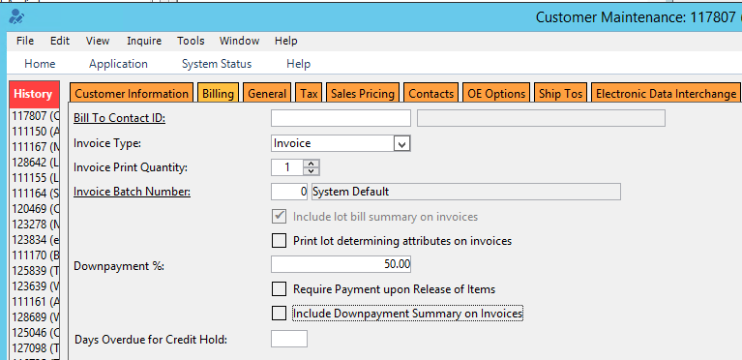
Customer Maintenance Configurations
Billing Tab:
Downpayment %: Requires the customer to remit a % of payment for items on backorder
Require Payment upon Release of Items: requires the customer to pay in full before an order can be shipped/released
Include Downpayment Summary on Invoices: prints a summary of all downpayment activity on customer invoices

Slide 13
Front Counter Orders vs. Orders
Difference between Front Counter Orders and Orders per Prophet 21 Help
“The Front Counter Order Entry window in Order Processing is used to enter customer orders placed in a showroom or at your front counter or when the material being purchased is taken by the customer at that time.
The primary difference between the Front Counter window and the Order Entry window lies in the calculation of sales tax. In regular Order Entry, the system uses the customer’s Ship To Location tax group. That is, if the customer is taxable, the taxes are charged based on the physical location of the customer receiving the ordered material.
In Front Counter Order Entry, if the customer is taxable, the system looks at the Sales Location tax group then the customer’s Ship To Location tax group. If the Sales Location and Ship To Locations share a common tax jurisdiction, tax is applied to the order if the taxable check box is active for the common jurisdiction at the Ship To Location. This is because if the customer’s Ship To Location is tax exempt, the exemption has to apply if the customer picks up the order at the Sales Location, or the material is shipped to the customer’s Ship To Location.”

Slide 14
Entering Orders Utilizing Cash Drawers

Slide 15
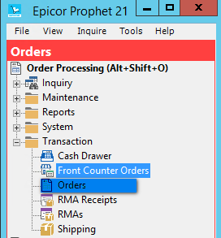
Front Counter Order Entry
Cash Drawer orders can be entered through “Front Counter Orders” or “Orders”
Orders – Order Processing – Transaction – Front Counter Orders/Orders

Slide 16
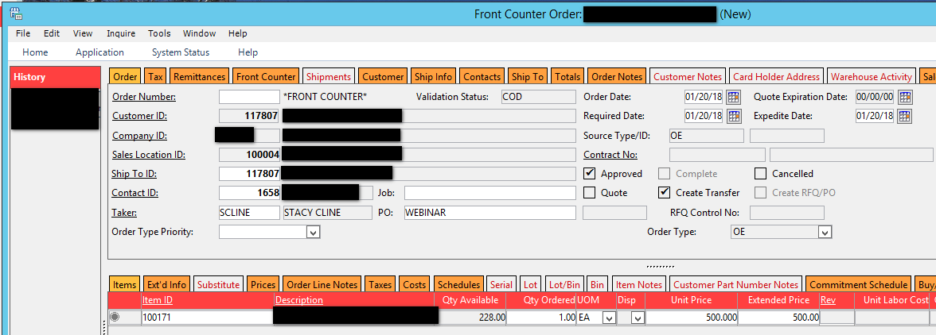
Front Counter Order Entry
Open Front Counter Orders. Enter Order information:
Customer ID
Ship To ID
Contact ID
PO
Items
Etc.

Slide 17
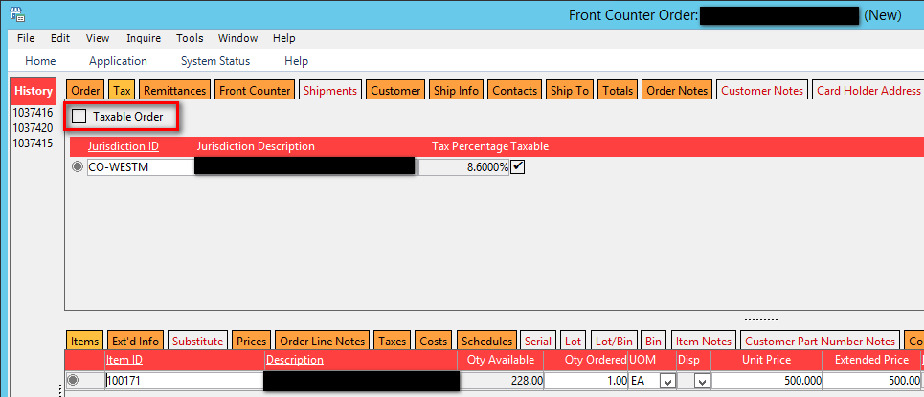
Front Counter Order Entry
Click on the Tax Tab. Select the box for “Taxable” if the order is taxable. Ensure the Jurisdiction ID is correct.

Slide 18
Front Counter Order Entry
Remittances Tab: Here’s where you make the decisions about how the order will be paid for. Some options are:
Require Payment upon Release of Items: use this checkbox if you are not remitting payment in full at time of order entry, but you want payment in full before the order ships.
Add Payment Details: enables multiple payment types (ex. $100 cash and $443 check). You enter one payment type and the amount, press the box to “Add Payment Details” and remit the next payment
Pay Balance: when checked calculates the total amount outstanding on the order for remittance
Previous Row/Next Row: enables you to flip back and forth to view each of multiple payments individually
DP%: automatically populates if required for customer and one or more of the items is on backorder or special order. This is maintained in Customer Maintenance (Billing Tab) or can be entered manually on the remittances tab.

Slide 19
Base Case (Will Call)
Scenario: Customer places order and pays for it immediately with cash (Will Call):
Select Pymt Type = Cash
Enter Payment Amount OR select the box to Pay Balance. Ensure the Balance Box (bottom right) = $0

Slide 20
Base Case (Will Call)
Click on the Front Counter tab
Select the box to “Create Invoice” and save the order.
Since we have remitted payment in full there is no open A/R for the customer and the amount will show in the bank account associated with the cash drawer when the cash drawer is closed.
If you re-open the order you can click on the shipments tab to see the pick ticket and invoice that were generated.

Slide 21
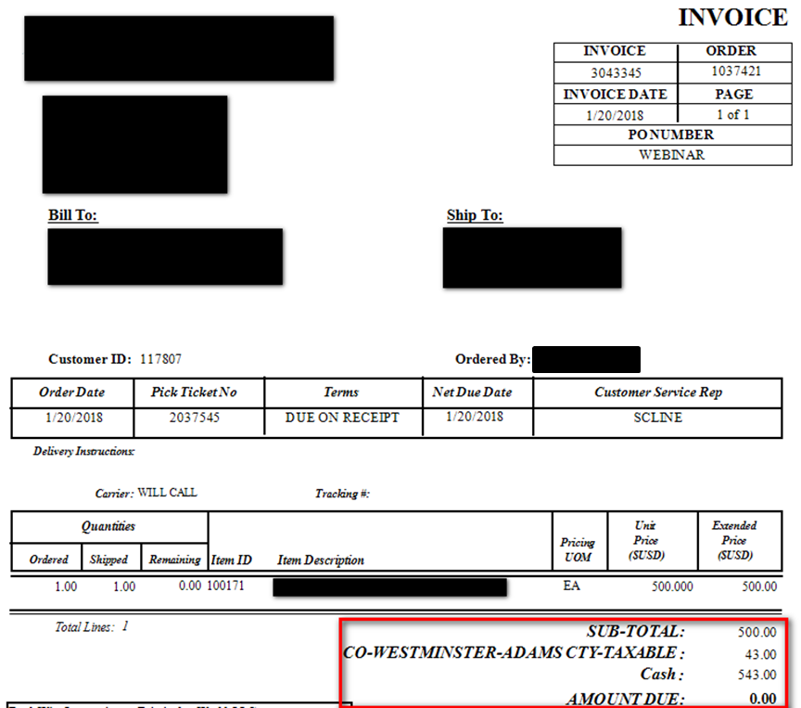
Base Case (Will Call)
If you pull up the invoice you will see the payment type at the bottom and an AMOUNT DUE = $0

Slide 22
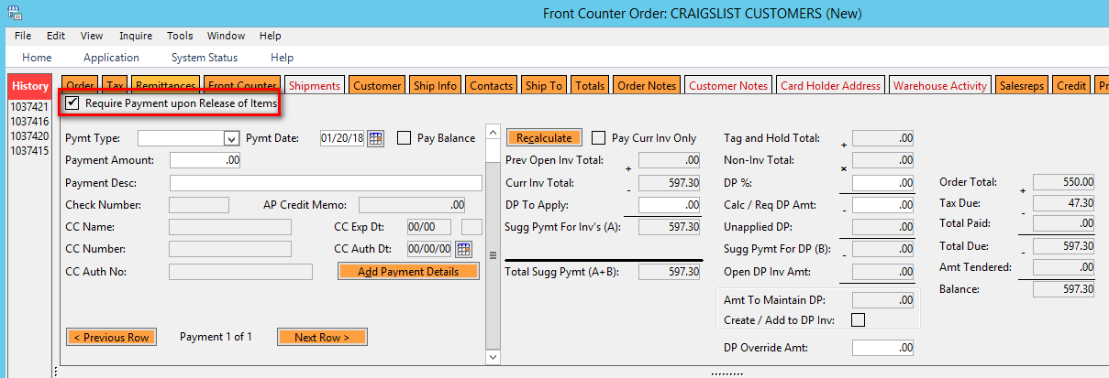
Payment Required to Release Shipment
Scenario: Customer places order and no payment is remitted. However, we will require that they pay for the items to be released.
Enter the order and click on the remittances tab. Select the box to Require Payment upon Release of Items and save.
If you require payment in full from a customer every time you can configure this in Customer Maintenance on the Billing tab.
Ensure Pick Ticket prints when scheduled.

Slide 23
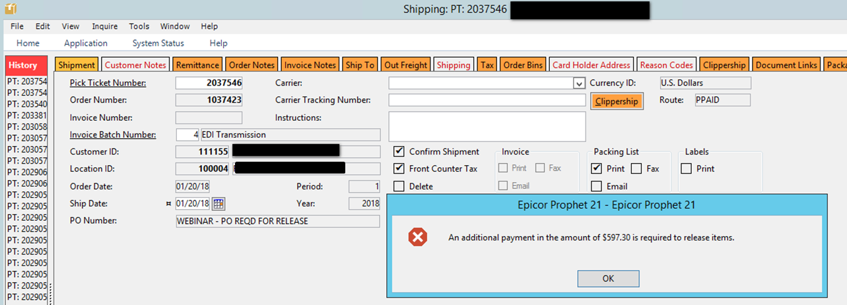
Payment Required to Release Shipment
If you attempt to ship the order in P21 before payment is remitted you will get an error.
Orders – Order Processing – Transactions - Shipping
Open the order and remit payment. Ship confirm.
Business Control: Shipping in P21 must be done concurrently with actual shipping. If not, goods can leave your warehouse without the required payment.

Slide 24
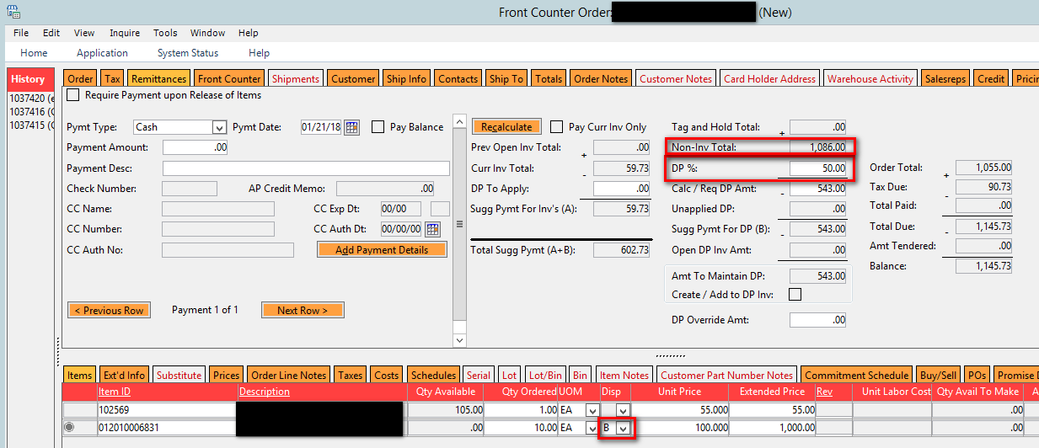
Downpayment
Scenario: a customer has a 50% downpayment configured in customer maintenance. They place an order and one of the items is on backorder. P21 generates a downpayment required of $543.
Even if a customer doesn’t have a downpayment configured in customer maintenance you can add a % to the order.

Slide 25
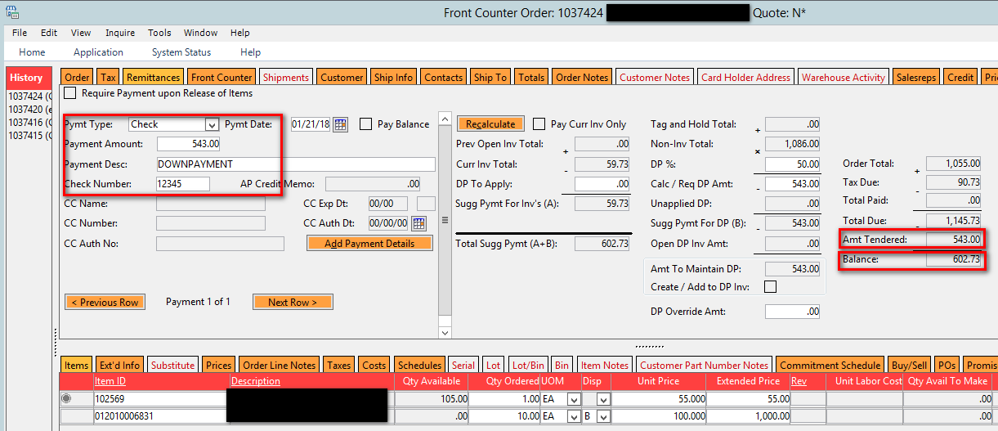
Downpayment
Remit the downpayment. Save the order. A downpayment invoice has been generated and can be printed/emailed/faxed.

Slide 26
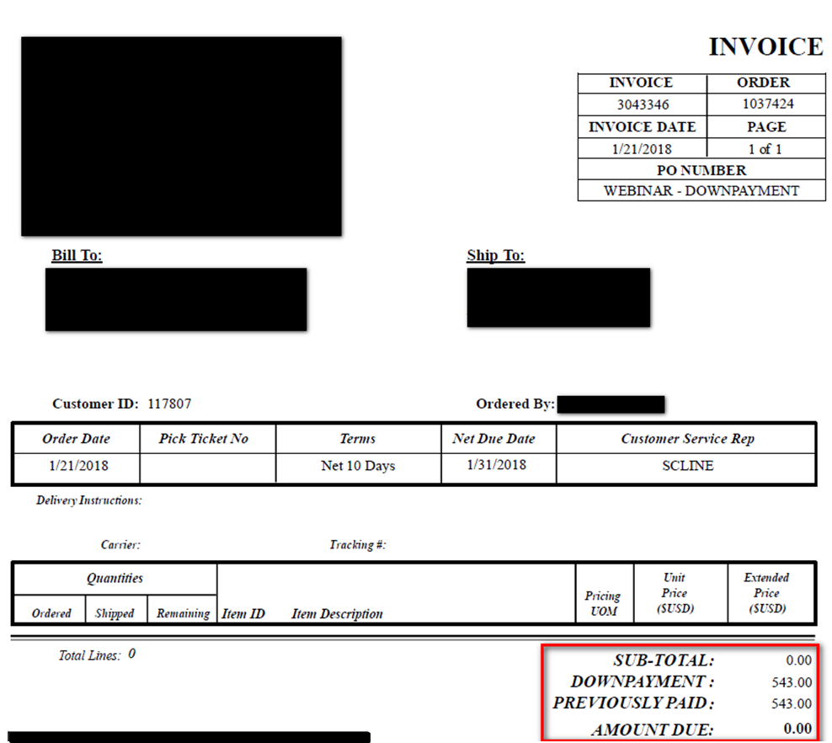
Downpayment

Slide 27
Downpayment
What happens to this in the system?
The order created an invoice showing a downpayment.
This invoice creates a liability in the deferred revenue account (you’ve received money for goods that haven’t shipped)
The cash received flows through the cash drawer as part of the daily remittances.
Where can I see the details?
Open Deferred Revenue Report
General Ledger
Cash Drawer Detail Report
Reconcile Cash Detail
For GL Reconciliation:
Open Deferred Revenue Report balance = Deferred Revenue GL balance
**may need to include store credits**

Slide 28
Downpayment
Where can you see the details?
Open Deferred Revenue Report: Accounting – Accounts Receivable – Inquiry – Open Deferred Revenue
General Ledger: Accounting – General Ledger – Inquiry – GL Drill Down (or GL report)

Slide 29
Downpayment
Where can you see the details?
Cash Drawer Detail Report: Orders – Order Processing – Reports – Cash Drawer Detail
Reconcile Cash Detail: Accounting – Accounts Receivable – Transaction – Reconcile Cash Detail

Slide 30
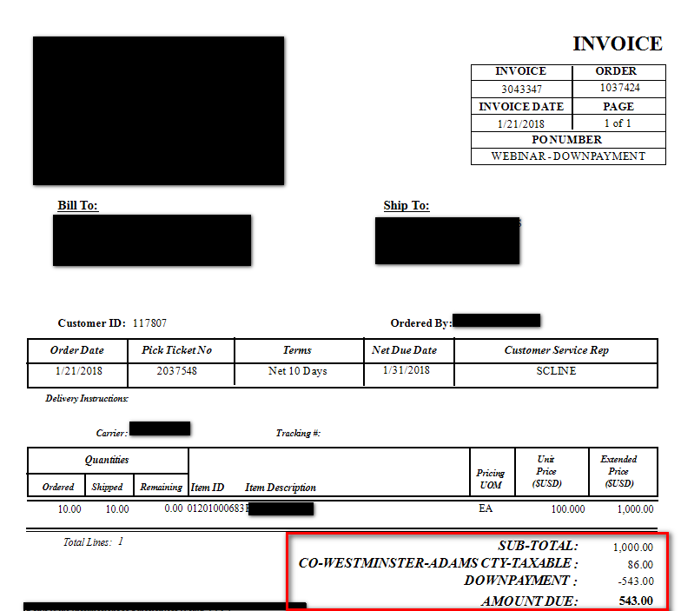
Downpayment
After the items come into stock and the order is shipped the downpayment automatically gets applied to the invoice. It no longer shows as deferred revenue, and in this example the remaining $543 due on the invoice is a receivable.
We could have selected the box to Require Payment upon Release of items. That would have prompted payment for the $543 for the items to ship and the funds would have gone through the cash drawer.

Slide 31
Entering an RMA Utilizing Cash Drawers

Slide 32
RMA
Scenario: a customer calls and needs to return an item. An RMA is created in the system. Ensure the RMA is linked to an invoice
Open RMA Receipts: Orders – Order Processing – Transaction – RMA Receipts
Enter the Source Location ID and RMA Number
Enter the Quantity Received and Quantity to Stock/Adjust/Return to Supplier
Click the box to Confirm
Ensure the tax is correct
Click on the Remittances Tab

Slide 33
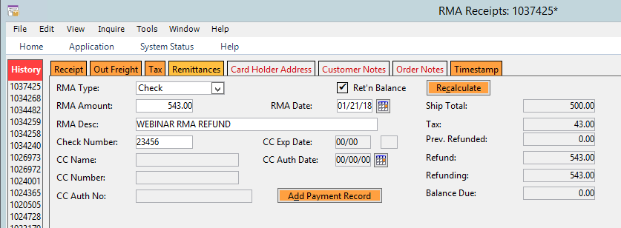
RMA
RMA Type = payment method you’re refunding
RMA Amount = refund amount
If you don’t know the exact amount you can click the box to “Ret’n Balance”. This will populate the amount for you.

Slide 34
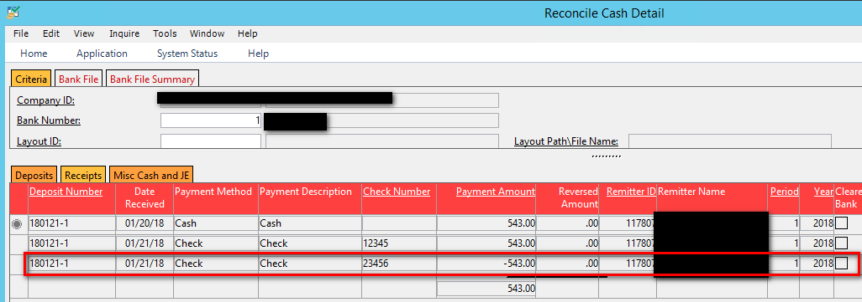
RMA
The RMA refund now shows in the cash drawer, can view through the Cash Drawer Detail report, Reconcile Cash Detail function or the GL Reports

Slide 35
Relationship between Cash Drawers and Payment Types

Slide 36
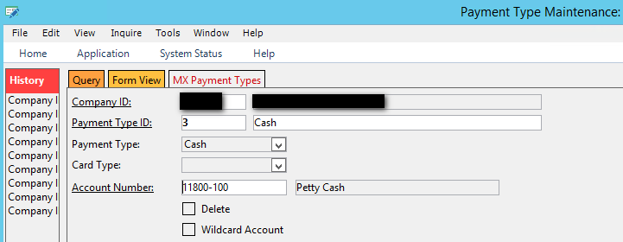
Relationship between Cash Drawers and Payment Types
Payment Types are configured in Payment Type Maintenance.
Every Payment Type configured shows in your dropdown box for Payment Type on the Remittances tab.
When you configure a Payment Type you have to enter an account number:
In this example we want cash to deposit to the Petty Cash account. **This is for example purposes only. Typically cash will deposit to your primary cash account **
Now you open your cash drawer. The bank account set on the cash drawer is the primary cash account for your business. You remit payments with a payment type of cash and close the drawer. What account will the cash be deposited to? Petty Cash or the Primary Cash Account?

Slide 37
Relationship between Cash Drawers and Payment Types
It will be deposited to the Primary Cash Account. The bank account associated with the cash drawer over-rides the bank account on the payment type.
There is one exception to this. Payment types with a payment type of “Credit Card” can be configured to go to an alternate account (ex. Credit Card Clearing).
In the example below all Visa/MasterCard/Discover payments will be posted to the Credit Card Clearing account. Since the Payment Type = Credit Card this setting will over-ride the bank account on the cash drawer

Slide 38
Other Cash Drawer Applications

Slide 39
Other Cash Drawer Applications
Cash drawers are typically used to remit payments through a front counter/phone order/etc.
However in today’s constantly changing business environment there are other applications for cash drawers.
Any order that doesn’t have a true receivable associated with it because you’ve already received the money can go through a cash drawer.
Some applications include e-commerce platforms:
Amazon Seller Central, eBay, websites with shopping carts, etc.
Using a cash drawer for this activity ensures your receivables are accurate (there is no true A/R) and reduces workload.
This activity requires payment types to be created to designate the different sources of revenue

Slide 40
Questions?
Stacy Cline
Cline Financial Services, LLC
stacy@clinefinancialservices.com
970-744-0206

