Slide 1
LANDED COST
Presented by:
Stacy Cline
Cline Financial Services, LLC

Slide 2
Session title
Stacy Cline Cline Financial Services, LLC stacy@clinefinancialservices.com www.clinefinancialservices.com 970-744-0206

Slide 3
Prophet 21 World Wide User Group Officers
President
Sam Snow T. J. Snow Company, Inc. Vice President of Finance
Tim Edmunds TSI Solutions Vice President of Marketing and Education
Mike Chadwick T. J. Snow Company, Inc.
Vice President of Operations
Ted Hoffman Utility Supply and Construction
Vice President of Member Relations
Eric Lunsford Pye-Barker Engineered Solutions

Slide 4
DISCALIMER
This conference is an attempt by P21WWUG members to assist each other by demonstrating ways that we utilize the Prophet21 system and other related products.
The P21WWUG and the individuals conducting the classes and round tables take no responsibility for potential issues that arise as a result of taking the advice given during the conference.
The P21WWUG does not recommend using any SQL statements to update your database without having those statements first reviewed by Epicor or other experienced SQL professionals. Test any code in your Play Database!
Using SQL statements to update your database may result in corrupting your database. Test any code in your Play Database!

Slide 5
AGENDA
Introduction/Bio
What is Landed Cost?
Configuring Landed Cost in P21
Applying Landed Cost to a PO
Accounting Impact
Accounting Transactions
Item Master Inquiry (IMI)
Convert Landed Cost to Voucher
Impact of Variances
Reconciliation
Wrap Up
Q&A
Agenda

Slide 6
BIO
Background in corporate finance for eight years, running financial budget/plan, monthly close, reporting, etc. of $500M service offering
Independent consultant for six years
End user of Prophet 21 for four years
Specialize in Finance & Accounting practices and procedures, EDI implementation, project management and identifying areas of efficiency and cost savings
Stacy Cline
Cline Financial Services, LLC
stacy@clinefinancialservices.com
www.clinefinancialservices.com
970-744-0206
Bio

Slide 7
What is Landed Cost?
Landed Cost, in it’s simplest form is inventory cost + any cost to get the inventory to your warehouse.
Costs are typically ocean freight, domestic freight, insurance, taxes and duties, etc.
Example: You have a shipment en route from China. The shipment is for 100 units @ $50/each, totaling $5000. Inbound Costs are as follows:
Freight = $1000
Customs & Duties = 3% ($150)
Total Inbound Expense = $1000 + $150 = $1150

Slide 8
What is Landed Cost?
What is the total cost for the purchase?
$5000 – item cost
$1150 – inbound expense
$5000 + $1150 = $6150
So, how do we handle the $1150 of inbound expense? The options are as follows:
Expense it – this can grossly overstate your COGS expense if your inventory doesn’t have a fast turnover rate.
Hold it on the balance sheet and relieve it manually as the goods are sold – this works but can be difficult to manage, assess and ensure auditability.
Integrate it as a part of the unit cost for the goods. In this case the final per unit cost of the good is $61.50
$5000/100 units ($50/unit) + $1150/100 units ($11.50/unit) = $61.50
What is Landed Cost?

Slide 9
Why does Landed Cost Matter?
Knowing, implementing and utilizing landed cost is the only way for your company to definitively know your bottom line.
It is essential for pricing – ensures you understand your true cost and price your inventory accordingly.
Gives you visibility into your supply chain – helps you assess if you can negotiate better rates, alter volume of shipments, address additional fees, etc.

Slide 10
Configuring Landed Cost in P21

Slide 11
Configuring Landed Cost: Steps
Configuring landed cost requires a lot of set-up. However, it only needs to be done once!
Steps:
Create Landed Cost Clearing Account in Chart of Accounts Maintenance and assign in Company Maintenance and on your Financial Statements
Configure Landed Cost Settings in System Settings
Create Landed Cost Categories
Assign Landed Cost Categories (from prior step) in Company Maintenance
Define Landed Cost Driver Types & Search Order
Create Landed Cost Drivers

Slide 12
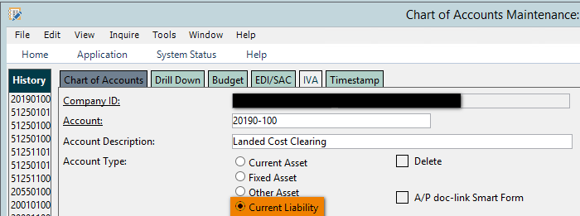
1. Create Account & Assign in Company Maintenance
Create a Landed Cost Clearing Account in Chart of Accounts Maintenance. This account will be a current liability:
This account will hold the landed cost until the PO is vouchered
Note: check to see if one already exists before creating a new one!

Slide 13
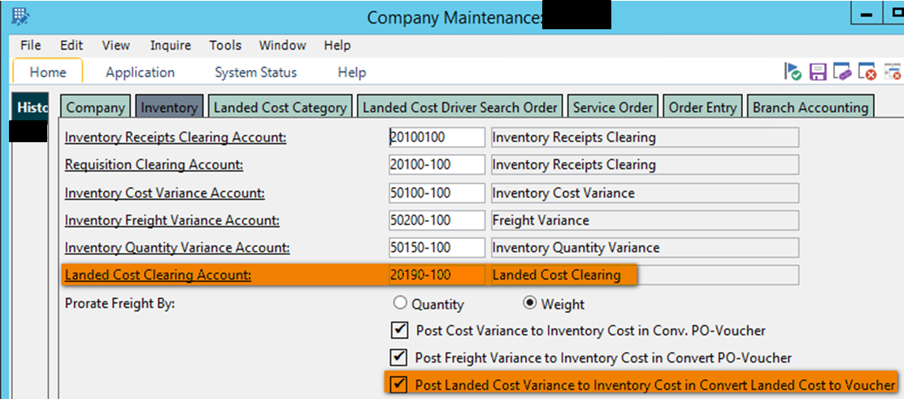
1. Create Account & Assign in Company Maintenance
Open Company Maintenance:
Setup – System Setup – System – Company Maintenance.
Click on the Inventory Tab.
Assign account to the Landed Cost Clearing box:
Decide if you want the “Post Landed Cost Variance to Inventory Cost in Convert Landed Cost to Voucher” box checked.
If checked, P21 will post any landed cost variance to the remaining items in stock from the original purchase, allocated on the driver methodology.

Slide 14
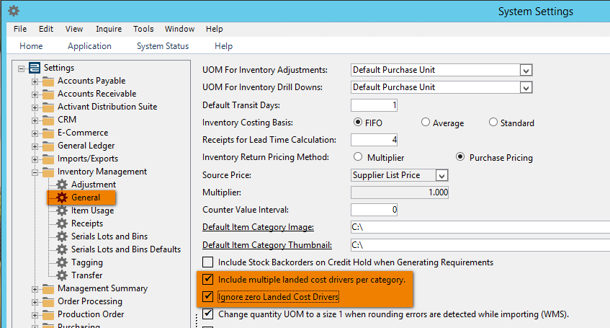
2. System Settings
Navigate to System Settings
Setup – System Setup – System - System Settings
Select Inventory Management – General
Ensure the boxes for “Include multiple landed cost drivers per category” and “Ignore zero Landed Cost Drivers” are checked:
Include multiple landed cost drivers per category: Enables landed cost category and thus a PO or transfer to have multiple landed cost drivers.
Ignore Zero Landed Cost Drivers: ensures the Unvouchered Landed Cost report and Convert Landed Cost to Voucher don’t show $0 landed cost drivers

Slide 15
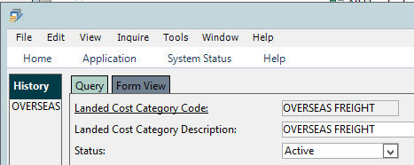
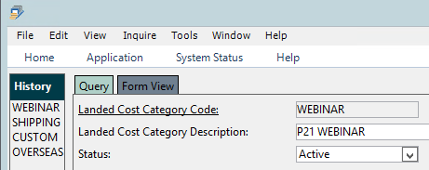
3. Create Landed Cost Categories
Create Landed Cost Categories:
These are user defined categories. They should be descriptive of the types of charges you incur. Later you will create drivers specific to these categories
Navigate to Landed Cost Category Maintenance
Setup – System Setup – Maintenance – Landed Cost Category Maintenance
You will create a category for each type of charge you want to account for (i.e. Ocean Freight, Domestic Freight, Insurance, Taxes & Duties, etc.)

Slide 16
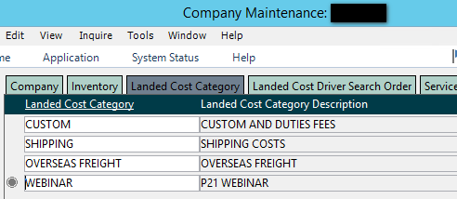
4. Assign Landed Cost Categories
Navigate to Company Maintenance:
Setup – System Setup – System – Company Maintenance.
Enter the Company ID, then select the “Landed Cost Category” tab. Ensure all Landed Cost Categories created in step #3 are listed here.
Enter through for a new line and enter the missing category:

Slide 17
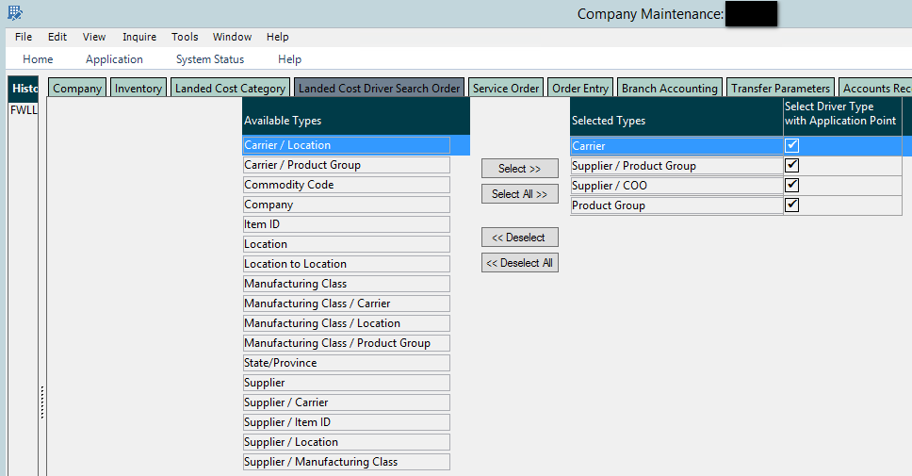
4a. Define Landed Cost Driver Search Order
Next, select the “Landed Cost Driver Search Order” Tab
Select the Landed Cost Driver Type (left side) for the Landed Cost Drivers (we will create them in the next step) you want to use for your company and order them how you want the system to search for them (right side)
The types you select here affect how the Landed Cost Drivers are set-up
i.e. if I want to have a driver set up specific to a location I wouldn’t be able to do it with the selections below. I would need to move over the “Location” type

Slide 18
5. Create Landed Cost Drivers
So far we have set and assigned an account for landed cost, created categories for the drivers, established them in Company Maintenance and determined what driver types we will use and the search order for them.
Now, we configure the drivers themselves.
The drivers created are:
Assigned to a Landed Cost Category (step #3)
Customized based on the Landed Cost Driver types (step #4a)
Reflective of how and where you will calculate and apply landed cost

Slide 19
5. Create Landed Cost Drivers
How do I know what Landed Cost Drivers to create?
Assess your inbound expenses. Group the types into the landed cost categories you already created.
i.e. If you have an “Ocean Freight” category the total charges may be comprised of transportation to/from the port and the actual freight charge for moving the shipment across the ocean
These could be two different Landed Cost Drivers within the “Ocean Freight” category
Have the conversation – find the person who knows these shipments inside and out. Get them talking about how they decide to ship. This will likely be the basis of your criteria.
Start small – set up your drivers for the most straight-forward scenarios first. Then use them, analyze them, and decide if they’re working as you expected, if they need tweaking, and if your “landed cost” for the item is correct.
Test, test test!

Slide 20
5. Create Landed Cost Drivers
Scenario:
A company wants to use landed cost, but their inbound domestic shipping varies greatly depending on the carrier
The use of the carrier isn’t specific to a supplier or item, so they need the flexibility to use different carriers.
Solution:
We established a “Webinar” landed cost category in Step #3.
For purposes of this session we are using it to describe domestic freight
Within the “Webinar” category we can create multiple drivers
Since we are focusing on domestic freight for different carriers we may have drivers configured for FedEx, UPS, R&L, Old Dominion, etc.
These drivers will be assigned the same Landed Cost Category, “Webinar”
Selecting a Landed Cost Driver Type enables us to customize the criteria
We can then select a calculation methodology
And pick our point of application (PO receipts, Container Receipts, Vessel Receipts, Transfer Receipts)
For purposes of this session we will just create one driver for FedEx

Slide 21
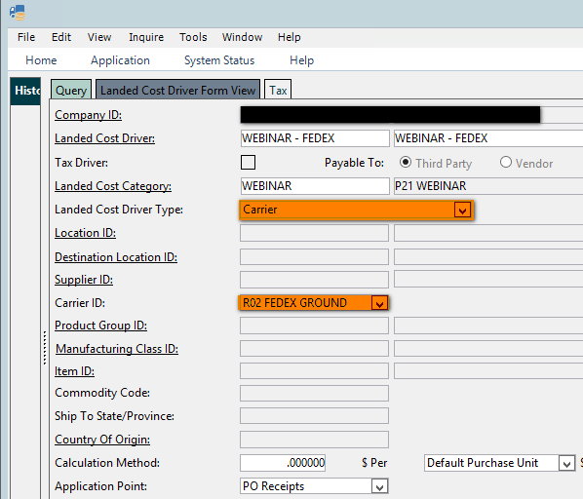
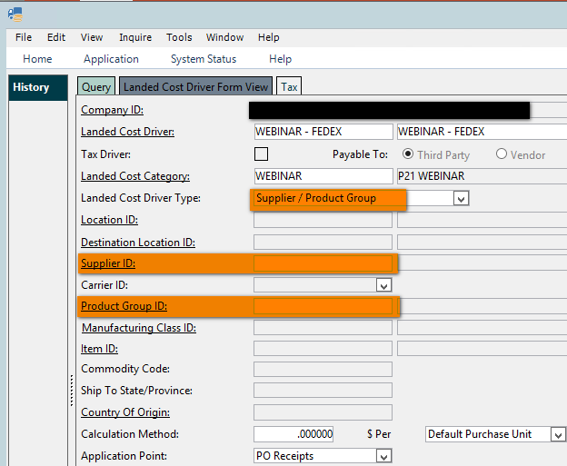
5. Landed Cost Drivers
Navigate to Landed Cost Driver Maintenance
Inventory – Inventory Management – System – Landed Cost Driver Maintenance
Enter in a name and description for your Landed Cost Driver (user defined)
Assign it to one of the categories created in Step #3
Then, select the Landed Cost Driver Type
The drop down box contains the Search Order Criteria selected in Step #4a
The type of Driver Type you select will determine which fields below it open up for you to populate.
In this case, we are creating a driver specific to FedEx so we will leave it as Carrier and assign FedEx in the Carrier ID field.

Slide 22
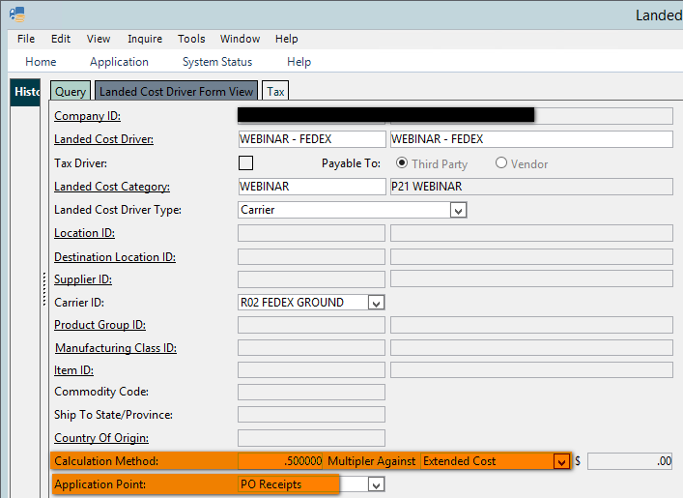
5. Landed Cost Drivers
The Calculation Method tells P21 how to calculate a landed cost amount and apply it when the driver is used.
We’ve selected .50000 multiplier against Extended Cost. This means that if the PO = $1000 the landed cost applied will be $1000 x .5000 = $500
Total PO + Landed Cost = $1000 + $500 = $1500
Enter the Application Point for landed cost (PO receipts, Container Receipts, Vessel Receipts, Transfer Receipts)
This tells the system when to apply the landed cost to the PO

Slide 23
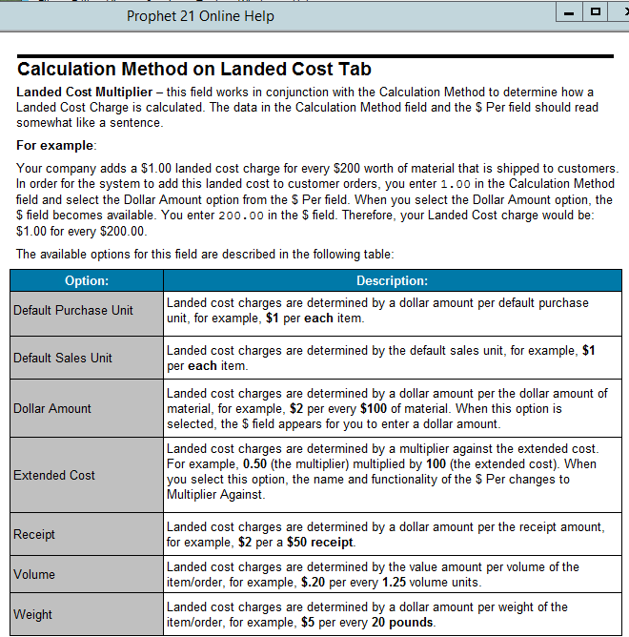
5. Landed Cost Drivers
Calculation Method Definitions: P21 help menu has a great description of each of these:

Slide 24
5. Landed Cost Drivers
Repeat this process until all your drivers are configured.
Then, you’re ready to apply landed cost in P21!!!!

Slide 25
APPLYING LANDED COST TO A PO

Slide 26
Applying Landed Cost to a PO
Create a new PO. The landed cost tab (at both the header and line level) should become available after you enter items.
If P21 finds a driver (based on it’s search criteria) it will show on this tab
If there are no drivers found you can right click and add
If you want to add additional drivers enter through for a new line
Landed Cost can be applied when entering the PO or at point of PO/Container/Vessel/Transfer Receipt.
The total value of the PO = $3200.00. Since the multiplier was set up as .50000 of Extended Cost (in step #5) the system has calculated a Landed Cost Amount = $3200 x .50000 = $1600.
This can be edited on the screen, i.e. multiplier, application point and calculation method can be changed to tailor directly to the PO.
The line level shows how much Landed Cost is applied to each item.

Slide 27
Applying Landed Cost to a PO
Purchase Order (Point of Receipt) Receipt:
Receiving a Purchase Order automatically creates a Receipt for Landed Cost.
From here the transaction splits – there is one “Convert PO to Voucher” for the goods, and one “Convert Landed Cost to Voucher” per driver for the Landed Cost piece.
This enables you to voucher one/multiple vendors for the landed cost piece, i.e. if my PO has landed cost lines for “Customs & Duties” and one for “Webinar – FedEx” I will have two lines of Landed Cost to voucher, enabling me to use multiple vendors
Don’t worry – you’re not locked into the landed cost amount on the initial purchase order! You can edit the landed cost at point of receipt.
We are going to go through examples of editing the landed cost at point of PO receipt next, but please keep in mind the original transaction:
PO Value = $3200
Landed Cost (.5000 multiplier on Extended Cost) = $1600
Total Value + Landed Cost = $4800

Slide 28
Applying Landed Cost to a PO
Examples of Editing Landed Cost:
Total items received are more than the initial PO. P21 automatically calculates the additional amount based on the driver. In this case calculated freight went from $1600 to $1850
Unit Price of item 100213 = $0.10
Landed Cost = .5000 x $0.10 = $0.05/unit
5000 additional units x $0.05 = $250
Landed Cost increases from $1600 to $1850

Slide 29
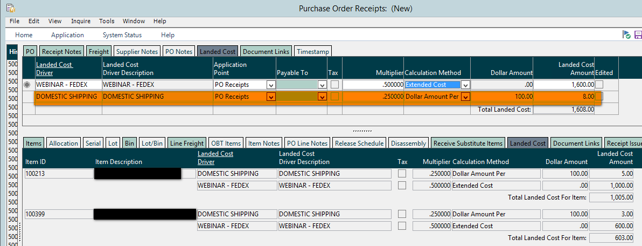
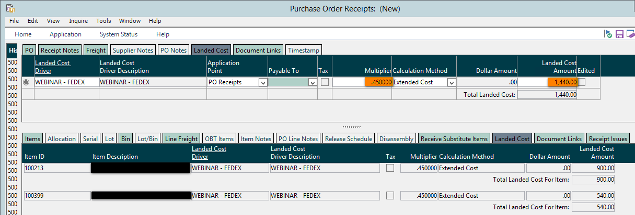
Applying Landed Cost to a PO
Examples of Editing Landed Cost:
Adding a Driver: creates another line of landed cost for each item on the PO
Editing a Driver: changed the multiplier from .50 to .45

Slide 30
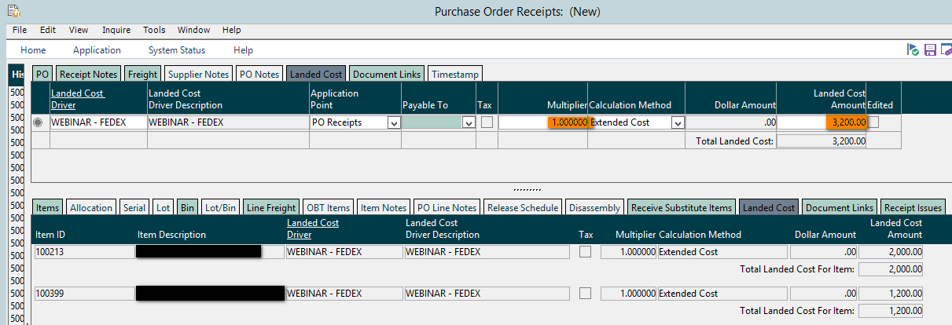
Applying Landed Cost to a PO
For the Final PO Receipt we will receive all items and change the Extended Cost Multiplier to 1.0:
PO Item Cost = $3200
Landed Cost = $3200
Total Item Cost + Landed Cost = $6400

Slide 31
Accounting impact

Slide 32
Accounting
We have configured the landed cost in P21 and applied our driver(s) on a PO. But what transactions are generated in P21?
Create PO with Landed Cost
PO Receipt
Convert PO to Voucher
Convert Landed Cost to Voucher
Open POs Report
Inventory Value Report
Unvouchered PO Report
Unvouchered Landed Cost Report
AP Trial Balance
AP Trial Balance
No Subledger Activity
Inventory Subledger Debited for Item Cost + Landed Cost Value
Inventory Receipts Subledger Credited for Item Cost
Landed Cost Subledger Credited for Landed Cost Drivers
Inventory Receipts Subledger Debited for Item Cost, AP Subledger Credited for Item Cost for Vendor items purchased from
Landed Cost Clearing Subledger Debited for Landed Cost Driver(s), AP Subledger Credited for Landed Cost Driver(s) for Vendor(s) purchased from
No GL Activity
GL Inventory Account Debited for Item Cost + Landed Cost Value
GL Inventory Receipts Clearing Credited for Item Cost
GL Landed Cost Clearing Credited for Landed Cost Drivers
Inventory Receipts Clearing GL Debited for Item Cost, AP GL Account Credited for Item Cost
Landed Cost Clearing GL Debited for Landed Cost Driver(s), AP GL Account Credited for Landed Cost Driver(s)
We will also take a look at Item Master Inquiry (IMI) to see the impact at an item level

Slide 33
Accounting
As we know from the prior slide, transactions get started at point of PO Receipt. How do we see them?
We can see the GL Transactions generated by the PO Receipt in GL Drilldown:
These are the same transactions detailed on the “PO Receipt” step on the prior slide
The Unvouchered Landed Cost, ($3200), shows on the “Unvouchered Landed Cost” Report:
If we pulled the Unvouchered PO and Inventory Value Reports we would see $3200 and $6400 there respectively

Slide 34
IMI
What happened at the item level?
First, let’s review our PO Receipt:
For the remainder of the presentation:
When we work in Convert Landed Cost to Voucher we will be looking at the entire landed cost amount, $3200 ($2000 for item 100213 and $1200 for item 100399)
When we look at IMI we will only be looking at the item cost and landed cost applied to item 100213:
The PO has 20,000 units at $0.10/unit = $2000
The Landed cost was a 1.0000 multiplier on Extended Cost, 1.0000 x $2000 = $2000
We will expect to see $4000 of item cost in IMI for this PO

Slide 35
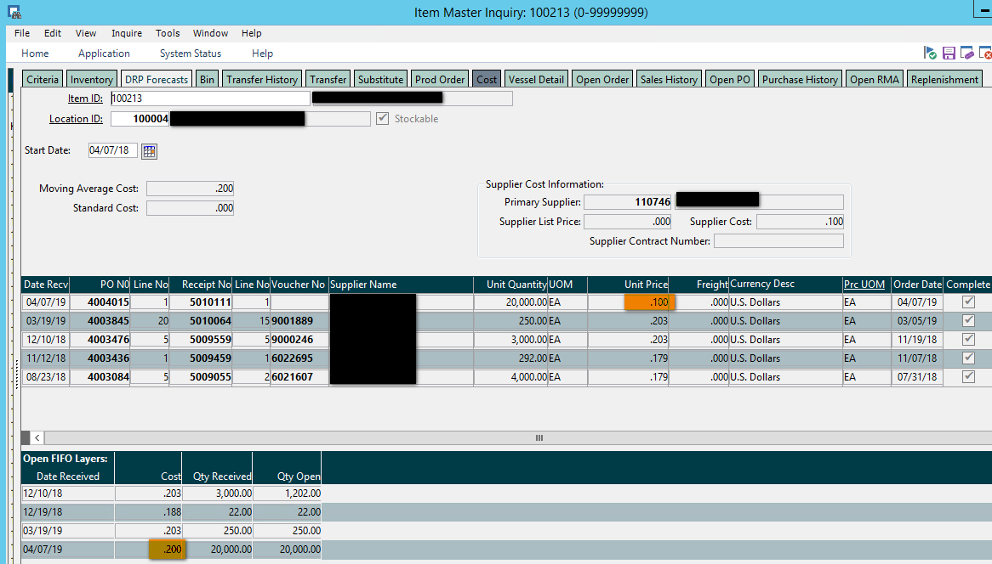
IMI
Open IMI (Item Master Inquiry) and select the Cost tab:
You can see the PO Receipt on the top section of the screen, receiving 20,000 units @ $0.100/unit
On the bottom half it has the FIFO layer cost at $0.200/unit
What’s the difference?
Landed Cost! Since we used an Extended Cost Multiplier of 1.00 it doubled the unit price of the item.
Item Cost/Unit = $0.100, Landed Cost/Unit = $0.100, Total Cost/Unit = $0.200
The Total Cost/Unit drives the Moving Average Cost (MAC)
The Inventory Value report would show an increase of $4000 after this PO Receipt
Total Cost/Unit = $0.200 x 20,000 units

Slide 36
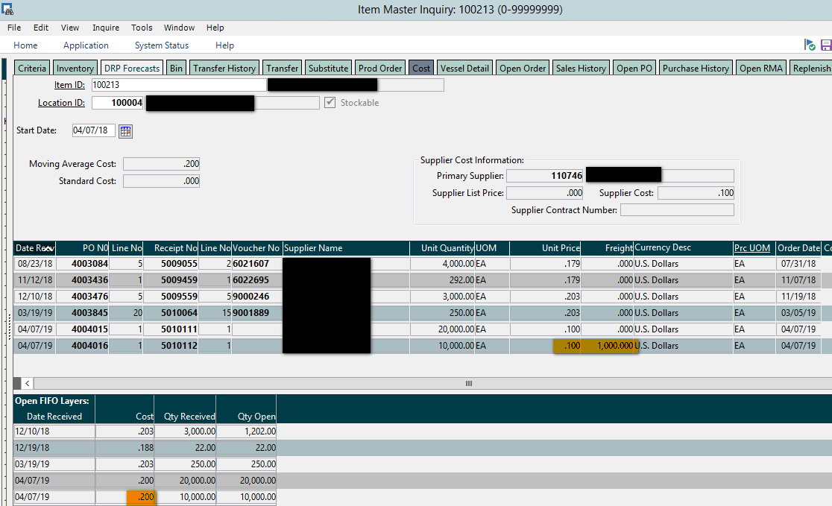
IMI
Why is the Freight Box Blank?
The Freight box represents freight the Supplier charged on the PO, not a separate vendor
Note: this is a PO receipt from a different PO, for demonstration purposes only. It DOES NOT affect the PO we’ve been working with
Entering a Freight amount allocates freight down to a line item level, still affecting MAC:

Slide 37
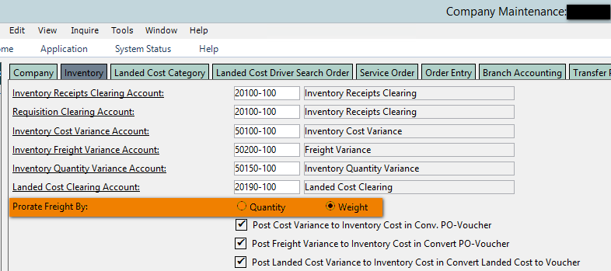
IMI
When do I use Landed Cost vs. entering Freight on the PO?
Landed Cost:
Gives you control over how the drivers are applied at a line item level
Enables you to voucher multiple vendors for a PO
Freight:
Enables you to enter freight charged directly from the supplier without having to enter multiple vouchers
How does it apply the freight to a line item level?
This is a setting in Company Maintenance. Your options are to have P21 allocate the freight by either Quantity or Weight. Be sure you know which is your selection and the implications
i.e. Quantity won’t take into account the value or weight of the item, Weight can get skewed if not all weights are in P21, or weights are input incorrectly

Slide 38
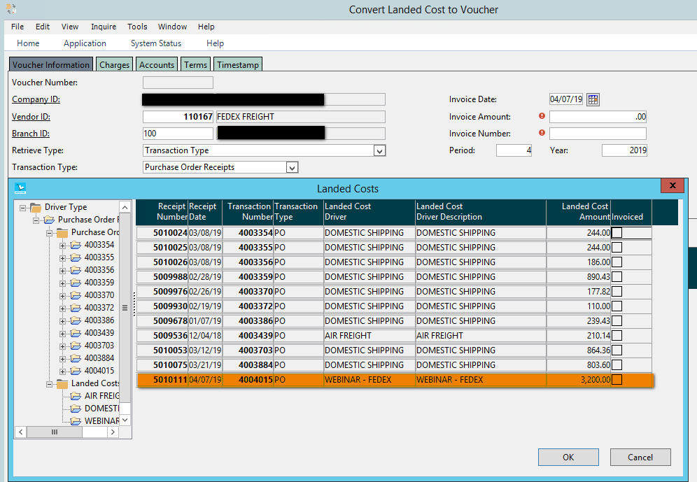
Convert Landed Cost to Voucher
Back to the Original PO Receipt which had $3200 of Landed Cost:
Now we get the invoice from FedEx and need to enter it into P21.
Navigate to Convert Landed Cost to Voucher:
Accounting – Accounts Payable – Transaction – Convert Landed Cost to Voucher
Enter in the Vendor to Vouch, select the Retrieve Type and Transaction Type. Select one or multiple Receipts to Vouch:
Enter the remaining voucher information and save. You’re done!

Slide 39
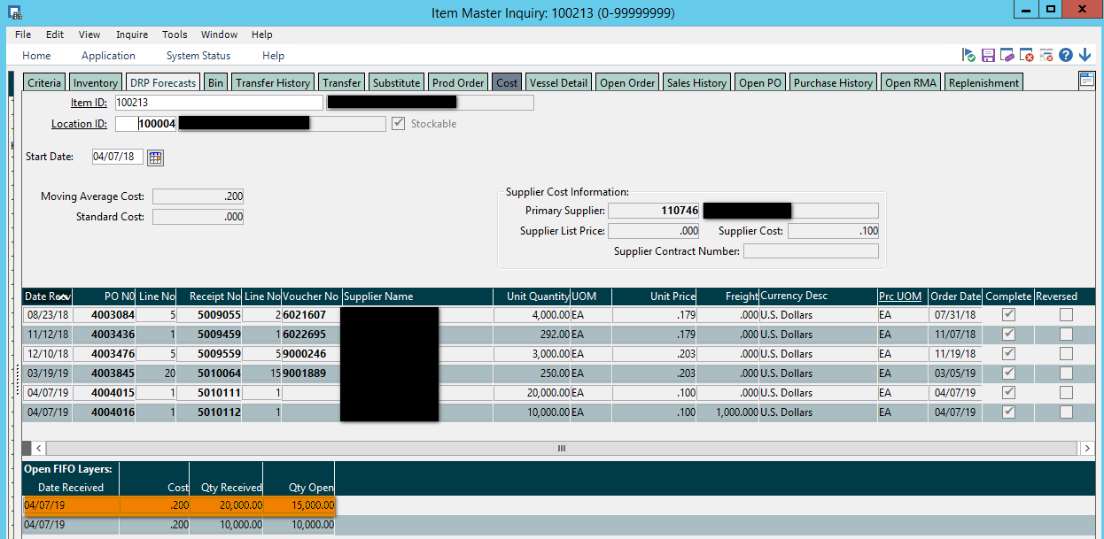
Convert Landed Cost to Voucher
But what happens when the voucher is different from the Landed Cost?
Scenario: FedEx sent a bill for this shipment late (if only!!). By the time the bill is received we have sold through 5,000 of the 20,000 units, leaving 15,000 units left in stock.
Also, as it turns out the shipment was overnighted, instead of shipped ground so the invoice is for $7000 instead of $3200. You have a decision to make – do you expense the additional freight, or, since this happens frequently build it into the unit cost?

Slide 40
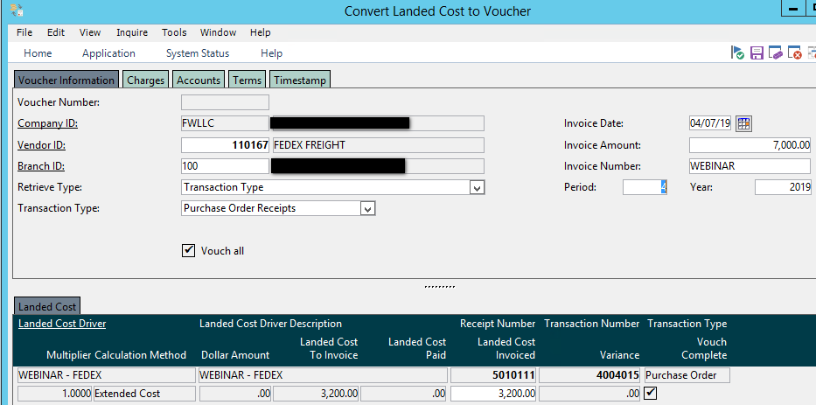
Convert Landed Cost to Voucher
Option #1: Expense the additional freight, not impacting the unit cost or MAC of the item
Enter the Vendor, Retrieve Type and Transaction Type. Enter the information of the voucher:
Then, select the “Charges” tab. Enter the additional charges and select the account you want the expense to reflect in:
We are saying that the “expected” landed cost for the item is $3200 and there were $3800 of additional charges that we expensed = $7000 total voucher amount.
Save and pay when due.

Slide 41
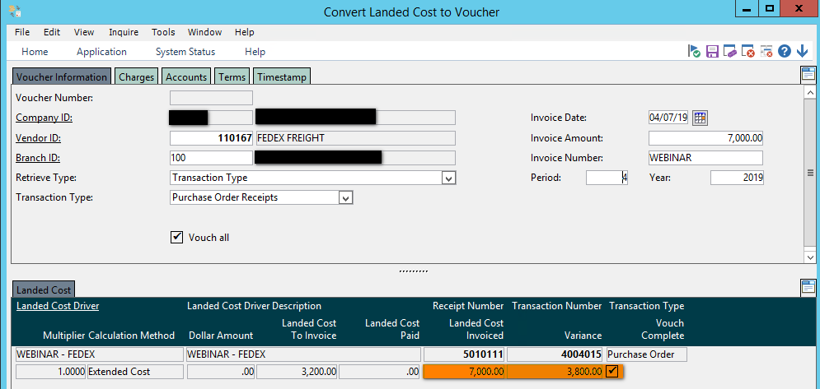
Convert Landed Cost to Voucher
Option #2: Add the additional freight into unit cost
Enter the Vendor, Retrieve Type and Transaction Type. Enter the information of the voucher, and change the “Landed Cost Invoiced” amount to the invoice amount:
Notice the additional $3800 is now in the “Variance” column.
Save the voucher and pay when due.
Where did the variance go?

Slide 42
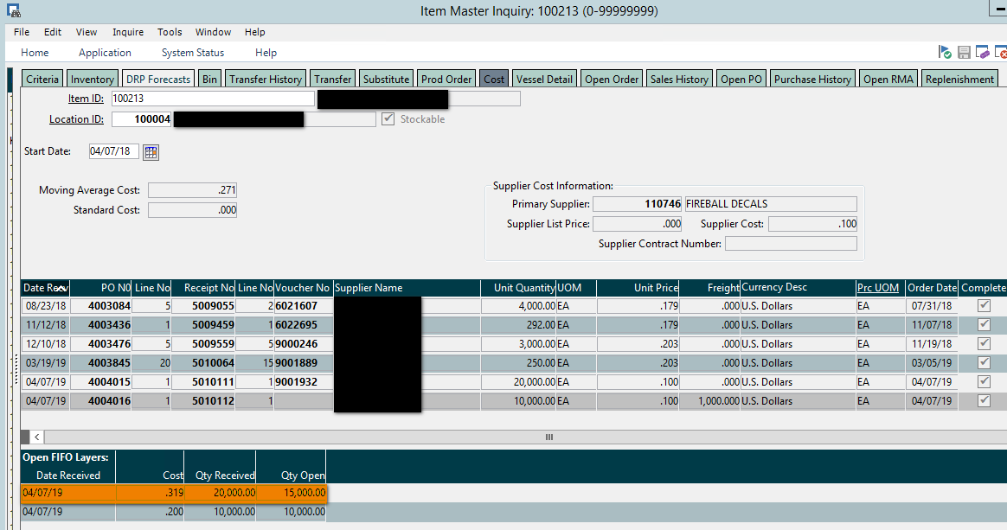
Variance
Where did the variance go?
We have a system setting in place (from Company Maintenance in Setup Step #1) to “Post Landed Cost Variance to Inventory Cost in Convert Landed Cost to Voucher”
This means that the Variance Per Unit will be applied back to the items from the purchase order.
Variance Per Unit: $2375/20,000 units = $0.119/unit
$2375 is the portion of the $3800 that went to item 100213
The item cost is now $0.319, comprised of $0.1 unit cost + $0.1 landed cost + $0.119 variance

Slide 43
Variance
Where did the variance go?
But this only accounts for the variance on 15,000 of the 20,000 units, where is the variance for the 5,000 units that already sold?
Drilling down on the transaction shows the following:
Accounts Payable: Credited for the entire amount of the voucher, ($7000)
Landed Cost Clearing: Debited for the initial amount of the freight, $3200 – this clears it off the Unvouchered Landed Cost Report
Inventory: Debited for the variance factored into MAC – Increases Inventory Value on the Inventory Value Report
Inventory Cost Variance: Debited for the affect on MAC for units sold (5,000)

Slide 44
Reconciliation
How do we reconcile these on a monthly basis?
GL Inventory Accounts = Inventory Value Report
GL Inventory Receipts Clearing Account = Unvouchered PO Report
GL Landed Cost Clearing Account = Unvouchered Landed Cost Report

Slide 45
Questions?

Slide 46
Stacy Cline Cline Financial Services, LLC stacy@clinefinancialservices.com www.clinefinancialservices.com 970-744-0206

