Slide 1
Accounting – connecting the dots
Presented by:
Stacy Cline
Cline Financial Services, LLC

Slide 2
Session title
Stacy Cline
Cline Financial Services, LLC
stacy@clinefinancialservices.com
www.clinefinancialservices.com
970-744-0206

Slide 3
Prophet 21 World Wide User Group Officers
President
Sam Snow
T. J. Snow Company, Inc.
Vice President of Finance
Tim Edmunds
TSI Solutions
Vice President of Marketing and Education
Mike Chadwick
T. J. Snow Company, Inc.
Vice President of Operations
Ted Hoffman
Utility Supply and Construction
Vice President of Member Relations
Eric Lunsford
Pye-Barker Engineered Solutions

Slide 4
DISCALIMER
This conference is an attempt by P21WWUG members to assist each other by demonstrating ways that we utilize the Prophet21 system and other related products.
The P21WWUG and the individuals conducting the classes and round tables take no responsibility for potential issues that arise as a result of taking the advice given during the conference.
The P21WWUG does not recommend using any SQL statements to update your database without having those statements first reviewed by Epicor or other experienced SQL professionals. Test any code in your Play Database!
Using SQL statements to update your database may result in corrupting your database. Test any code in your Play Database!

Slide 5
AGENDA
Introduction/Bio
2018 Review
Where to Begin
Researching Subledger to GL
Transactions that Cause Imbalances:
    Inventory
    Unvouchered PO/Unvouchered Landed Cost
    A/R & A/P
Q&A
Agenda

Slide 6
BIO
  Background in corporate finance for eight years, running financial budget/plan, monthly close, reporting, etc. of $500M service offering
  Independent consultant for six years
    End user of Prophet 21 for four years
  Specialize in Finance & Accounting practices and procedures, EDI implementation, project management and identifying areas of efficiency and cost savings
  Stacy Cline
  Cline Financial Services, LLC
  stacy@clinefinancialservices.com
  www.clinefinancialservices.com
  970-744-0206
Bio

Slide 7
Review from 2018

Slide 8
Sales Order to Cash Cycle:
#1: Sales Order Entry
#2: Pick Ticket
#3: Ship Confirmation (creates invoice)
#4: Invoice sent to Customer
#5: Cash Receipt
#6: Reconcile Cash Detail/Bank Reconciliation
Open Order Report
Pick Tickets Report
A/R:
Aged Trial Balance Report
Inventory:
Inventory Value Report
Invoice Report or Generate Customer Statements Report
Cash Receipts History &
Deposit Slips Report
Reconcile Cash Detail
No Subledger Activity
Inventory subledger allocates items, no value change
Accounts Receivable Subledger debited for invoice
Inventory Subledger credited for items
No Subledger Activity
Accounts Receivable subledger credited for invoice
No Subledger Activity
No GL Activity
No GL Activity
A/R GL Account Debited
Inventory GL Account Credited
No GL Activity
A/R GL Account Credited, Cash Account Debited
No GL Activity

Slide 9
Sales Order to Cash Cycle: Cash Drawer
#1: Sales Order Entry
#3: Pick Ticket
#4: Ship Confirmation (creates invoice)
#5: Cash Receipt – System Generated
#6: Reconcile Cash Detail/Bank Reconciliation
#2: Remit Payment at Time of Order Entry
Open Deferred Revenue
Example: Customer places an order for 5 units of 100171.
  Accepting Remittance at time of order alters the Order to Cash Cycle slightly. It accounts for the cash receipt at the time of order entry, placing the received funds into Deferred Revenue (credit) and Cash (debit). The deposit number to cash is system generated, YYMMDD-Bank Number. It is available to clear when the cash drawer is closed.
  The received funds will show on the Deferred Revenue Report until the order is ship confirmed/invoiced.
Deferred Revenue Subledger Credited
GL Deferred Revenue Credited, Cash Debited

Slide 10
Sales Order to Cash Cycle: RMA
#1: RMA Entry
#2: RMA Receipt
#4: Reconcile Cash Detail/Bank Reconciliation
#3: Cash Receipt
Open RMA Report
A/R:
Aged Trial Balance Report
Inventory:
Inventory Value Report
Cash Receipts History &
Deposit Slips Report
Reconcile Cash Detail
No Subledger Activity
Accounts Receivable Subledger credited for invoice
Inventory Subledger debited for items
Accounts Receivable subledger debited for invoice
No Subledger Activity
No GL Activity
A/R GL Account Credited
Inventory GL Account Debited
A/R GL Account Debited, Cash Account Credited
No GL Activity

Slide 11
Purchase Order to Cash Cycle:*
      *Not Using Landed Cost
#1: Purchase Order Entry
#2: Purchase Order Receipt
#3: Convert PO to Voucher
#4: Check Issued
#5: Reconcile Disbursements /Bank Reconciliation
Open POs Report
Unvouchered POs Report
Inventory Value Report
AP Trial Balance
Check Register
Reconcile Disbursements
No Subledger Activity
Inventory subledger debited for items
Accounts Payable Subledger credit for invoice
Accounts Payable subledger debited for invoice
No Subledger Activity
No GL Activity
Inventory GL Account Debited, Inventory Receipts Clearing Account Credited
Accounts Payable credited, Inventory Receipts Clearing Account Debited
A/P GL Account Debited, Cash Account Credited
No GL Activity

Slide 12
Purchase Order to Cash Cycle: Landed Cost
#1: Purchase Order Entry
#3: Purchase Order Receipt
#4: Convert PO to Voucher
#6: Check Issued
#7: Reconcile Disbursements /Bank Reconciliation
#2: Enter Landed Cost on PO
#5: Convert Landed Cost to Voucher
Unvouchered Landed Cost Report
Inventory Value Report
AP Trial Balance
Inventory subledger debited for items
Accounts Payable Subledger credit for invoice
Inventory GL Account Debited, Landed Cost Clearing Account Credited
Accounts Payable credited, Inventory Receipts Clearing Account Debited

Slide 13
So What Matches What?!?
You should always be aware of what reports (subledgers) and GL accounts tie together (your accounts will be different depending on your set-up). Keeping the balances in sync will ensure accurate transactions and reporting:
Account | Account Description | Report
14020-100 | Inventory | Inventory Value
14004-100 | Inventory in Vessel | Vessel Report
13000-100 | Accounts Receivable | Aged Trial Balance
11000-100 | Cash | Reconcile Cash Detail & Reconcile Disbursement feed the Bank Reconciliation Worksheet (ties out cash)
22200-100 | Deferred Revenue | Open Deferred Revenue (may need to add in Store Credits)
20010-100 | Accounts Payable | AP Trial Balance
20100-100 | Inventory Receipts Clearing | Unvouchered PO
20190-100 | Landed Cost Clearing | Unvouchered Landed Cost
20130-100 | RMA Receipts Clearing | Open RMAs (run as ONLY)

Slide 14
Where to begin

Slide 15
Out of Balance
But what happens when transactions go wrong, affecting your Subledger to GL balancing?
This can be frustrating, and users often feel at a loss as to where to begin.
But, as with most things in P21, we can research, identify the cause, fix the issue and help your teams prevent it from re-occurring.
We will spend time identifying how we isolate the out of balance transactions and what types of transactions cause us to be out of balance.

Slide 16
Where to Begin
Your subledgers are out of balance to the GL, where do you begin?
  Always pull the subledger to GL for the current day (ideally when the system isn’t transacting). If you’re in balance then the issue was something posted cross-period. Notate it for month end, save the in-balance reports and move on.
  There are multiple ways to approach this – I always start with what you know.
  Navigate to GL Drilldown. Pull the account(s) associated with the subledger. Drill into the detail for the month. Look for any Journal ID’s that don’t belong.
    For example, we know that across the board there should never be a “GJ” or “PR” journal ID in a subledger account.
    Other examples are:
      A “CR” (Cash Receipt) or “MR” (Miscellaneous Cash Receipt) in any subledger besides Accounts Receivable or Deferred Revenue
      An “IA” (Inventory Adjustment) or “IC” (Inventory Cost) in an Accounts Payable, Accounts Receivable, Landed Cost, etc. subledger
      Etc…
    Spend time learning the Journal ID’s and mapping which ones are acceptable in which accounts.

Slide 17
Journal ID’s
Some of the most common ID’s you see are:
  A complete list is available in “Journal Maintenance”
Journal ID | Journal Description | Source (P21 Window) | System vs. Manual
CD | Cash Disbursements | Vouchers | System
CR | Cash Receipts | Cash Receipts | System
GJ | General Journal | Journal Entry | Manual
IA | Inventory Adjustment | Inventory Adjustments | System
IC | Inventory Cost | Edit Item Cost | System
IR | Inventory Receipts | Purchase Order Receipts | System
MR | Misc Cash Receipts | Misc. Cash Receipts | System
PD | Production Order Journal | Production Order Processing | System
PR | Payroll | Journal Entry | Manual
SJ | Sales Journal | Shipping Confirmation, RMA Receipt, Debit Memo/Credit Memo | System
TJ | Transfer Journal | Transfer Shipping/Transfer Receipts | System
VR | Inventory Return | Inventory Return Shipping | System

Slide 18
Where to Begin
Your subledgers are out of balance to the GL, where do you begin?
  Pull the reports from the last time they were in balance. Hopefully this is the prior month (since we always pull month end reports and do the reconciliation!).
    If not, trace back as best you can to when they were in balance. If you can’t find any we’ll have to make some assumptions and ultimately make a decision of when to “put a stake in the ground” to balance. Then, you move forward from there.
    I also like to balance these by branch, if applicable. It’s easier to work with less data – when you balance by branch you have the ability to isolate the branch and focus your attention there.
  You will end up comparing the subledger reports (say July and August), narrowing down the activity by vendor/customer/item/etc. and looking for any anomalies.
  If you don’t find any outright anomalies you will turn your focus to the GL activity. In this case we would look at August activity since we were balanced in July and something went awry in August.
  Find the link between the GL and Subledger and compare the monthly activity. Research the items that don’t balance.
Easy, right?!?

Slide 19
Researching subledger to gl

Slide 20
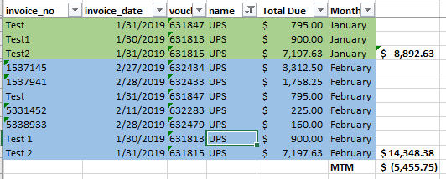
Researching Accounts Payable
Let’s start with AP.
  In this example we are comparing January to February.
  We pull the January and February A/P Trial Balance Reports (it was in balance in January, out of balance now in February). Save at a detail level in Excel. Calculate the Total Due, ensure it ties out the report from P21.
  You would do this analysis on a global level, using pivot tables and VLOOKUPS to compare data. For this we are going to look at one vendor to understand how you isolate the data.

Slide 21
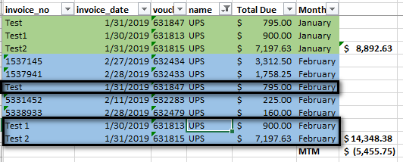
Researching Accounts Payable
Start with what you know:
  All the invoices that existed in January are still in the February Balance. This means there were no checks issued to the vendor. This should key you in that when we look in the GL we won’t see any “CD” associated with the vendor.
  We should expect to see four new “PJ” for the new invoices, totaling ($5455.75).

Slide 22
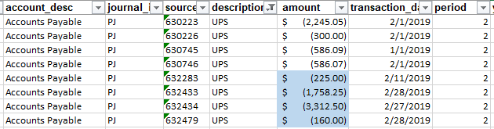
Researching Accounts Payable
Navigate to the GL. For AP, the “Description” field is roughly equivalent (with some exceptions) to the “Name” in the AP Trial Balance. The GL “Source” is the “Voucher” from the AP Trial Balance.
  Check the Journal ID’s to ensure the ID’s are valid for this account (they are). Ensure there are not any Disbursements.
  Find the four vouchers we expected (in blue). Ensure the balances tie.
  Look at the other GL activity – these are the transactions causing the imbalance.
  Now, you can go research those transactions individually and see what happened! We will cover some of the reasons why this happens later.

Slide 23
Researching Inventory
Again, we start with what we know. These ones are especially essential to save monthly (Summary and Detail level, both PDF and Excel) as they cannot be pulled retroactively.
  Pull up the prior month report where you were in balance. Then open the current month report where you’re out of balance.
  Format the data (assuming you pull directly out of P21).
    When I format the data I extract the following from the Excel Detail:
  Combine the months and create a Pivot Table, pulling on the location and the item.
Since the GL doesn’t have detail at an item level we will be looking at items with large swings and diving in from there.
  Remember, with A/P (and A/R) you can look at the Vendor/Customer and compare it to the GL at that level. Inventory doesn’t have the same ability.

Slide 24
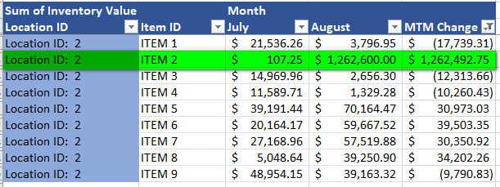
Researching Inventory
Copy and paste the pivot table (as values – I find this easier) into a new tab. Then, add on a MTM delta and filter the data. Here you’re looking for any large swings:
Here, the biggest swing is obvious (the imbalance was $1M+). We have the starting point for the imbalance, so we will check the GL inventory account(s) to see if there are any transactions for roughly that same amount. If there are not it signals an imbalance and we can begin research there.

Slide 25
TRANSACTIONS THAT CAUSE IMBALANCES – INVENTORY

Slide 26
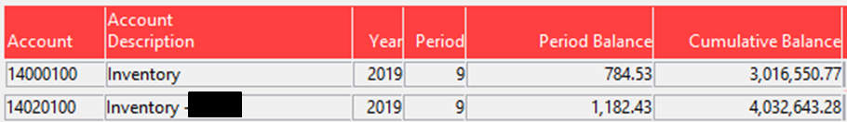
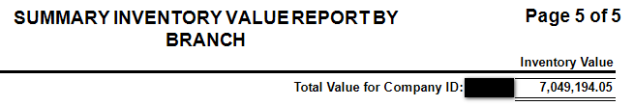
Inventory
There are a few ways inventory imbalances happen:
  Inventory Adjustments
  Incorrect Item Set-Up
  Inventory Cost Edits
Let’s take our starting point:
  General Ledger Inventory Balance: $7,049,194.05
  Inventory Value Report: $7,049,194.05

Slide 27
Inventory – Inventory Adjustments
Inventory Adjustments can cause your system to be out of balance if the account associated with it is an inventory account.
Inventory Adjustments are identified with a Journal ID = “IA”
The Inventory Adjustment Reasons are free form and are managed in the Adjustment Reason Maintenance window (Inventory – Inventory Management – System – Adjustment Reason Maintenance).
  These codes require a GL Account to be associated with them.
  Whatever code you choose dictates the GL Account it hits. If there is an Adjustment Reason code with a GL Account associated with Inventory your balance will be off.
Solution: Ensure all Adjustment Reason Codes hit a P&L account, not an Inventory account.

Slide 28
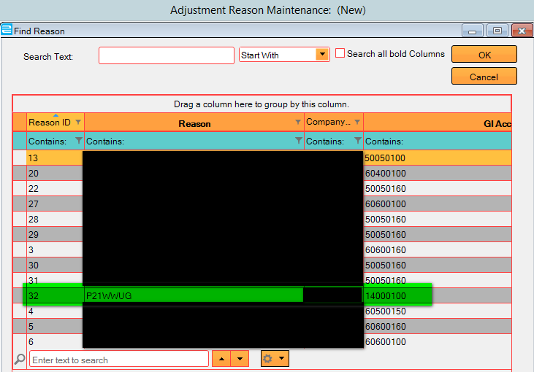
Inventory – Inventory Adjustments
Navigate to Adjustment Reason Maintenance. Double click in the Reason Box. Review all codes.
  This can be done individually, or you can DynaChange the pop up screen to pull on the GL Account (recommended).
  As you see below, there is one code with a 14000-100 account, which is an inventory account.

Slide 29
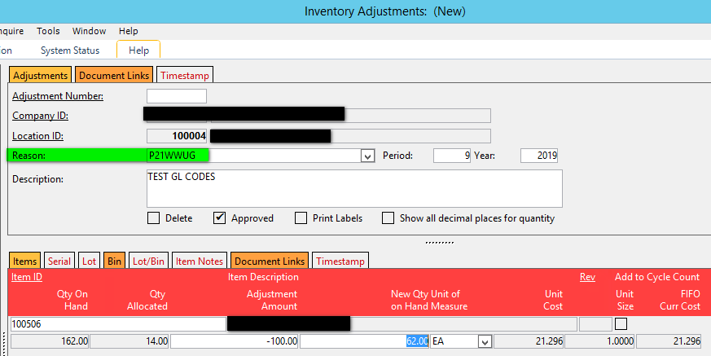
Inventory – Inventory Adjustments
Navigate to Inventory Adjustment (Inventory – Inventory Management – Transaction – Inventory Adjustments)
Enter the Reason Code and fill out the adjustment.

Slide 30
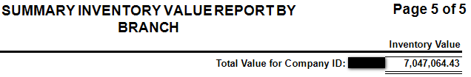
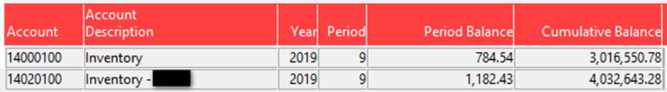
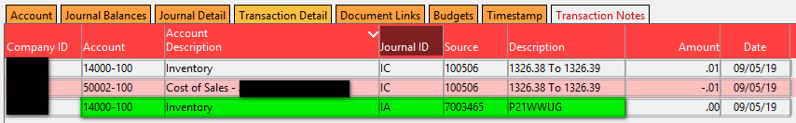
Inventory – Inventory Adjustments
Now, we re-pull reports:
  Inventory Value:
  GL: $7,049,194.06
  Delta = ($2129.73)
  The Inventory Adjustment processed both a CR and a DR to the same account, netting a $0 transaction for the GL, but adjusted inventory out of P21, affecting the Inventory Value. We are now out of balance.

Slide 31
Inventory – Item Configuration
There are two types of items to consider here:
  Inventory Items
  Other Charge Items: these are service based items, such as labor, fees, etc. They should not have any inventory stock or any inventory value associated with them.
Inventory Items MUST have the GL Asset Account = Inventory Account. Revenue and COS Accounts should be P&L accounts.
Other Charge Items MUST have a GL Asset Account = Non-Inventory Account (recommend P&L unless there’s a business reason to have something different). Revenue and COS Accounts should be P&L Accounts.
Places to Check:
  Product Group Maintenance: ensure Product Groups have correct accounting
  Item Fast Edit: ensure Items have correct accounting

Slide 32
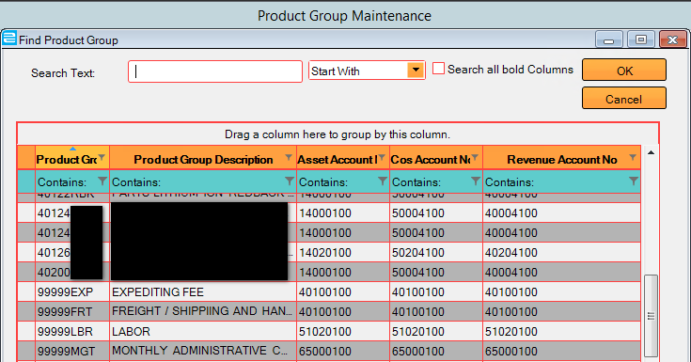
Inventory – Item Configuration
Product Group Maintenance: Inventory – Inventory Management – System – Product Group Maintenance
  Ensure Product Groups are set up with correct accounting, i.e. Product Groups with Inventory Items have the correct accounts and Product Groups with Other Charge items have correct accounts.
  Inventory Items and Other Charge Items should not share a product group.
  Recommend doing a DynaChange on the pop up window to view all accounts at once!
  Once the Product Groups have the correct accounting, move to Inventory Fast Edit.
Items in these groups should be Inventory Items
Items in these groups should be Other Charge Items

Slide 33
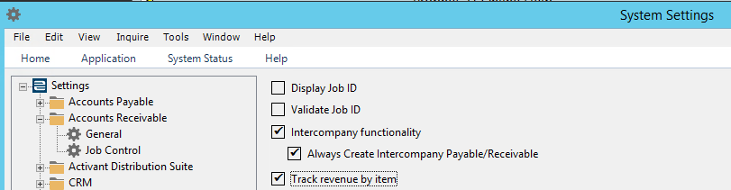
Inventory – Item Configuration
Inventory Fast Edit:
  If your System Setting is to “Track Revenue by Item”, the account associated with the item will drive the GL posting accounts. You know this by checking in system settings: Setup – System Setup – System – System Settings. Navigate to Accounts Receivable – General:

Slide 34
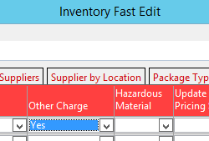
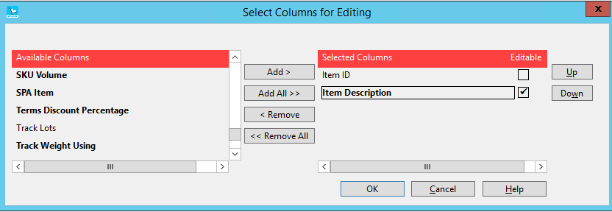
Inventory – Item Configuration
Inventory Fast Edit – Other Charge Items:
  Look for Other Charge items with an Inventory Account for the Asset Account, and ensure Product Groups are “Other Charge Item” based.
  Right Click and Select “Apply Query”. Add the Item ID and Item Description as Columns. Press OK. This will populate a list of all “Other Charge” items configured in your system.

Slide 35
Inventory – Item Configuration
Inventory Fast Edit – Other Charge Items:
  Click on the Location Tab. Add on the following columns:
    Item ID
    Item Description
    Product Group ID
    Product Group Description
    Asset Account
    COS Account
    Revenue Account
  Select OK. Data will populate.

Slide 36
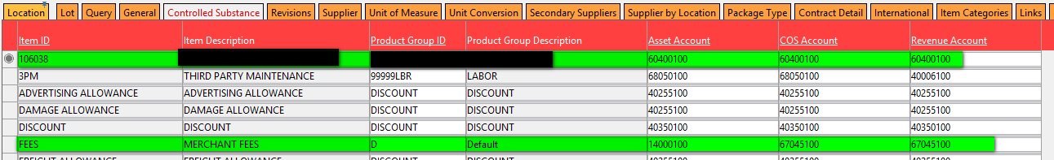
Inventory – Item Configuration
Inventory Fast Edit – Other Charge Items:
  Now, we look for any anomalies.
    First item to check is 106038. Based on this particular companies’ Item ID nomenclature, this looks like it may be an inventory item, not an Other Charge item. You would check this with the team responsible for item configuration.
    Next item to address is “FEES”. This looks like an Other Charge item but has an inventory account associated with it. We will need to verify that it’s other charge (it is) and update the account.

Slide 37
Inventory – Item Configuration
Inventory Fast Edit – Other Charge Items:
  “FEES” Item:
    If the account is not updated, and the item is costed in OE, inventory will be out of balance.
    If the account is not updated and the item is NOT costed in OE, inventory will stay in balance. But there are other areas where there can be issues – so this is not recommended.
    Let’s take a look at what happens:
      Inventory Value Balance before Order: $7,049,153.76
      Inventory GL Balance before Order: $7,049,153.76

Slide 38
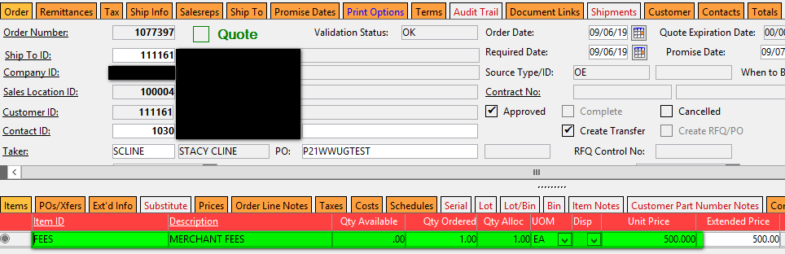
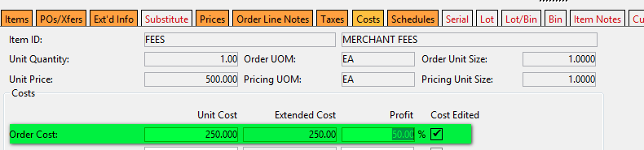
Inventory – Item Configuration
Inventory Fast Edit – Other Charge Items:
  FEES Item: Create an order and enter a cost for the Other Charge item on the Cost Tab. Invoice the Order.

Slide 39
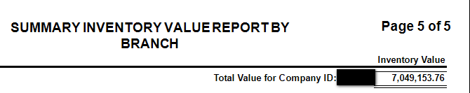
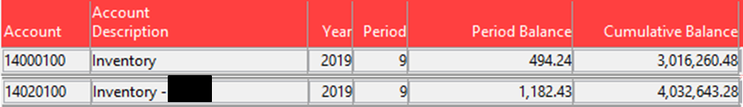
Inventory – Item Configuration
Inventory Fast Edit – Other Charge Items:
  FEES Item:
    New Inventory Balance: $7,049,153.76 – no change. This is because there were no units to remove out of inventory.
    New GL Inventory Balance: $7,048,903.76 – reduced by $250, the item cost we manually entered.
    Delta: ($250.00). Since the Asset Account is set to an Inventory account, the GL Inventory account was credited for the amount of cost entered and the COGS account was debited for the same amount.

Slide 40

Inventory – Item Configuration
Inventory Fast Edit – Inventory Items:
  Navigate back to Item Fast Edit. This time we set the “Other Charge Items” to “N”. Because of the volume of items we may also want to limit the product group ID in the “Location Product Group ID” column.
  Right Click and Select “Apply Query”. Add the Item ID and Item Description as Columns. Press OK. This will populate a list of all “Inventory” items configured in your system.

Slide 41
Inventory – Item Configuration
Inventory Fast Edit – Inventory Items:
  Click on the Location Tab. Add on the following columns:
    Item ID
    Item Description
    Product Group ID
    Product Group Description
    Asset Account
    COS Account
    Revenue Account
  Select OK. Data will populate.

Slide 42
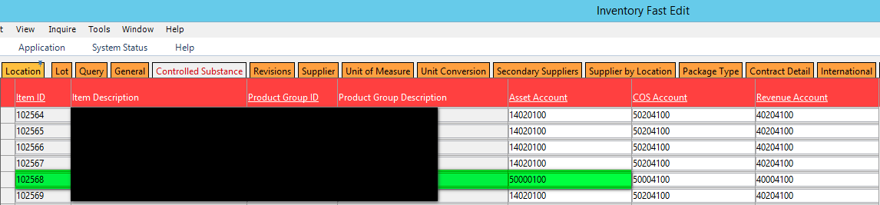
Inventory – Item Configuration
Inventory Fast Edit – Inventory Items:
  Now, we look for Asset Accounts that have Non-Inventory Accounts.
    Here, we see item 102568:
    If we process orders for this item with this accounting we will be out of balance, but in reverse. The GL Inventory Accounts will be higher than the Inventory Value Report. Items will drop off (or be received in if processing a PO) of the inventory report, but the GL impact will hit the 500000-100 account, causing the imbalance.

Slide 43

Inventory – Edit Inventory Cost
Edit Inventory Cost:
  This window enables you to manually edit the cost of an item and shows up in the GL with a Journal ID of “IC”. It will write the variance off to the account you specify. However, a few things can go wrong here:
    Incorrect Accounts on the Item = Imbalance
      Recall the Imbalance we found in Inventory?
      After some digging, we found that this item was set up incorrectly. The company was using this item as an “Other Charge” item, but it was set up, with stock, as an Inventory Item. The asset account was assigned as a COS account. So, when the cost was edited, it took the variance x units in stock and increased the Inventory Value as you see above. However, since the asset account was a COS account inventory was then out of balance. The transaction hit the GL as follows:
        The solution here was to re-do the IC adjustment in the other direction to level set everything. Then, correct the item type to “Other Charge”, remove the inventory associated with it (since there should not be any). And, if the item needs to be costed do it directly on the order on the “Cost” tab.

Slide 44
Inventory – Edit Inventory Cost
Edit Inventory Cost:
  This window enables you to manually edit the cost of an item and shows up in the GL with a Journal ID of “IC”. It will write the variance off to the account you specify. However, a few things can go wrong here:
    Setting the Variance Account = Inventory Account.
      The Variance Account Number MUST be a non-inventory account. Otherwise (assuming the item has a Asset Account = Inventory Account), the DR and CR will both hit inventory, causing the inventory to adjust on the Inventory Value report, but have a net $0 transaction on the GL.
      This should not be an issue for Other Charge items as they should not have stock associated with them.
      Inventory Value = Inventory GL = $7,049,153.76
      Navigate to the Edit Inventory Cost Window: Inventory – Inventory Management – System – Edit Inventory Cost.

Slide 45
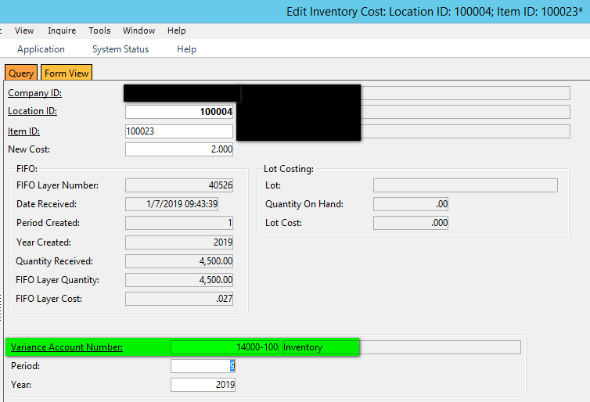
Inventory – Edit Inventory Cost
Edit Inventory Cost:
    Setting the Variance Account = Inventory Account. THIS SHOULD NEVER HAPPEN!
    We are increasing the item cost from $0.027 to $2.00

Slide 46
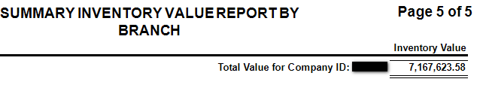
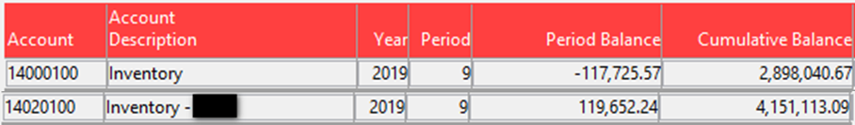
Inventory – Edit Inventory Cost
Edit Inventory Cost:
    Inventory Value: $7,167,623.58 – Inventory Value increased by the amount of the item cost edit.
    GL Value: $7,049,153.76, no change because the Variance Account = Asset Account for the item, so both the DR and CR hit inventory, creating a net $0 transaction.
    Delta = $118,469.82

Slide 47
TRANSACTIONS THAT CAUSE IMBALANCES:
Inventory Receipts Clearing/Unvouchered PO
Landed cost clearing/unvouchered landed cost

Slide 48
Inventory Receipts Clearing/Landed Cost Clearing
The process we will outline here works the same for both PO’s and Landed Cost:
  Inventory Receipts Clearing Account = Unvouchered PO Report
  Landed Cost Clearing Account = Unvouchered Landed Cost Report
When a PO is received into the warehouse, a PO receipt is completed. Landed Cost is automatically received by the PO Receipt.
Then, when the voucher is received from the vendor, the “Convert PO to Voucher” or “Convert Landed Cost to Voucher” process is completed. This removes the liability from the balance sheet account(s) and the PO and Landed Cost Drivers from the Unvouchered PO and Unvouchered Landed Cost reports, respectively.
The GL and Subledger are in balance at this point.
  The rest of this section will focus on the PO side rather than landed cost, but the process and implications are the same.

Slide 49
Inventory Receipts Clearing/Landed Cost Clearing
If the voucher is reversed for any reason the subledger to GL reconciliation will be off. When P21 reverses the voucher it puts the liability back into Inventory Receipts Clearing account, but it DOES NOT put it back onto the Unvouchered PO report, meaning you cannot do another “Convert PO to Voucher” for the vendor invoice.
When the new voucher is entered into P21, the Purchase Account will need to be set to the Inventory Receipts Clearing account for the amount of the original voucher. Any other amount must hit a different account. This will bring everything back into balance.
What does this look like in P21?

Slide 50
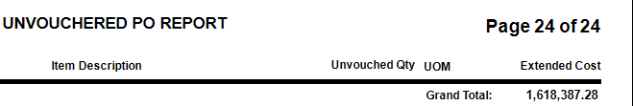

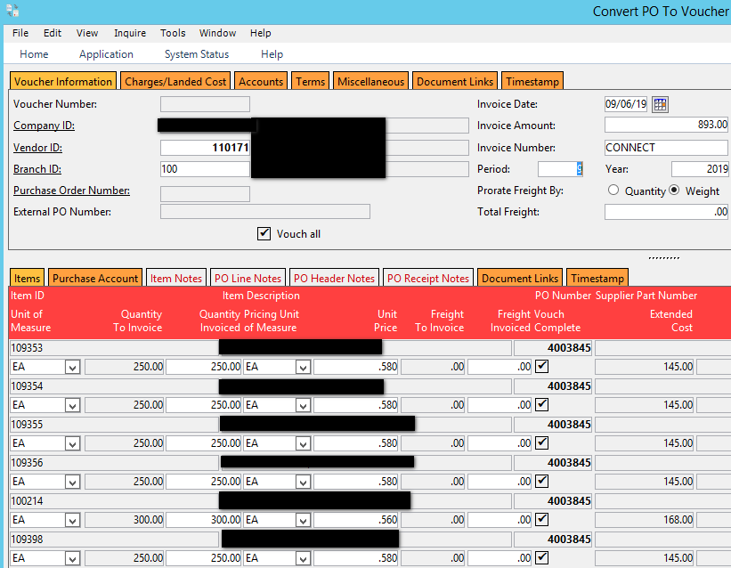
Inventory Receipts Clearing/Landed Cost Clearing
Original Balances:
Convert PO to Voucher Function is Completed:

Slide 51
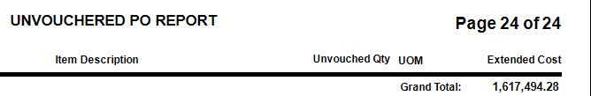

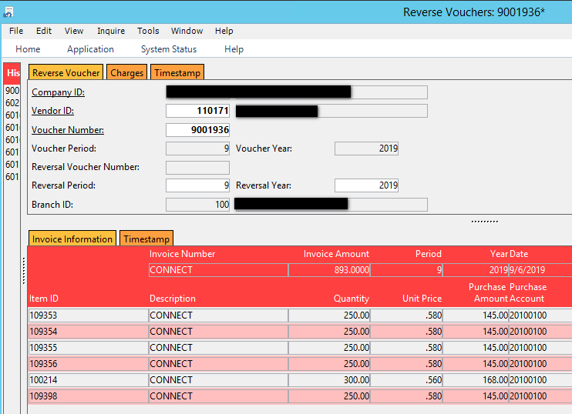
Inventory Receipts Clearing/Landed Cost Clearing
New Balances:
Reverse Voucher:

Slide 52
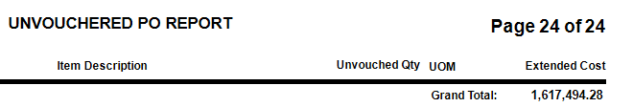
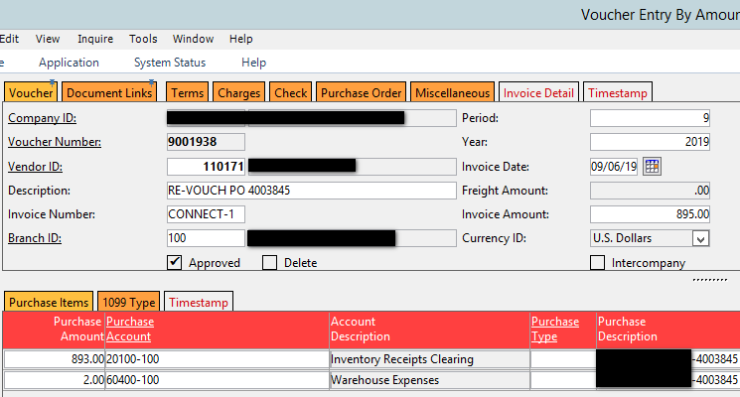
Inventory Receipts Clearing/Landed Cost Clearing
Subledger and GL are now out of Balance:
The PO is not available in the Convert PO to Voucher screen any longer. It can only be processed there once. Instead, we must enter a manual voucher.
Manual Voucher: Enter a new voucher for the Vendor. Refer to the original PO in the Description and the Purchase Description. Enter the amount on the PO in the Purchase Amount field. This must match exactly or you will still be off. In this case the new voucher was for $895 (instead of $893) so we will enter $893 to clear the liability and choose a different account for the remaining amount.

Slide 53
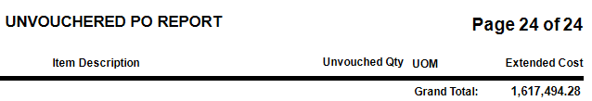

Inventory Receipts Clearing/Landed Cost Clearing
We are now back in balance!

Slide 54
TRANSACTIONS THAT CAUSE IMBALANCES – ACCOUNTS PAYABLE & ACCOUNTS RECEIVABLE

Slide 55
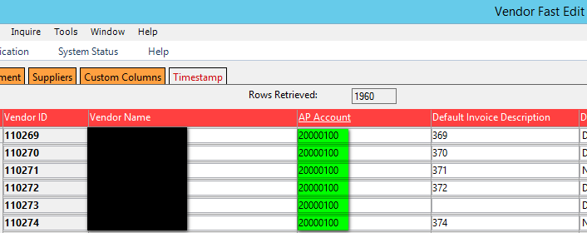
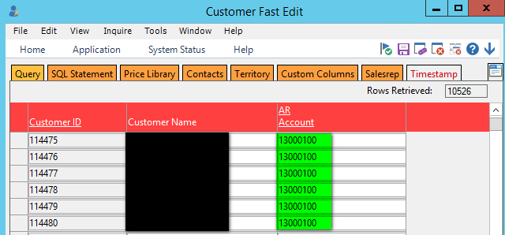
A/R & A/P IMBALANCES
A/R and A/P have similar reasons for imbalances.
  The first thing to check is Vendor Fast Edit and Customer Fast Edit. Ensure the accounts are A/P or A/R accounts.

Slide 56
A/R & A/P IMBALANCES
A/R and A/P have similar reasons for imbalances.
  Next, check the GL drilldown for any Journal ID’s that shouldn’t be there:
    A/P should have PJ and CD only.
    A/R should have SJ, CR & MR only.
  Finally, pull the balance as of the current day to see if you are now in balance. If you are, there was a timing related issue, you can notate and move on.
  But, how do timing issues happen?
    Posting cross period! If you enter an invoice date of 8/30/19 and post to period 9 you will be out of balance for both A/R and A/P. The subledger will pick the invoice/voucher up and the GL won’t show it until period 9.
  Also, for A/R, ensure all your cash drawers are closed.

Slide 57
Questions???

Slide 58
  Stacy Cline
  Cline Financial Services, LLC stacy@clinefinancialservices.com www.clinefinancialservices.com
  970-744-0206

